Slide 1
Transforming Teflon A Systematic Investigation of Hydrophobic Material Coatings
Group T²
Notes:
** Rohan

Slide 2
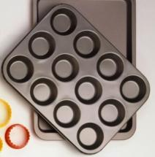
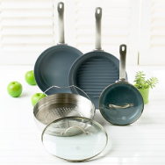
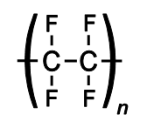
History of Teflon
Polytetrafluoroethylene
Discovered: 1938
1944: Manhattan project
1960: cookware, insulation
Notes:
** Rohan
-Discovered in 1938
-Polymer polytetrafluoroethylene (PTFE) is another name for Teflon
-1944: used to enrich uranium in the Manhattan Project
- Can also be used as insulation in the electrical industry, in the brake systems and oil filters of cars, surgical instruments

Slide 3
Characteristics of Teflon
Non-stick
Hydrophobic, oleophobic
Low coefficient of friction
Low heat dissipation factor
Problems?
Flakes off
Possible carcinogen
Notes:
** Rohan
Why is Teflon so valuable in society and industry?
non-stick material: can be used in cooking
both hydrophobic and oleophobic : resists both water and oil
low dissipation factor: can retain heat
withstand temperatures from -300°C up to nearly 300°C
low coefficient of friction (between .05 and .20) // resistance to chemicals, compounds: good for industry
seem indestructible after tests performed on it
What are the problems here?
Can flake off & not chemically bonded
EPA announced that could be a carcinogen
PFOA: perfluroctanoic acid can cause tumors in experimentation // workers may develop prostate cancer

Slide 4
Goals
Find a hydrophobic surface coating (an alternative for Teflon)
Compare octadecylphosphonic acid (OPA) with perfluoroctylphosphonic acid (P-FOPA)
Improve speed of reaction
Explore further applications for OPA
Notes:
** Rohan
How?
Testing primers on different materials
Applying coating and durability tests on aluminum, SS, glass
I will now proceed to explain the mechanism in which the OPA bonds to the metal oxide surface

Slide 5
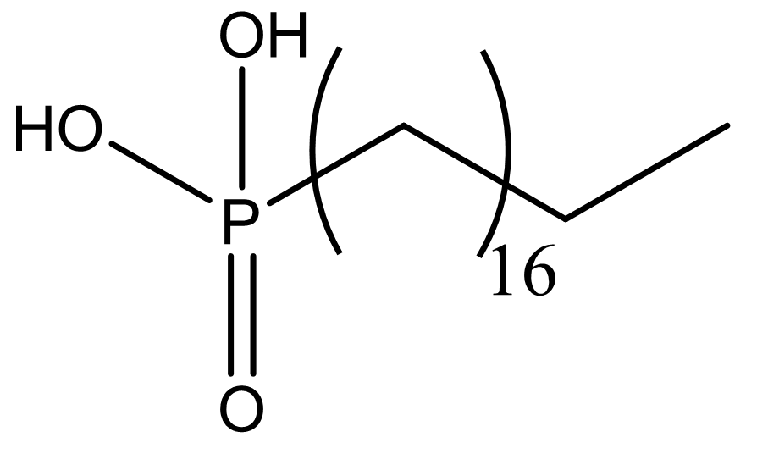

Slide 6
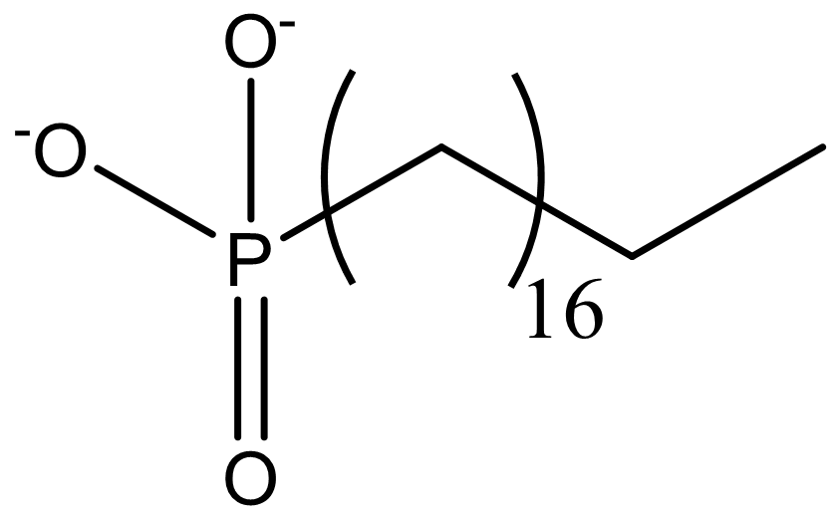
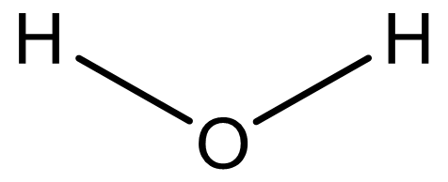
H⁺
H⁺
+

Slide 7
H⁺
OH

Slide 8
Experimental
Use of Primers to facilitate bonding
Comparison of Phosphonic acids and simulation of real world conditions
Use of SEM to visualize coating coverage
Notes:
** Lukas
Primers – Compounds that make a preliminary coating before phosphonic application.

Slide 9
Comparing and Testing Primers
Primers used
Diethyl Phthalate
PDMS-PFDD
(Polydimethylsiloxane-co-dimer acid, bis(perfluorododecyl) terminated)
PDMS-OH
(Polydimethylsiloxane hydroxyl terminated)
Tantalum(V) 2-Ethylhexoxide
Tantalum (V) Ethoxide
Tantalum (V) Chloride
Durability tests Conducted
Notes:
** Lukas
Diethyl Phthalate
Two siloxanes polymers
Two tantalum compounds
Don’t talk about specific tests-Don’t even mention the bullet.

Slide 10
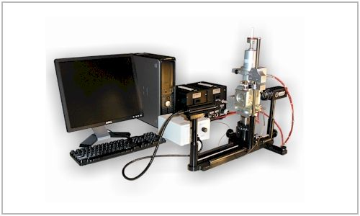
Ramé-hart Goniometer
Notes:
** Lukas
We used a goniometer, shown here, to measure hydrophobicity of our samples.
We do this with contact angles – Camera views a microdrop of water on a surface and measures the angle of the water drop and the surface.

Slide 11
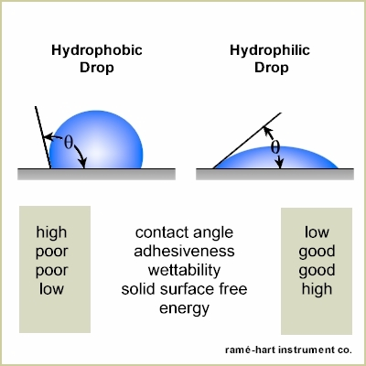
Notes:
Higher angle, shown on left, more hydrophobic.
Lower angle, shown on right, less hydrophobic.
Angles above 90 indicate hydrophobicity.

Slide 12
About Primers
Application is faster more efficient
Primers as linkers
What makes a good primer?
Industrial v. Medical Criteria
Tantalum as replacement for chromium.
Toxicity and cost
Notes:
** Lukas
Why use primers? They help to increase the overall speed of the process of bonding phosphonic acid to the metal.
This is because they act as a linker.
Good primers
Bond faster to the oxide surface than phosphonic acid does.
Provide more bonding sites for the acid to bond to.

Slide 13
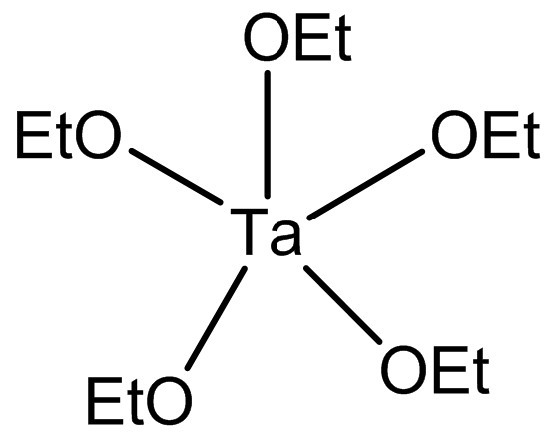
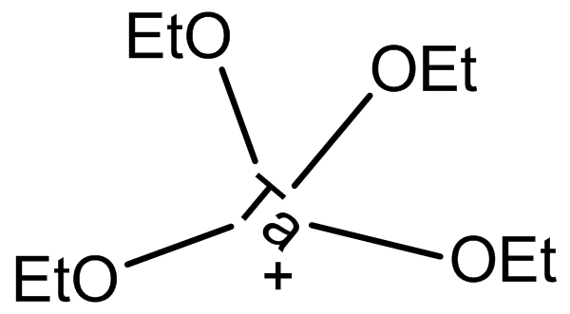
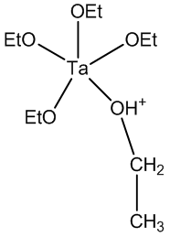
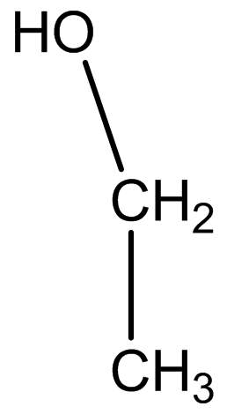
Phosphonic Acid Coating
Primer Coating
H⁺
Metal Oxide
Surface

Slide 14
Three Testing Methods
Bake on primer, bake on acid
Bake on primer, Iron on acid
Iron on primer, Iron on acid
Notes:
**Lukas
Primer tests:
Aluminum sanded down, washed in ethanol, dried
Primers sprayed onto three aluminum pieces each
10 μm Meyer Rod rolled across metal after being washed in ethanol as well
Ethanol + primer mixture: oven @ 120C for 30 minutes
Cooled then sprayed with phosphonic acid
Meyer Rod used again, evaporate, then put in oven for 48 hours
Contact angle measured
2nd batch prepared same way: OPA baked on, phosphonic acid ironed on with iron for 2 minutes
3rd batch: primer ironed on for 2 minutes, OPA ironed also for 2 minutes
Durability tested by being washed in ethanol; test efficiency of primers & heat applications
Which method produces the best result?

Slide 15
After Primer Tests
Notes:
**Lukas
- Primer & OPA baked on
After ethanol bath: angles increased
Multilayer forms. Dissolved off – increased angles.
Baking therefore might not be the best app method. Multilayers form.

Slide 16
After Primer Tests
Notes:
**Lukas
Shows decrease in hydrophobicity.
Might not be the most durable method. Iron on might not completely fuse primer.

Slide 17
After Primer Tests
N=3
Notes:
**Lukas
Favorite method. Showed high results, and fast app time. Primers showed slight advantage in durability as compared to unprimed.
Two washes conducted – subjected to household conditions.

Slide 18
Durability Tests
Notes:
** Trisha

Slide 19
Durability Test Applications
OPA dissolved in ethanol solvent
P-FOPA dissolved in chloroform/ethanol solution
Able to wet and coat surface!
Notes:
** Trisha
Make sure to emphasize that we got the P-FOPA to dissolve and coat the surface.
OPA dissolved in ethanol: 1 mmoles solution
P-FOPA dissolved in chloroform/ethanol solution
Materials: aluminum sheets, 316L stainless steel discs, glass microscope slides
Washed for 7 minutes in hot ethanol bath at 70C
Hot water bath for 2 minutes
OPA and P-FOPA
Sprayed on
Drag 3 microL Meyer rod on the liquid to even out → evaporated
Iron for 1 minute
Samples for durability tests in oven @ 130C for 24 hours
Infrared lamp – direct heat for 90 minutes
Half OPA, half P-FOPA
Aluminum foil sheet for even heating
Heat gun – 316C for one minute // cool air for 30 seconds
*procedure described

Slide 20
Durability Test Applications
Materials: aluminum, steel, glass
Clean with ethanol and hot water
Bake in oven, heat gun, infrared

Slide 21
Durability Tests
Steel wool – 10 seconds
Heat test – ½ hour @ 250C
Hot ethanol bath for 5 minutes
Washed with hand soap and sponge
Notes:
** Trisha
P-FOPA & OPA samples scrubbed for 10 seconds with steel wool
Sharpie test – written on, then wiped off to see if it came off
Samples placed in oven for an hour @ 250C
In hot ethanol for 5 minutes then wiped off
Washed with handsoap & spong

Slide 22
After Durability Tests

Slide 23
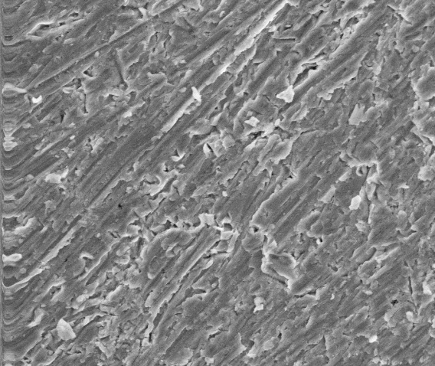
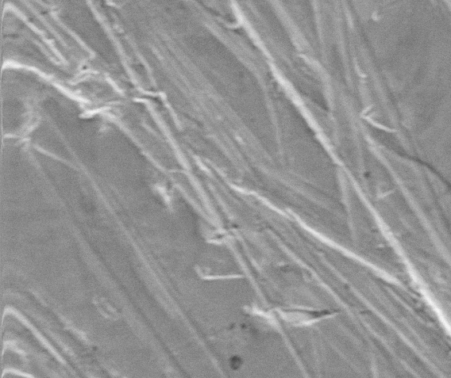
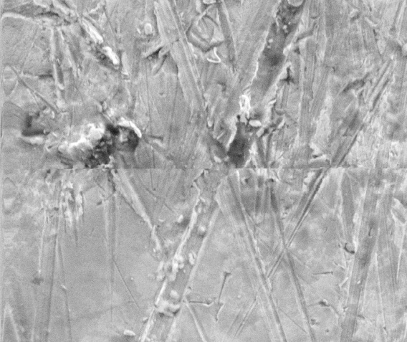
A
Aluminum
A: Uncoated
B: OPA
C: P-FOPA
C
B

Slide 24
Mixing Primers & P-FOPA

Slide 25
After Durability Tests
Notes:
** Trisha

Slide 26
Sources of Error
Quick washes
Lack of replication
3 samples
Human Error
Application method
Possible multi-layers: lower angles for unwashed samples

Slide 27
Conclusion
Best primers
Diethyl phthalate
PDMS-PFDD (polydimethylsiloxane-co-dimer acid, bis(perfluorododecyl) terminated)
Tantalum(V) ethoxide
Neither worked well with P-FOPA except when applied to stainless steel
OPA, P-FOPA
Heat gun – least time consuming
316L stainless steel discs
SEM: view coatings
Notes:
Primers 1,3,5
#1 – industrial // #5 – medical uses // #3 is good balance
PEBP: eliminated due to poor performance
Stainless steel superior **

Slide 28
Acknowledgements
Thanks to:
Dr. Avaltroni
Darius Rackus
Aculon, Inc.
Sponsors of the NJGSS 2009 Program

Slide 29
Picture Credits
http://www.wired.com/images/article/full/2009/04/teflon (2)
http://greatgreengadgets.com/gadgets/2007/08/22/green-alternative-to-teflon-cookware/ (2)
http://www.healthbase.com/resources/orthopedics/total-hip-replacement-surgery-implants/zimmer-hip-replacement-implant-cemented-cementless-press-fit-india-affordable-medical-tourism.html (2)
http://www.ramehart.com/goniometers/index.htm (10)
http://www.ramehart.com/goniometers/contactangle.htm (11)

Slide 30
Works Cited
Shannon, Fintan J.; Cottrell, Jocelyn M., Deng, Xiang-Hua, Doty, Steven B.; Warren, Russell F.; Wright, Timothy M.; Crowder, Katherine, N.; Avaltroni, Michael J.; Schwartz, Jeffrey; “A Novel Surface Treatment for Porous Metal Implants That Improves The Rate of Bony Ingrowth” J Biomed Mater Res A. 2008; 86(4):857-64.
Danahy, M. P.; Avaltroni, M. J.; Midwood, K. S.; Schwarzbauer, J. E., Schwartz, J. “Self Assembled Monolayers of a,w-Diphosphonic Acids on Ti Enable Complete of Spatially Controlled Surface Derivitization.” Langmuir, 2004, 20, 5333 – 5337
Schwartz, J.; Avaltroni, M. J.; Danahy, M. P.; Silverman, B. M.; Hanson, E. L. ; Schwarzbauer, J. E.; Midwood, K.; Gawalt, E. S. “Cell Attachment and Spreading on Metal Implant Materials.” Materials Science and Engineering C, 2003, 23, 395-400
Gawalt, E. S.; Avaltroni, M. J.; Danahy, M. P.; Silverman, B. M.; Hanson, E. L.; Midwood, K. S.; Schwarzbauer, J. E.; Schwartz, J. “Bonding Organics to Ti Alloys: Facilitating Human Osteoblast Attachment and Spreading on Surgical Implant Materials.” Langmuir, 2003, 19, 200-204
Gawalt, E. S.; Avaltroni, M. J.; Koch, N.; Schwartz, J. “Self Assembly and Bonding of Alkanephosphonic Acids on the Native Oxide Surface of Titanium.” Langmuir, 2001, 17, 5736-5740
Schwartz; Jeffrey (Princeton, NJ), Avaltroni; Michael J. (Staten Island, NY), Danahy; Michael P. (Princeton, NJ), Silverman; Brett M. (Princeton, NJ), Carrier Applied Coating Layers. U.S. Patent 7396594, July 8, 2008
Schwartz; Jeffrey; (Princeton, NJ) ; Danahy; Michael; (Lewiston, ME) ; Avaltroni; Michael; (Staten Island, NY) ; Guo; Jing; (Sunnyvale, CA), Enhanced Bonding Layers on Native Oxide Surfaces, U.S. Provisional Patent Award 20080166470, July 10, 2008
Schwartz, J.; Gawalt, E.; Avaltroni, M. “Enhanced bonding of phosphoric and phosphonic acids to oxidized subtrates”; United States Patent #6,645,644
Avaltroni, Michael J.; Bruner, Eric L. Hanson, Eric L.; “Organophosphate Adhesion Promoters“ U.S. Patent, Submitted 2006
Avaltroni, M.J.; Bruner, E.L.; Hanson, E.; „“Thin Films“, 2006, United States Patent Pending
Schwartz, J; Avaltroni, M.J.; “Devices With Multiple Surface Functionality“; 2006, United States Patent Pending
Schwartz, J; Avaltroni, M.J.; “Devices With Multiple Surface Functionality“; 2005, United States Patent 60/737,397
Schwartz, J; Avaltroni, M.J.; Danahy, Michael P.; Silverman, Brett M.; “Carrier Applied Coating Layers”; 2005, United States Patent 10/876,294
Schwartz, J.; Avaltroni, M.; Carolus, M.; Hanson, E.; Schwarzbauer, J.; Midwood, K.; Danahy, M. “Enhanced bonding layers on native oxide surfaces”; 2004, United States Patent 10/405,557.
Schwartz, J.; Danahy, M.; Avaltroni, M.; Midwood, K.; Scwarzbauer, J.; Carolus, M.; Gawalt, E. “ Enhanced bonding layers on titanium materials”; 2004, United States Patent 10/179,743

