Slide 1
Comparison of Insect and Fungal Damage to Leaves of Young , Invasive Norway Maple and Native Sugar Maple
Matthew Elkins, Athena Huang, Yamini Kathari,
Adwiteeya Misra, John Speigel, Matthew Tse, Zixiao Wang
Advisor: Kristi MacDonald-Beyers
Assistant: Jessica Reid
Notes:
Title

Slide 2
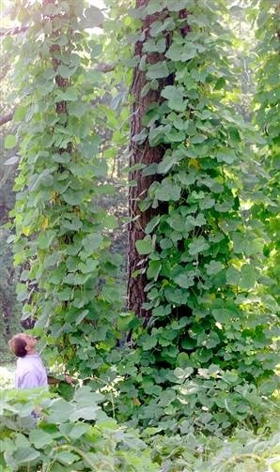
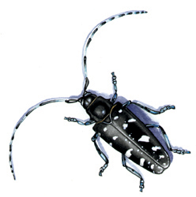
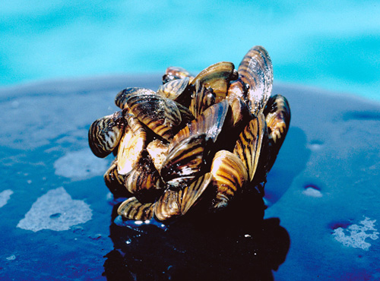
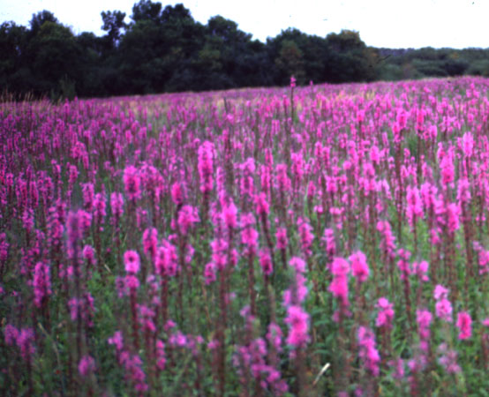
History
Invasive species
  Introduced to a non-native area away from their natural range
  Escape and adapt successfully
  to the new environment
  Often displace native species
Notes:
Introduction

Slide 3
Norway maple (Acer platanoides)
Originally introduced as a street tree; still popular today
Invading forests in the eastern United States
Displacing the native plants (Wyckoff and Webb, 1996)
  Pollution tolerant
  Shade tolerant
  Fills canopy gaps quickly
  Deep shade
Notes:
Introduction

Slide 4
Enemy Release Hypothesis (ERH)
Possible explanation for the success of invasive species
Species are normally inhibited by natural enemies
  Insects and fungi
Often, enemies in new environments are not as harmful to the invasive species as to natives
ERH is important to the question of biological control
Notes:
Introduction

Slide 5
Prior studies
Less damage in Norway maple leaves than sugar maple leaves in northeastern USA (Cincotta et al. 2008)
Comparison of Norway maple leaf damage found less damage on specimens growing in the USA than those in Europe (Adams et al. 2008)

Slide 6
The plan
Past study suggested further investigation of damage to saplings
Hypothesis: Norway maple (Acer platanoides) saplings would show less leaf damage than sugar maple (Acer saccharum) saplings in the same area
Collect, quantify, and analyze leaf damage of the two plants
A difference in leaf damage would indicate a possible competitive edge of the Norway maples
Notes:
Introduction

Slide 7
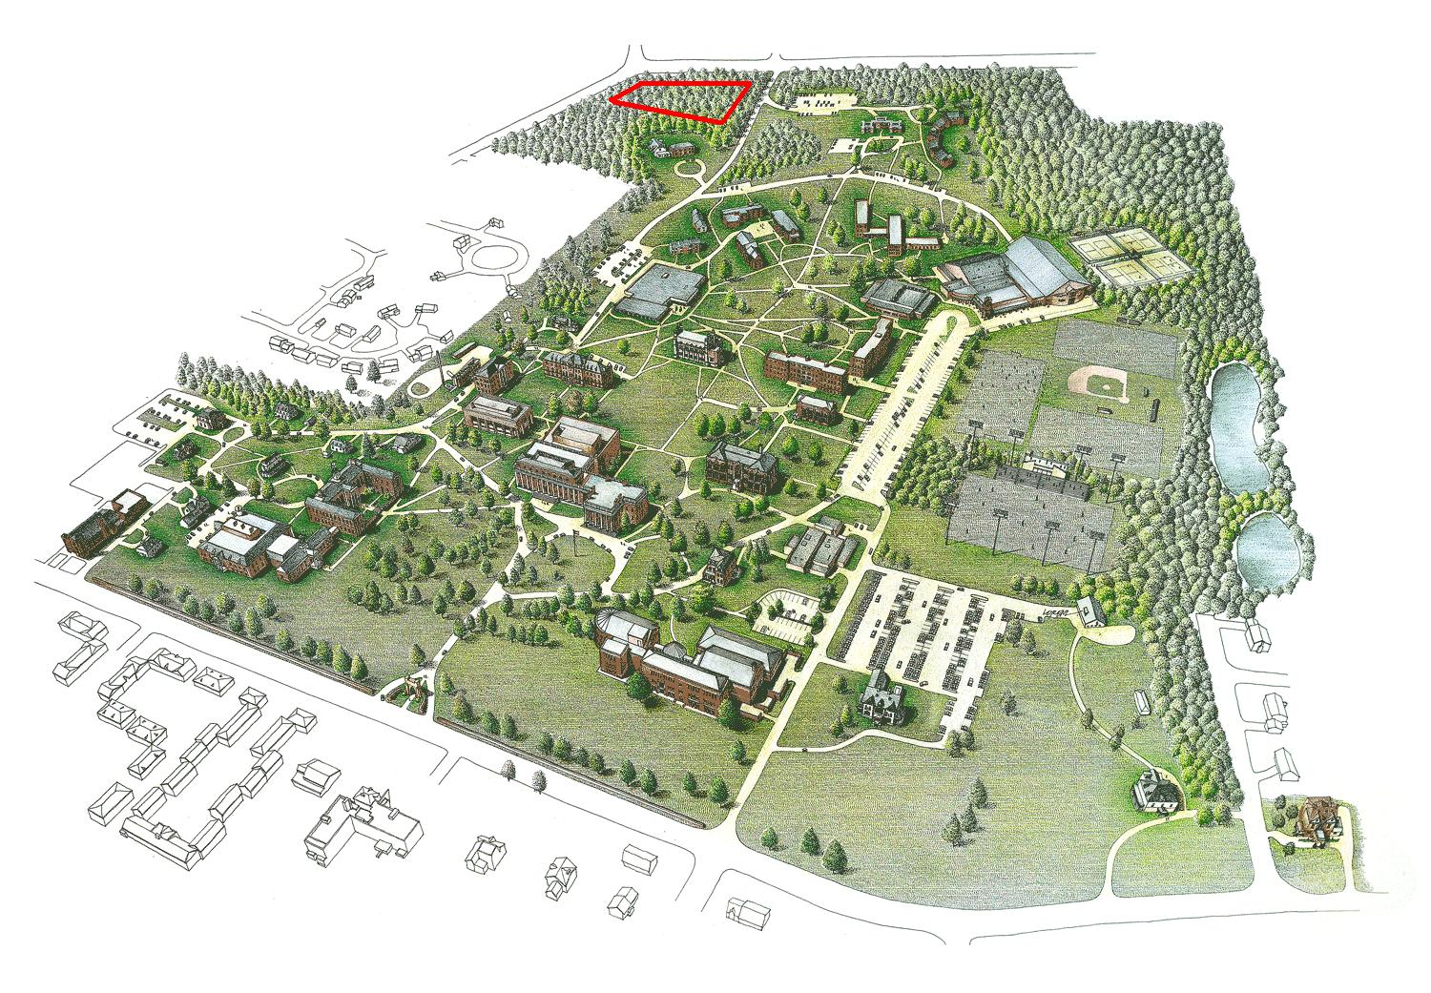

Materials and Methods
Study Area and Collecting the Data
Drew University Forest Preserve
About 3 ha plot
3 transects of 65 to 100 meters in length
3 lower twigs (3 to 9 leaves)
260 leaves for each species

Slide 8
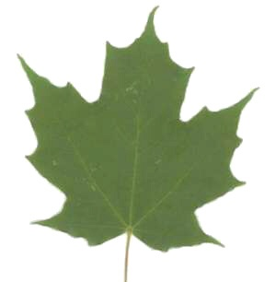
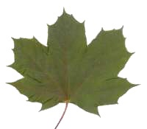
Identifying Characteristics
Sugar Maple | Norway Maple
5 major veins | 7 major veins
Clear sap | White sap
Tiny hairs | Waxy texture

Slide 9
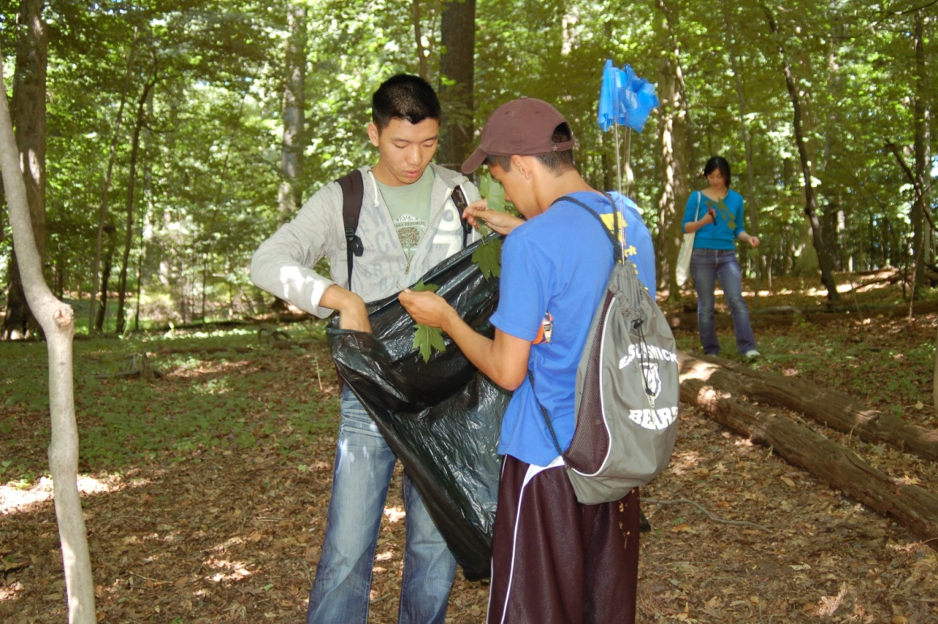
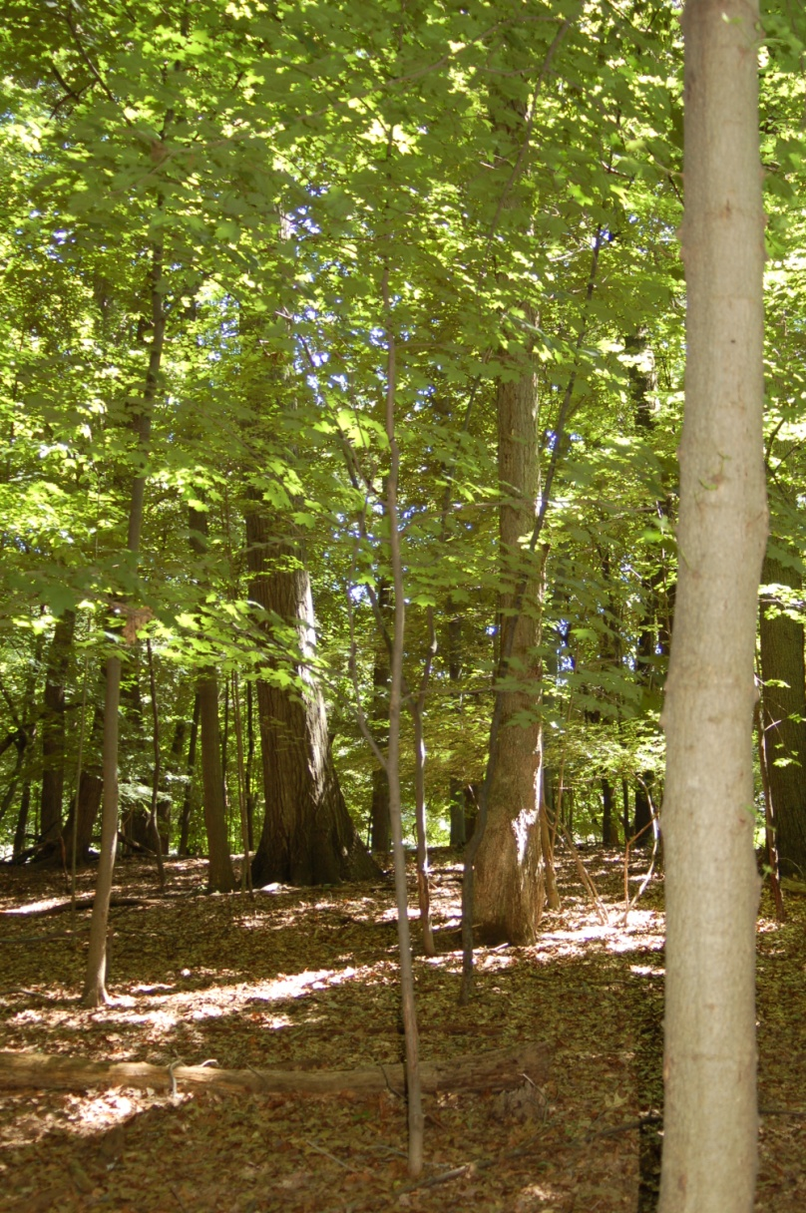
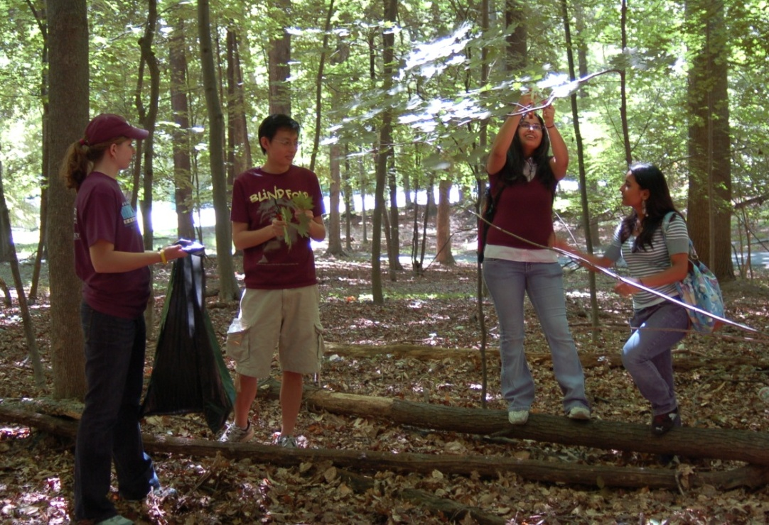

Slide 10
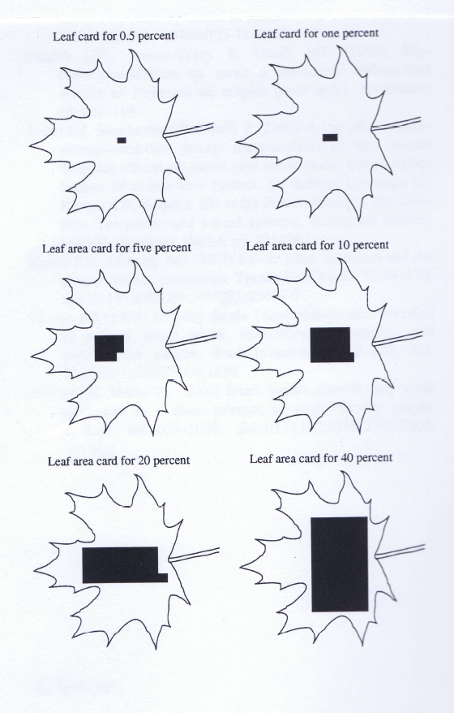
Materials and Methods
Damage Assessment and Analysis
Visually assessed with leaf cards
Fungal and predatory damage
  Holes
  Tears
  Brown spots
Statistical Package for Social
Sciences (SPSS)
  Independent 2 sample t-test

Slide 11
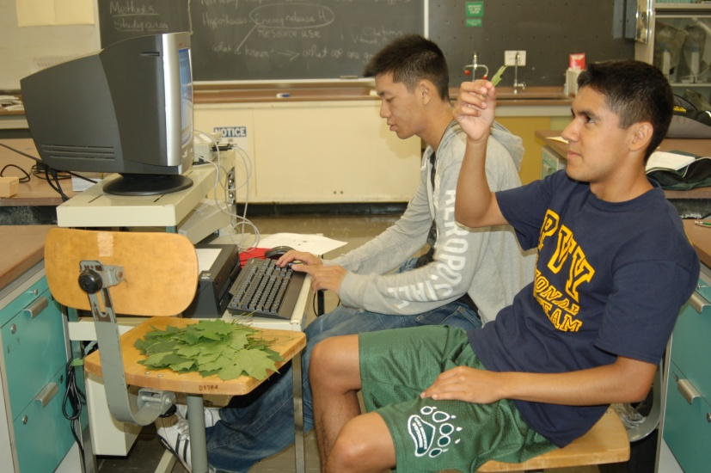
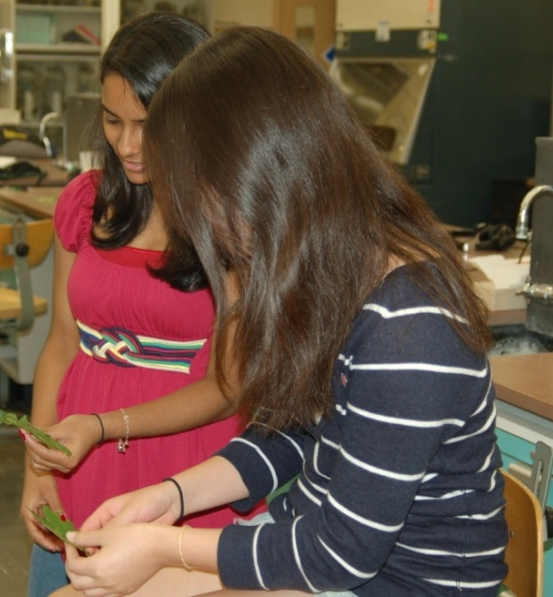
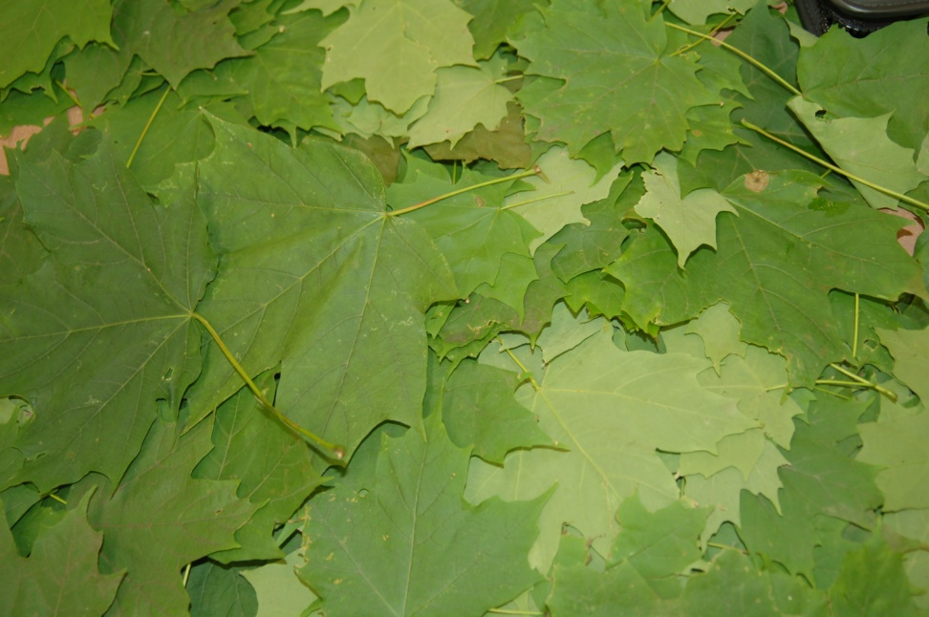
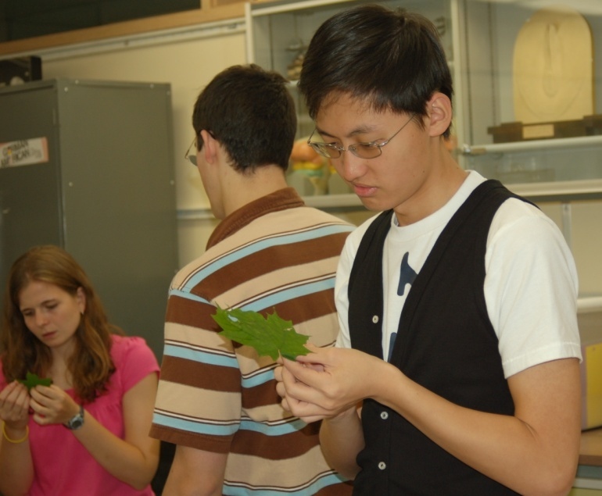
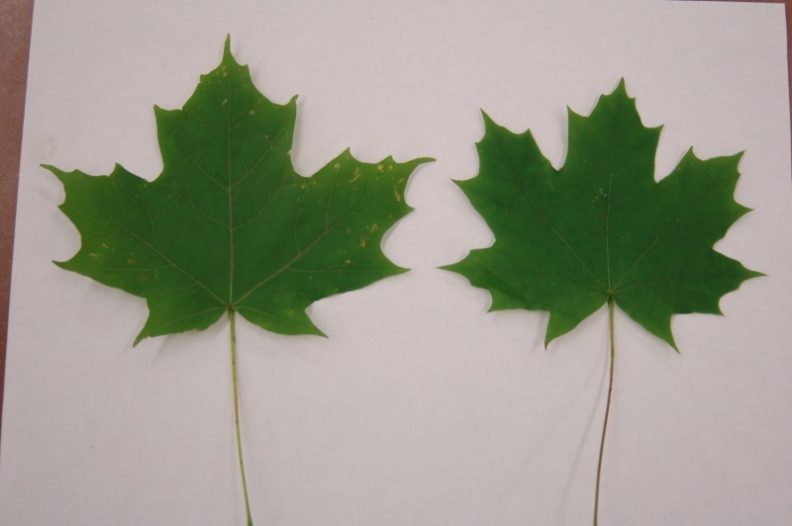

Slide 12
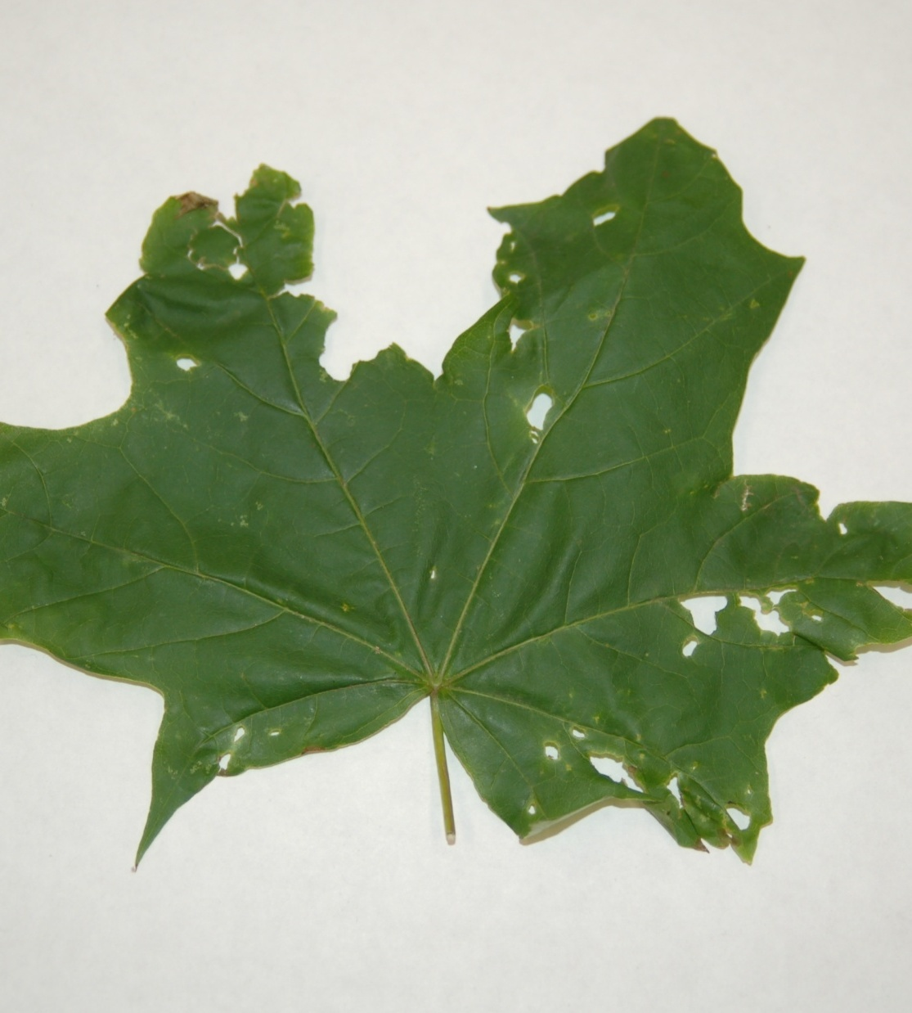
Damaged Norway Maple Leaf

Slide 13
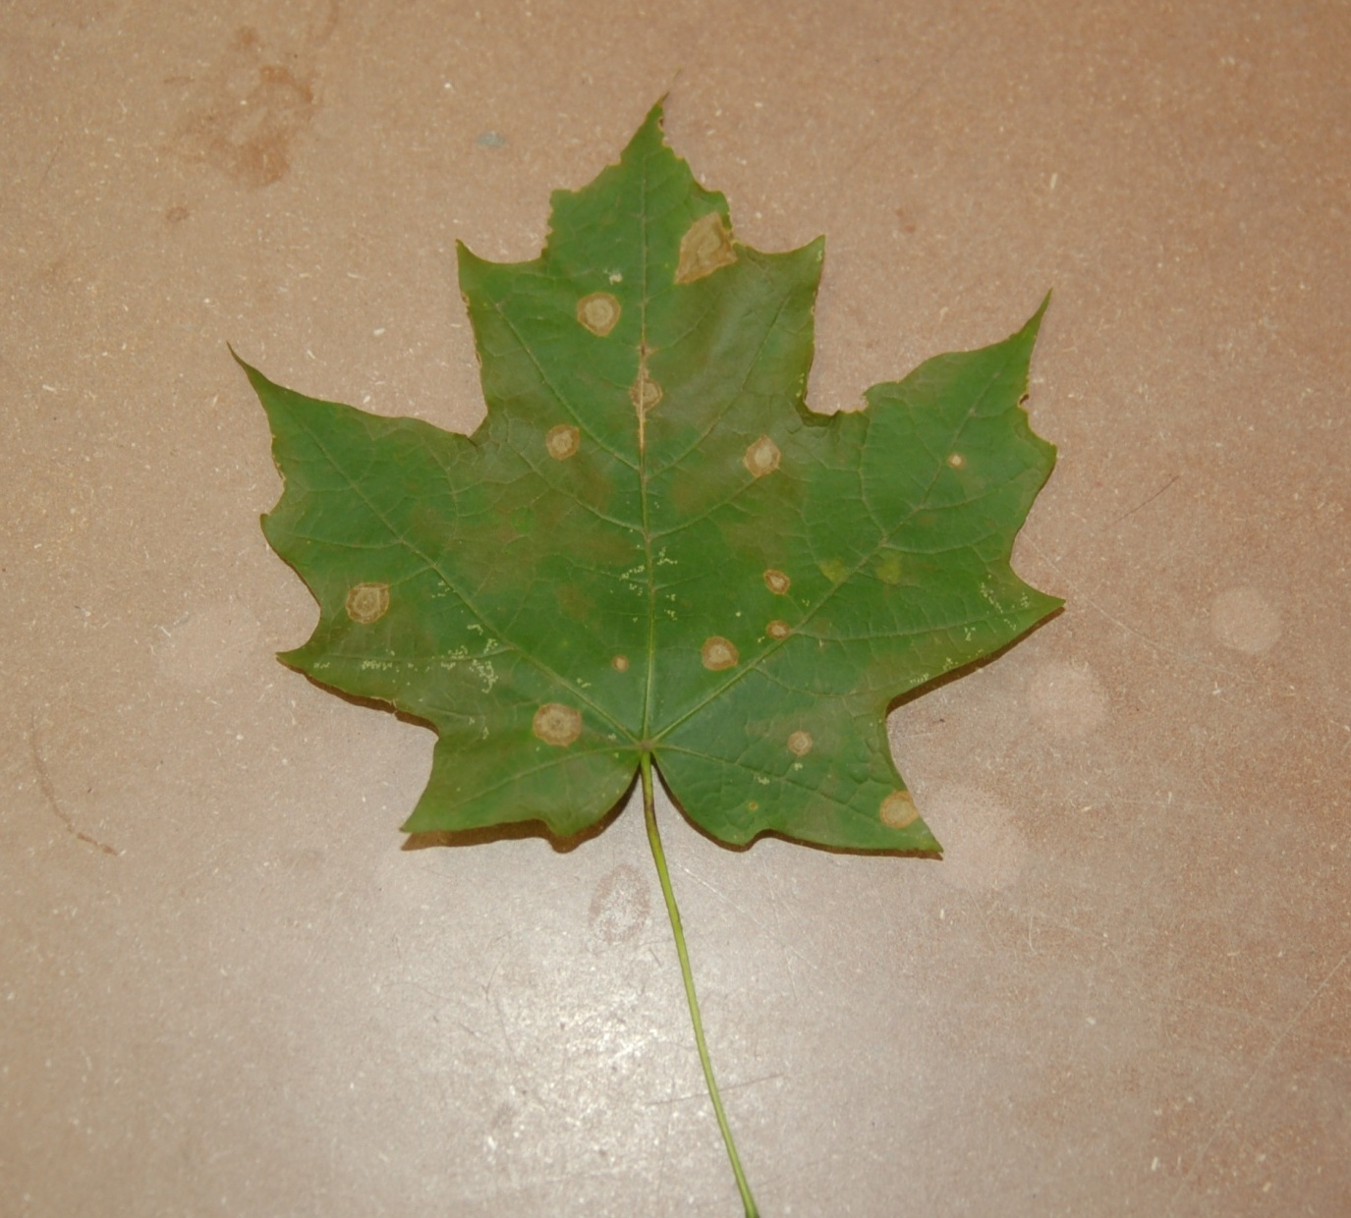
Damaged Sugar Maple Leaf

Slide 14
Results
63% of all Norway maple leaves and 51% of all sugar maple leaves had more than 1% leaf area damage
The remainder had less than 1% damage

Slide 15
Notes:
Damage Range:
Sugar maple damage ranged from 0 to 70 percent
Norway maple damage ranged from 0 to 37 percent
Sugar had a greater variability of damage, and higher outliers

Slide 16
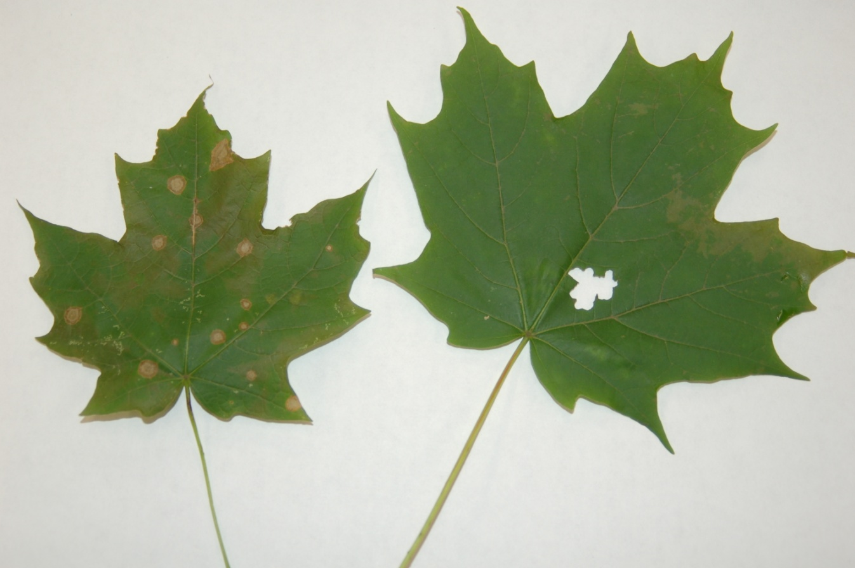
Mean Damage
Norway maple 5.079% (±.3694 S.E.)
Sugar maple 5.492% (±.6003 S.E.)

Slide 17
Mean Percent Damage between
Norway and Sugar Maples
Notes:
Sugar maples had a higher mean damage, but standard error showed the means could overlap.

Slide 18
Statistical Analysis
Data was square-root transformed before analysis
Null hypothesis: there is no significant difference in leaf damage between species
T-test returned p-value= 0.556, which was not significant

Slide 19
What does this mean?
Data did not support enemy release hypothesis (ERH)
Difference in amount of damage between Norway maples and sugar maples was not statistically significant
Norway maples: slightly more leaves had damage
Sugar maples: larger range of damage ( > 60% )

Slide 20
Why not ERH?
Sample size was small and only taken from one location
Possible localized damage from insects and fungi
Sample was age-specific → only saplings
Visual approximation vs. technological assessment

Slide 21
What more can be done?
Test other hypotheses
  Resource availability hypothesis
Experiment with other characteristics of Norway maples
  Shade tolerance
  Large seed size
  Lower rates of seedling predation
  Effects of soil, nutrients, and pollution
  Multiple causal factors

Slide 22
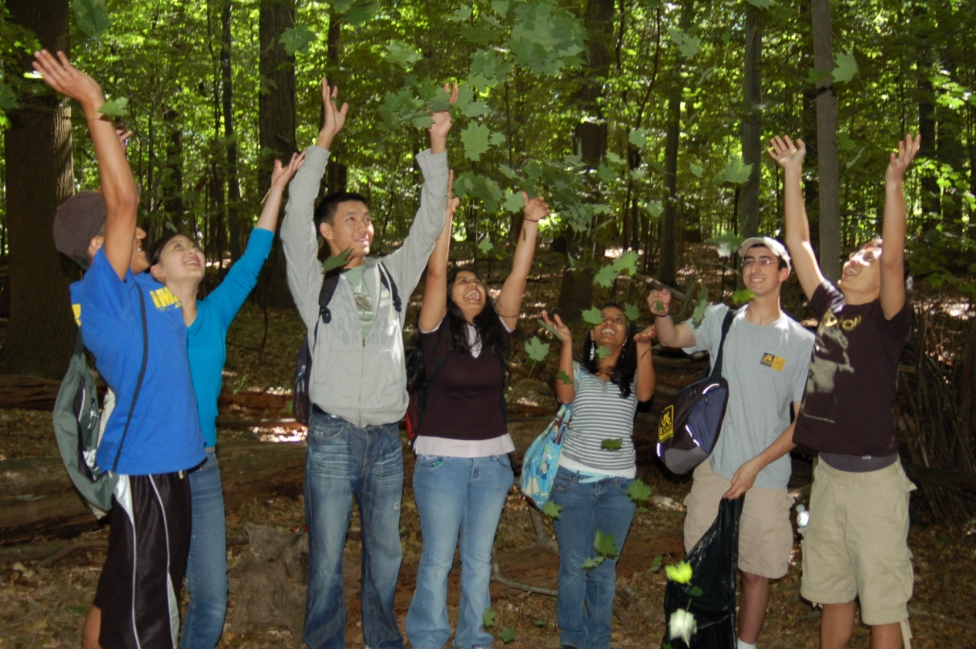
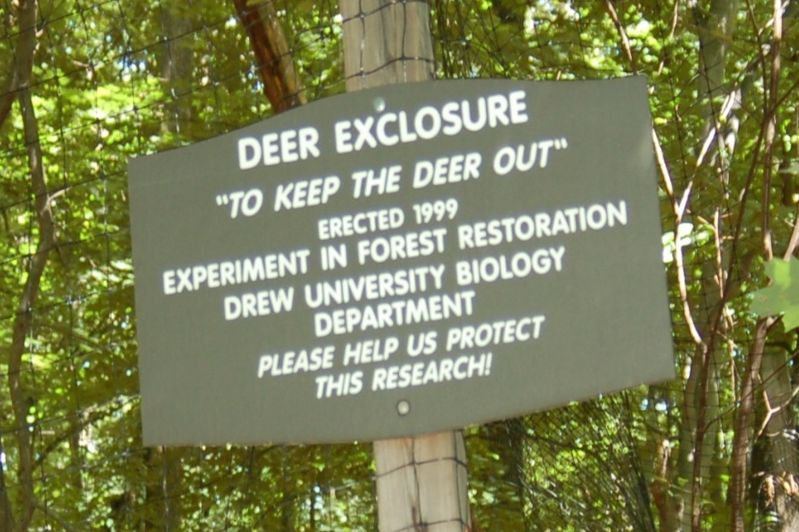
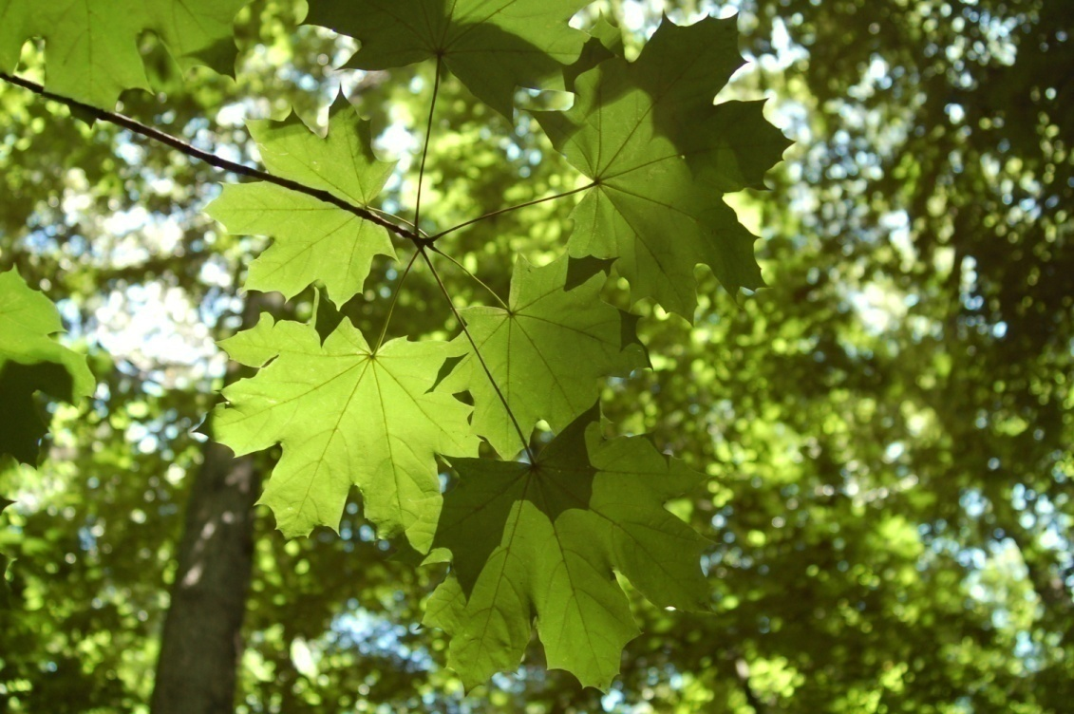
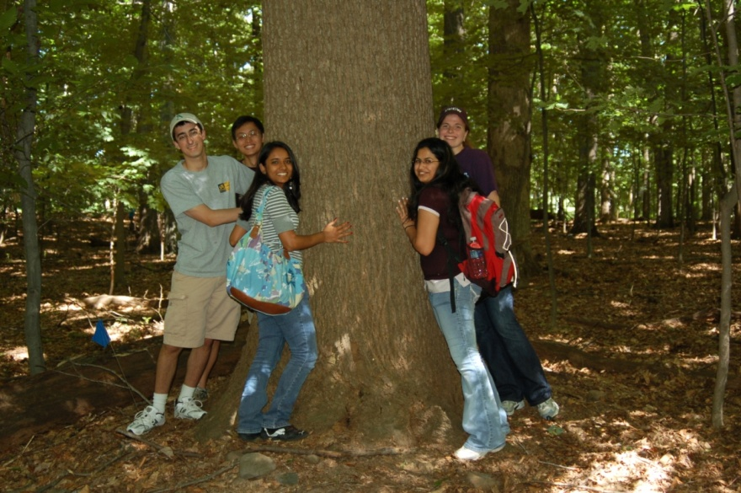

Slide 23
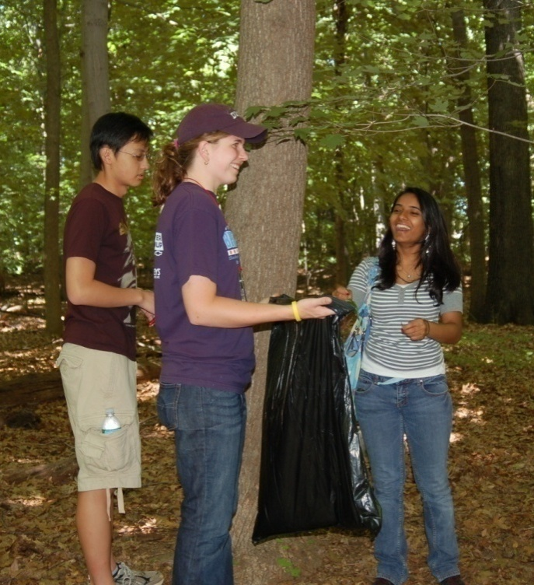
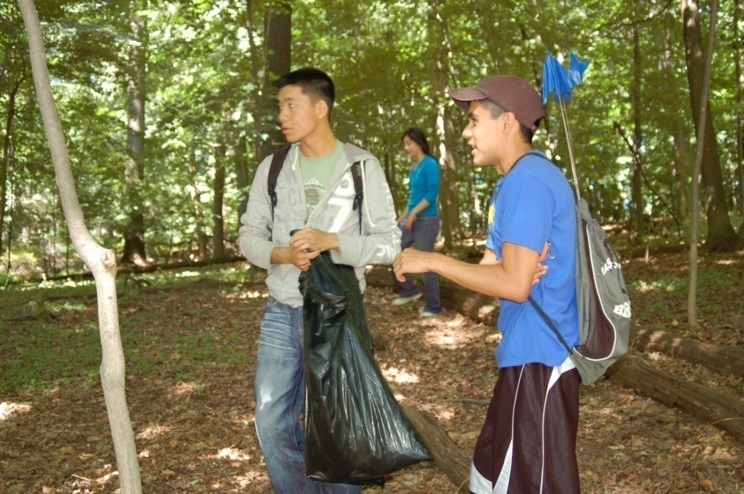
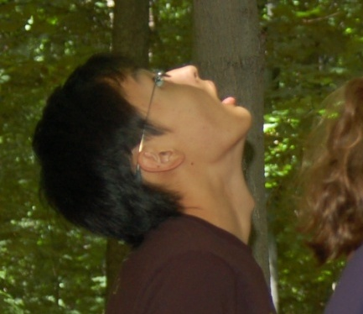
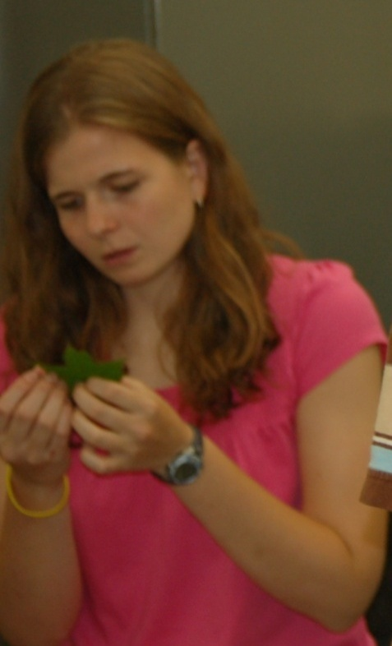
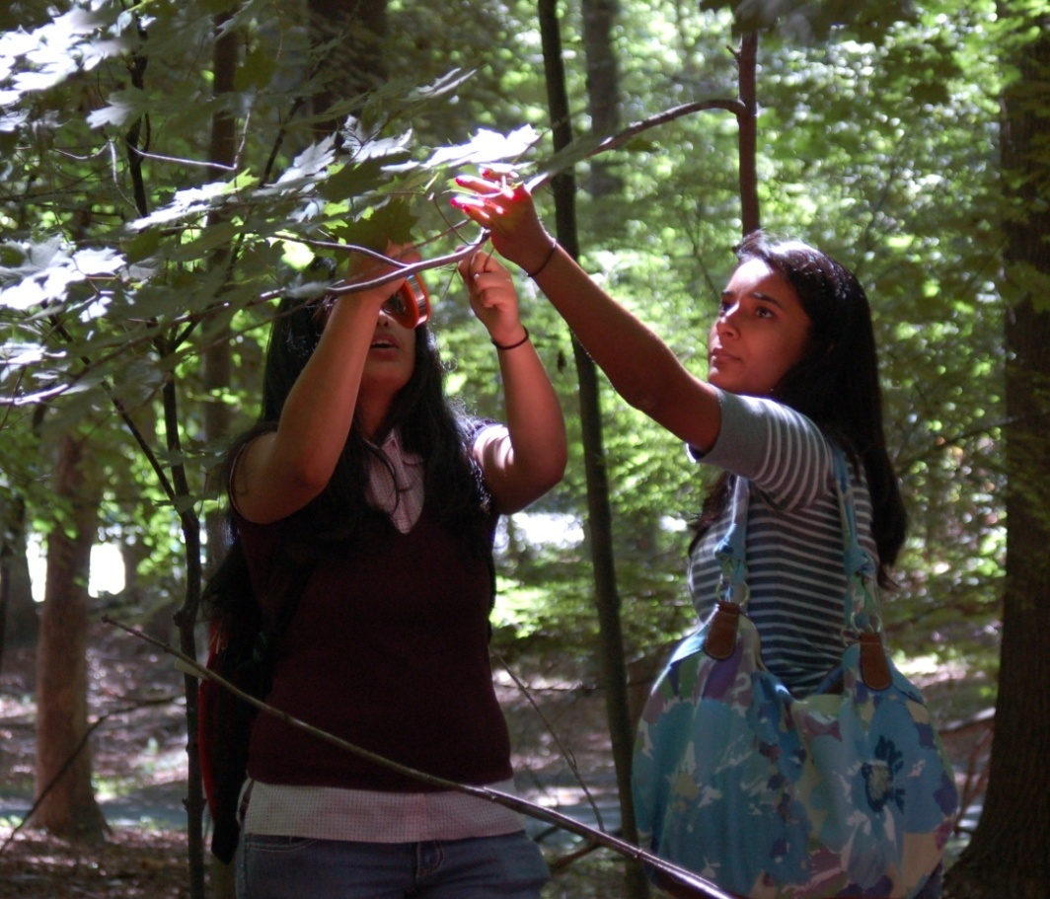
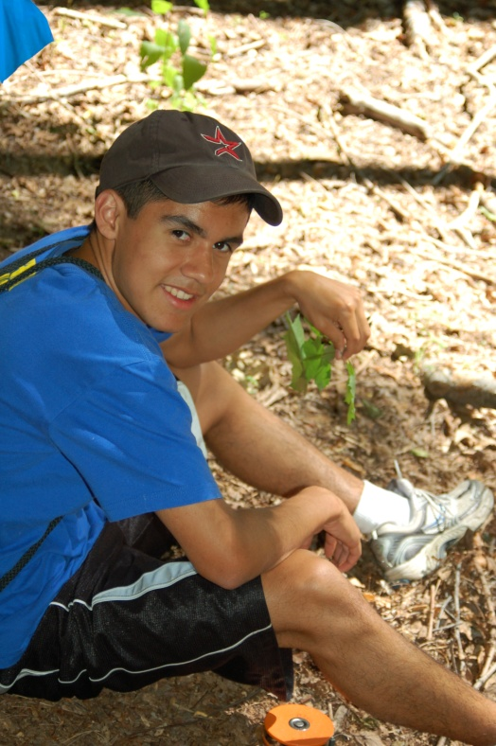

Slide 24
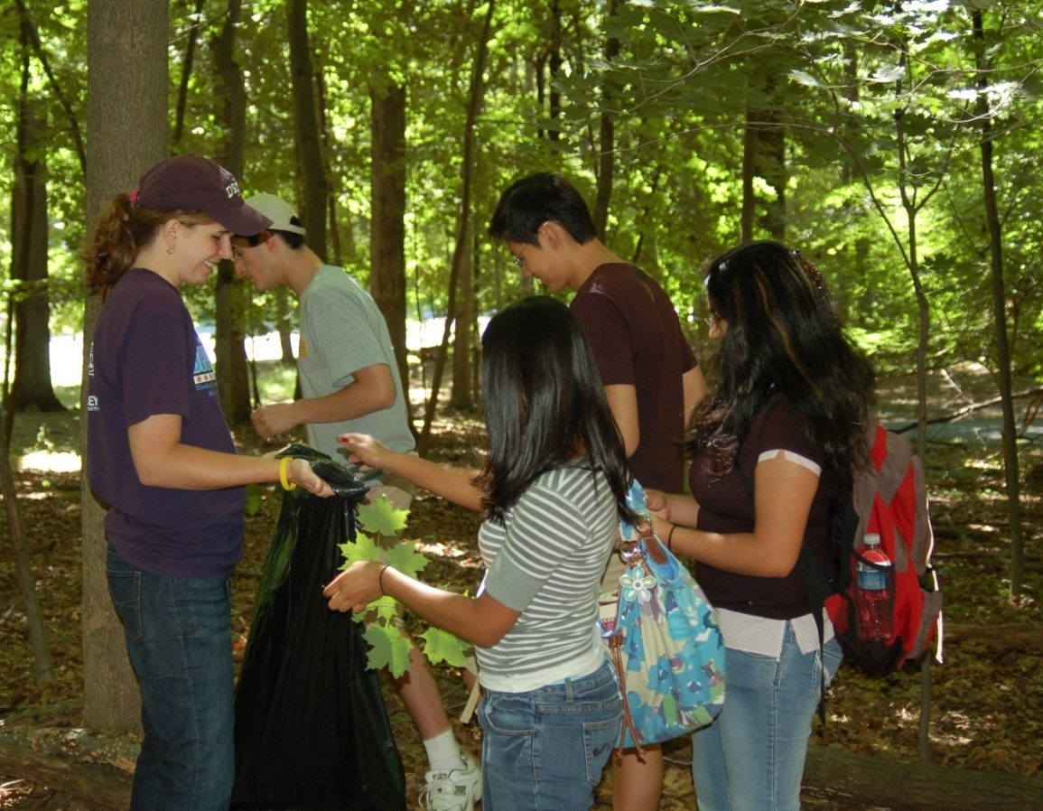
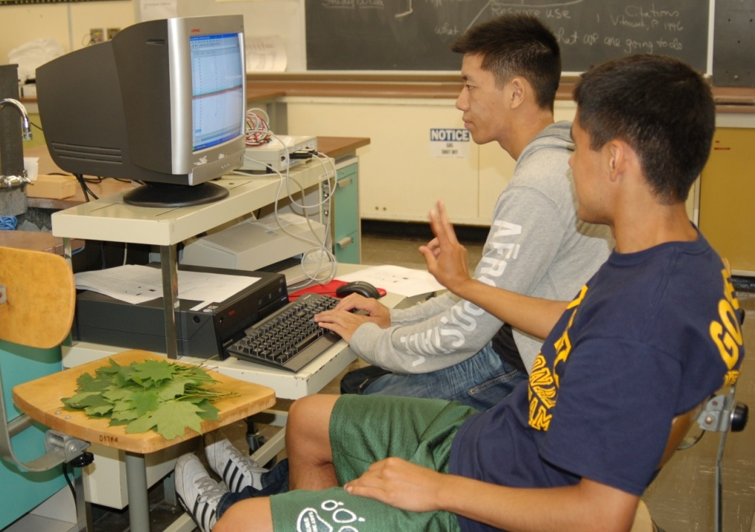
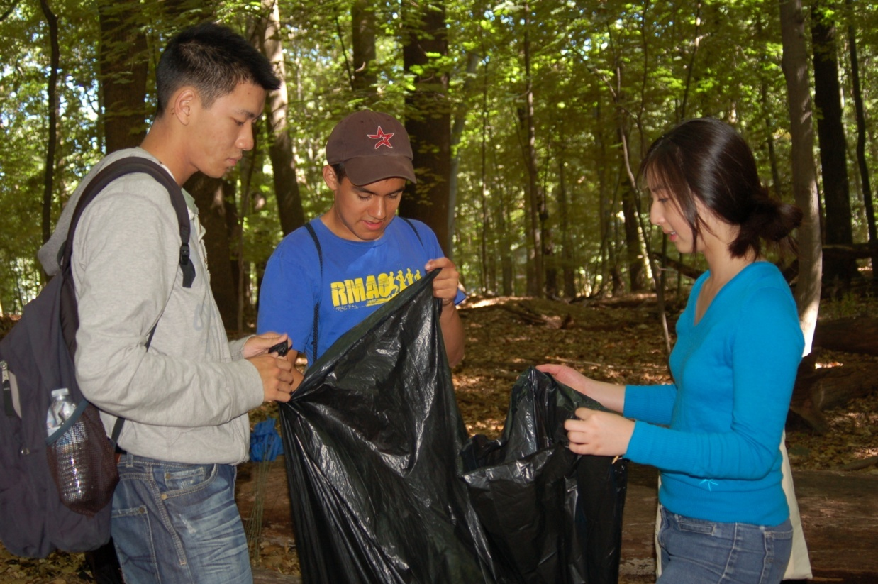
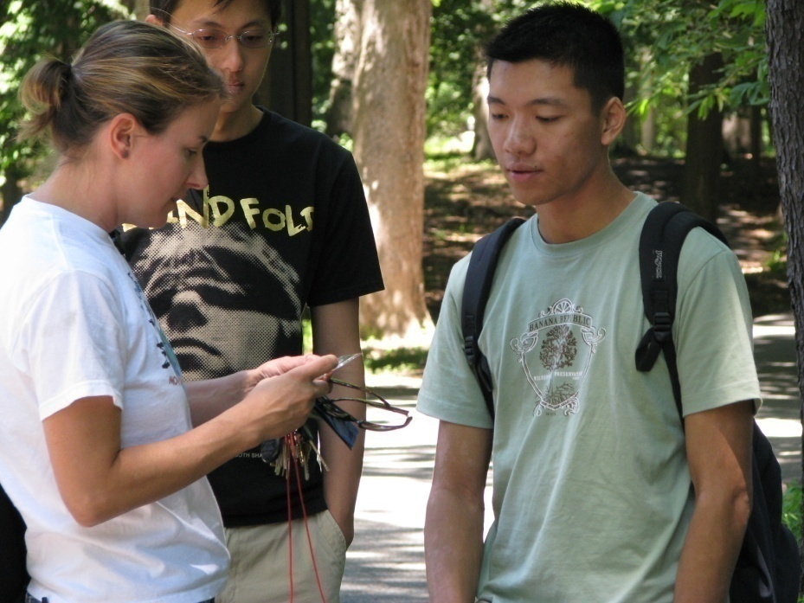

Slide 25
Acknowledgements
NJ Governor’s School in the Sciences
  Myrna Papier
  Dr. David Miyamoto
  Professor Sara Koepf
  Laura and John Overdeck
  Other sponsors
Dr. Sara Webb

Slide 26
Questions???

