Slide 1
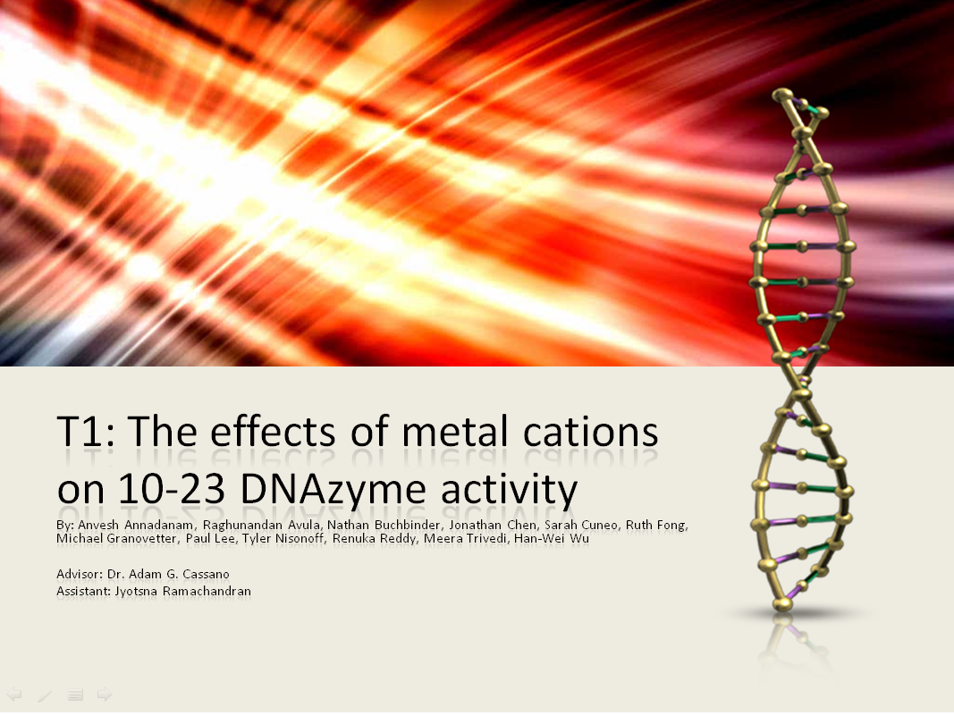
T1: The effects of metal cations on 10-23 DNAzyme activity
By: Anvesh Annadanam, Raghunandan Avula, Nathan Buchbinder, Jonathan Chen, Sarah Cuneo, Ruth Fong, Michael Granovetter, Paul Lee, Tyler Nisonoff, Renuka Reddy, Meera Trivedi, Han-Wei Wu
Advisor: Dr. Adam G. Cassano
Assistant: Jyotsna Ramachandran

Slide 2
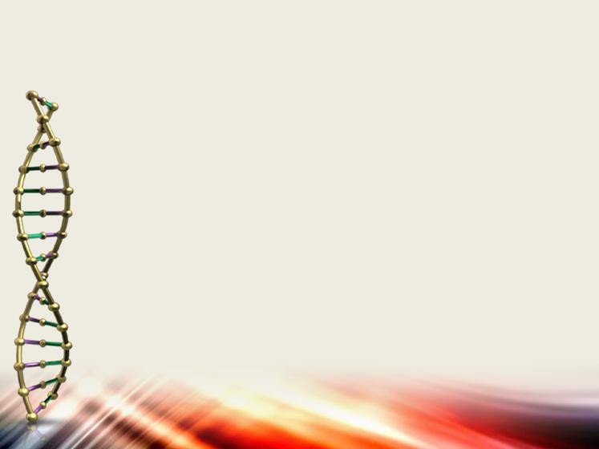
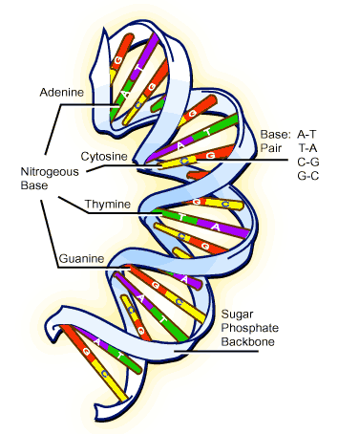
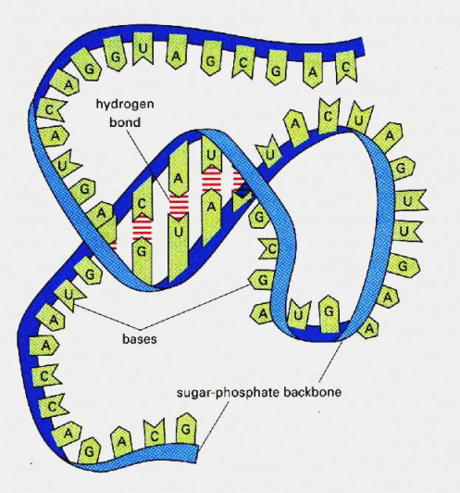
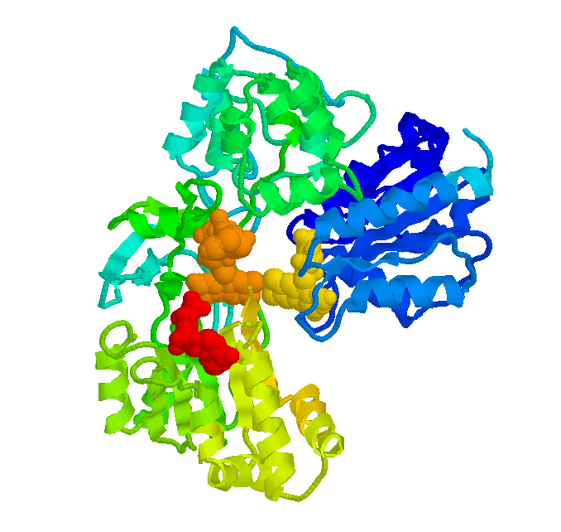
The Big Three
DNA – Deoxyribonucleic Acid
RNA – Ribonucleic Acid
Proteins
http://www.scq.ubc.ca/a-monks-flourishing-garden-the-basics-of-molecular-biology-explained/
http://ias-cnsh.org/CNSH%C4%90%E1%BB%99ngV%E1%BA%ADt/CNSHTrongTh%C3%BAY/tabid/60/BlogDate/2009-02-28/DateType/month/Default.aspx
http://www.mpsciences.com/index-2.html
Notes:
DNA-Deoxyribonucleic Acid
Stores genetic information in the form of nitrogenous bases (A, G, T, C)
RNA- Ribonucleic Acid
Intermediate form between DNA and Proteins that helps to translate and transcribe genetic information into proteins
Proteins
Organic macromolecule that has a variety of functions throughout the body including structure, support, and catalysis

Slide 3
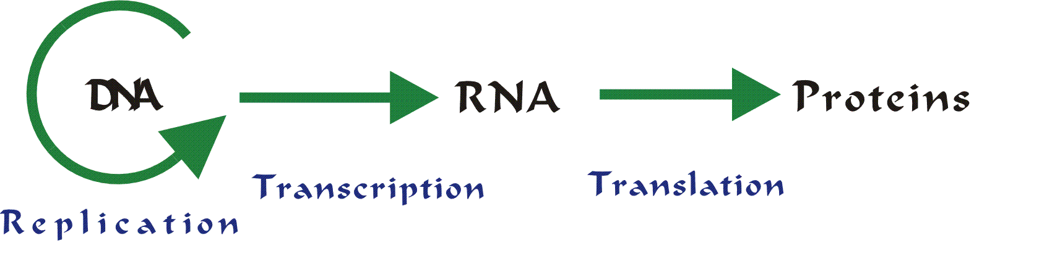
Which Came First?
DNA
Proteins
RNA
http://library.thinkquest.org/C0122429/intro/genetics.htm
Notes:
Ask the audience which came first
DNA
too big and complex
incapable of performing many functions needed to maintain life
Proteins
cannot store genetic information
can perform many other necessary functions such as enzyme catalysis (explain this han-wei)
RNA is capable of BOTH.
can store information
can perform many functions of proteins.
*mention RNA world

Slide 4
Ribozymes
RNA is capable of enzyme activities in certain cases
Functions are vital to life
Shows a mixture of functions between DNA and enzymes (proteins)
Newest discovery: DNAzyme
Notes:
RNA is capable of enzyme activities in certain cases
called Ribozymes
Involved in creating the tertiary structure of proteins
Although rare, it has essential functions
This provides strong evidence that RNA can perform complex functions that were previously attributed to proteins
However, our project focuses on a more recent discovery, the DNAzyme

Slide 5
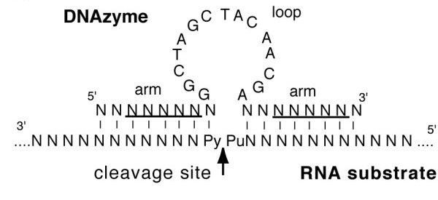
DNAzymes
Discovered in 1997
DNA with enzymatic functions
Capable of site-specific cleavage of RNA molecules

Slide 6
10-23 DNAzyme
Cleaves target RNA in a sequence specific manner
Requirement:
  Metal cations as cofactors
Notes:
Cleaves target RNA in a sequence specific manner
Creates two strands of RNA, an 11bp strand and a 9bp strand
Very slow rate of reaction
metal cations act as cofactors

Slide 7
10-23 DNAzyme: Previous Research
Mg²⁺ cation works
Monovalent cations not as efficient
Other salts not nearly as effective
Properties of cofactors in reaction still not fully understood
  Role of cofactors in the reaction
Notes:
Mg 2+ a cofactor at 50 mM
Monovalents need higher concentrations, but can also work as part of a salt solution
Other cations tested and found to be inefficient at specific concentrations
We’re not sure how cofactors work

Slide 8

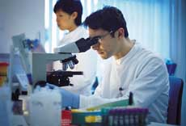
Medical Applications
RNA retroviruses
Treatment can be potentially damaging
DNAzymes show promise
http://www.deanza.fhda.edu/workforceed/images/06%20medical%20lab.jpg
http://www.mydogella.com/steth.jpg
Notes:
RNA is involved in many illnesses
Retroviruses
Treatment involves many medications that are toxic
DNAzymes as a treatment
Can cleave harmful RNA
Problems: requires use of toxic cations, and DNAzymes are not protected within the body

Slide 9
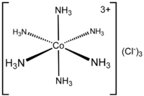
Purpose of Our Project
Functional mechanism of the 10-23 DNAzyme and its cofactors
Ligand exchange
Ionic Radius
  Charge of the Mg²⁺
http://img.search.com/thumb/f/fd/CoA6Cl3.png/200px-CoA6Cl3.png
Santoro SF and Joyce GW 1998
Notes:
To determine the functional mechanism of the 10-23 DNAzyme
To better understand the 10-23 DNAzyme
To determine whether it is the ligand function or the charge of the Mg²⁺ that makes it a good cofactor
Sr²⁺ has the same charge
[Co(NH₃)₆] is not capable of ligand exchange

Slide 10
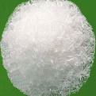
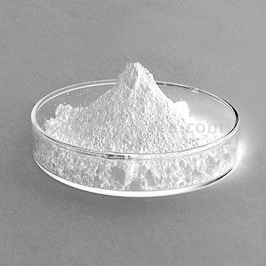
Questions to be Answered
Which factor is most important?
  Ligand exchange
  Molecular size
Which concentration works the best?
http://cvbinasejahtera.blogspot.com/2009/09/bahan-bahan-kimia-industri.html
http://www.made-in-china.com/showroom/starchemicalssellers/product-detailAMjmsnZgaGpz/China-Strontium-Carbonate.html
Notes:
Higher efficiency as concentration increases

Slide 11
Reactions
Total Volume 10 µL
  10-23 DNAzyme 1 µL
  RNA Substrate 1 µL
  EPPS Buffer 1 µL
  EDTA (ethylene diamine tetra-acetic acid) 1 µL
  Monovalent Salts (NaCl) 1 µL
  Cobalt Hexamine/ Strontium Chloride + H₂0 = 5 µL
Notes:
Every enzyme needs certain conditions to perform
Purpose:
DNAzyme- enzyme that cleaves RNA
RNA- substrate
EPPS-reaction buffer, provides a stable environment to resist dramatic changes in pH
EDTA-used to chelate out Mg2+ ions
Monovalent Salts- maintains a constant ion gradient within the gel
Cobalt Hexamine/Strontium Chloride: cofactor that allows reaction to occur

Slide 12
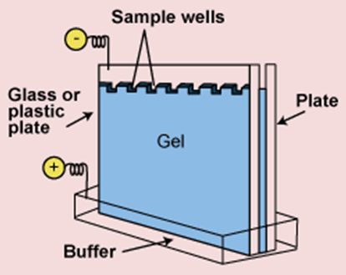
15% Polyacrylamide PAGE Gel with Urea
http://biotech.matcmadison.edu/resources/proteins/labManual/images/220_04_039.gif
Notes:
A solution of nucleic acids is applied to wells made in a thin gel that is held between two clear plates of plastic. An electric current is passed through, and over time, the reaction components separate by size. At 180 volts

Slide 13
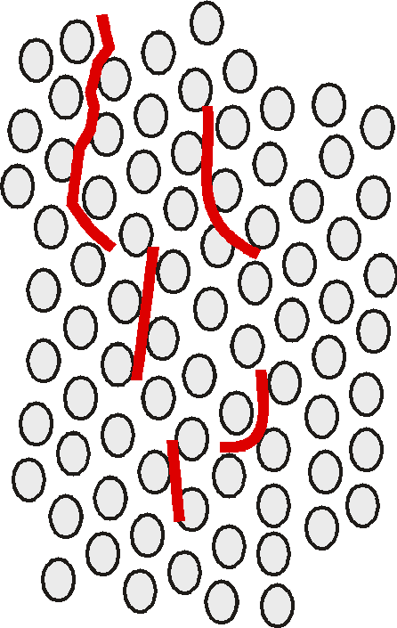
-
Migration
of DNA
+
p. 2-12
Notes:
Typical example of gel electrophoresis
Talk about why the reaction components separate- negative reaction components (nucleic acids) are drawn towards the positive anode
-gel acts as a molecular sieve, so larger molecules cannot move as quickly as the smaller molecules
-the buffer conducts the current across the gel

Slide 14
Controls and Standards
Notes:
-determine if reaction is successful by presence of RNA product band at the bottom of the gel
-positive control = Mg2+, allows us to compare to a known working value
-negative control= DNA, RNA, no salts, ensures that product formation is result of salt itself rather than outside factors
-control wells show where each band should appear, and also shows that the gel ran properly

Slide 15
Initial Cobalt and Strontium Reactions
Reactions ran for one hour
Trial one gel ran for 45 min
Trial two gel ran for one hour
SYBR green staining time increase
Reactions at 37 ºC

Slide 16
Cobalt Hexamine: Initial Trials
Notes:
First trial: wider variety of concentrations
Second trial: fewer concentrations with more controls

Slide 17
Strontium: Initial Trials
Notes:
First trial: no negative control
DNA enzyme and RNA with no cofactors (to see if the reaction will occur on its own)
Second trial: added negative control, but gels too inclusive for this to make a difference

Slide 18
Experimental Improvements
Reaction time increased
Gel Electrophoresis running time increased
SYBR-Green staining time increased
Notes:
Reaction Time: Increasing this ensures the completion of the reactions (1 hr → 24 hrs)
Gel Electrophoresis Running Time: Increasing this separates the product band from the blue dye and removes excess bromophenol blue dye
SYBR-Green Staining Time: Increasing this improves visibility of the bands

Slide 19
Strontium: Trial 3

Slide 20
Strontium Trial 3:
Percent of RNA Product After Electrophoresis

Slide 21
Cobalt Hexamine: Trial 3
Notes:
Slide 2: Trial 3 Gels of Strontium and Cobalt and the explanations = get the labeled pictures of these gels (#1 and #3)

Slide 22
Cobalt Hexamine Trial 3:
Percent of RNA Product after Electrophoresis

Slide 23
Conclusions
Strontium properties
Cobalt Hexamine properties
Ligand exchange is more important than size
Concentration effects
Notes:
Slide 3: Conclusion and Answer to Question/Hypothesis
Strontium works well
Cobalt doesn’t work as well
Strontium has ligand exchange but is much more massive than Magnesium
Cobalt hexamine is similar in size/structure to Magnesium but lacks ligand exchanges
Conclusion: Ligand exchange is a more vital property than size
Too much variability between trials to determine the optimal concetrations
Future stuff

Slide 24
Acknowledgements
Dr. Adam Cassano (Break a leg)
Dr. David Miyamoto
Dr. Paul Quinn
John and Laura Overdeck
Bayer HealthCare
Bristol-Myers Squibb
Jewish Communal Fund
The Ena Zucchi Trust
Johnson & Johnson
Roche
Novartis
The Crimmins Family Charitable Foundation
Independent College Fund of New Jersey
The Edward W. and Stella C. Van Houten Memorial Fund
Drew University

Slide 25
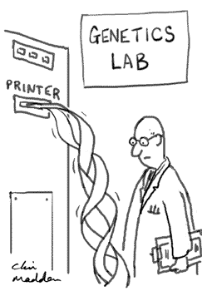
Questions?

