Slide 1
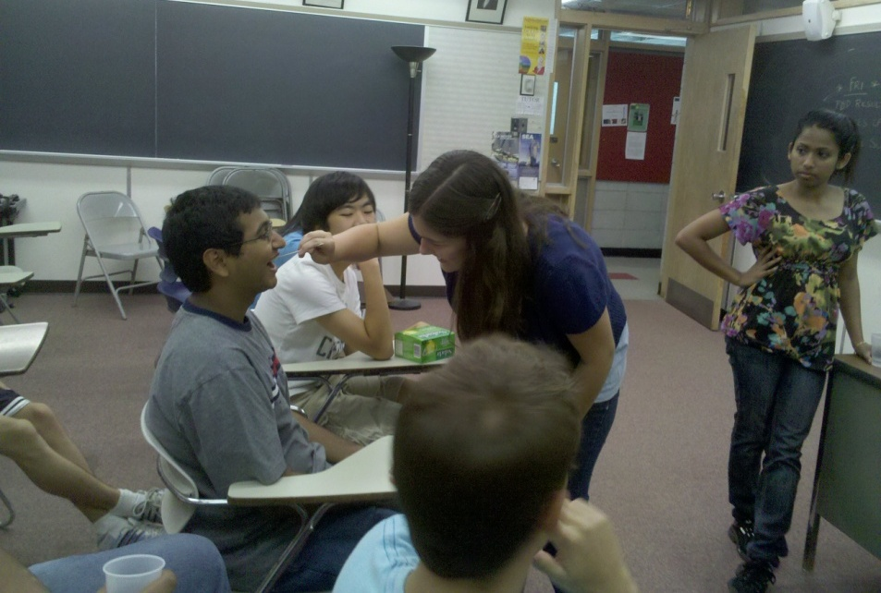
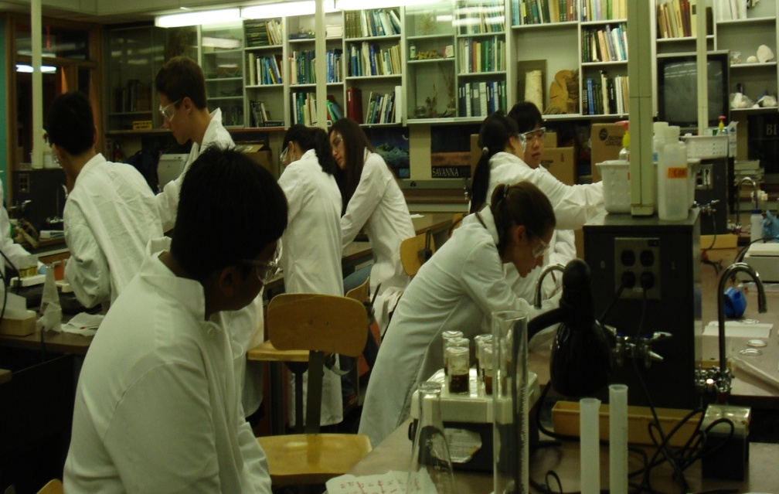
The effects of green tea (camellia sinensis) on oral bacteria
Margaret Axelrod, Sean Berkowitz,
Raina Dhir, Veronica Gould, Arjun Gupta, Eric Li, Jane Park, Amar Shah, Kevin Shi, Christelle Tan, Ming-Ming Tran
Instructor: Mrs. Rachel Sandler
Assistant: Tina Varghese

Slide 2
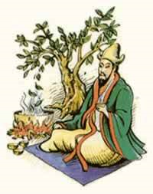
History
2737 B.C. : Shen Nung
Tang Dynasty – popularity grew
Ming Dynasty – common drink
China and Japan leading producers
2nd most popular drink
http://eclecticcommons.telldat.net/

Slide 3
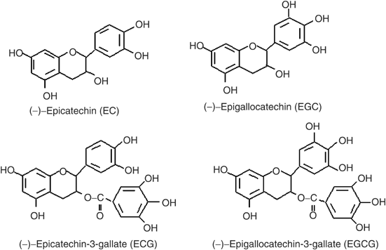
Composition

Slide 4
Health Benefits
EGCG → Free Radicals
Lowers cholesterol
Reduces risk for heart disease
Anticarcinogenic properties
Prevents binding of HIV to T-cells
http://www.aboutcoffeeandtea.com/tea/leafs/green/green-tea-health-benefits.php

Slide 5
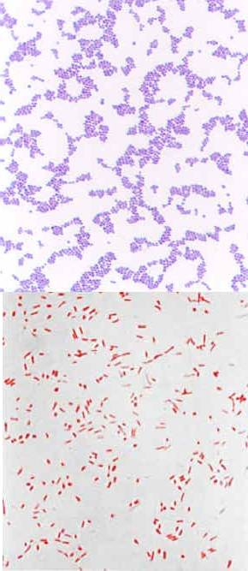
Antimicrobial Effects
Effective against:
Fungal pathogens
Gram-positive bacteria
Gram-negative bacteria.
Exhibits both bactericidal and anti-adherent abilities.
Gram-positive (purple) Gram-negative (red)
http://homepage.ntlworld.com/diamonddove/04a_Gram/Gram.htm

Slide 6
Anti-Adherent Effects
Prevents adherence by preventing synthesis of insoluble glucans.
Polyphenols interfere with glucosyltransferases (GTases), enzymes responsible for synthesizing glucans.

Slide 7
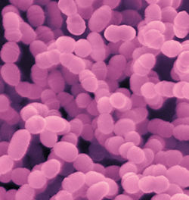
Susceptible Bacteria and Related Diseases
Streptococcus mutans and Streptococcus sobrinus – Dental caries (cavities).
Porphyromonas gingivalis – Periodontal disease
Streptococcus mutans
http://microbewiki.kenyon.edu/index.php/Streptococcus_mutans

Slide 8
Our Goals
Find the minimum inhibitory concentration (MIC) of green tea against common oral bacteria.
Test green tea’s ability to kill existing bacteria.
Compare green tea’s effectiveness to common mouthwashes.
Can green tea be used as an effective mouthwash?

Slide 9
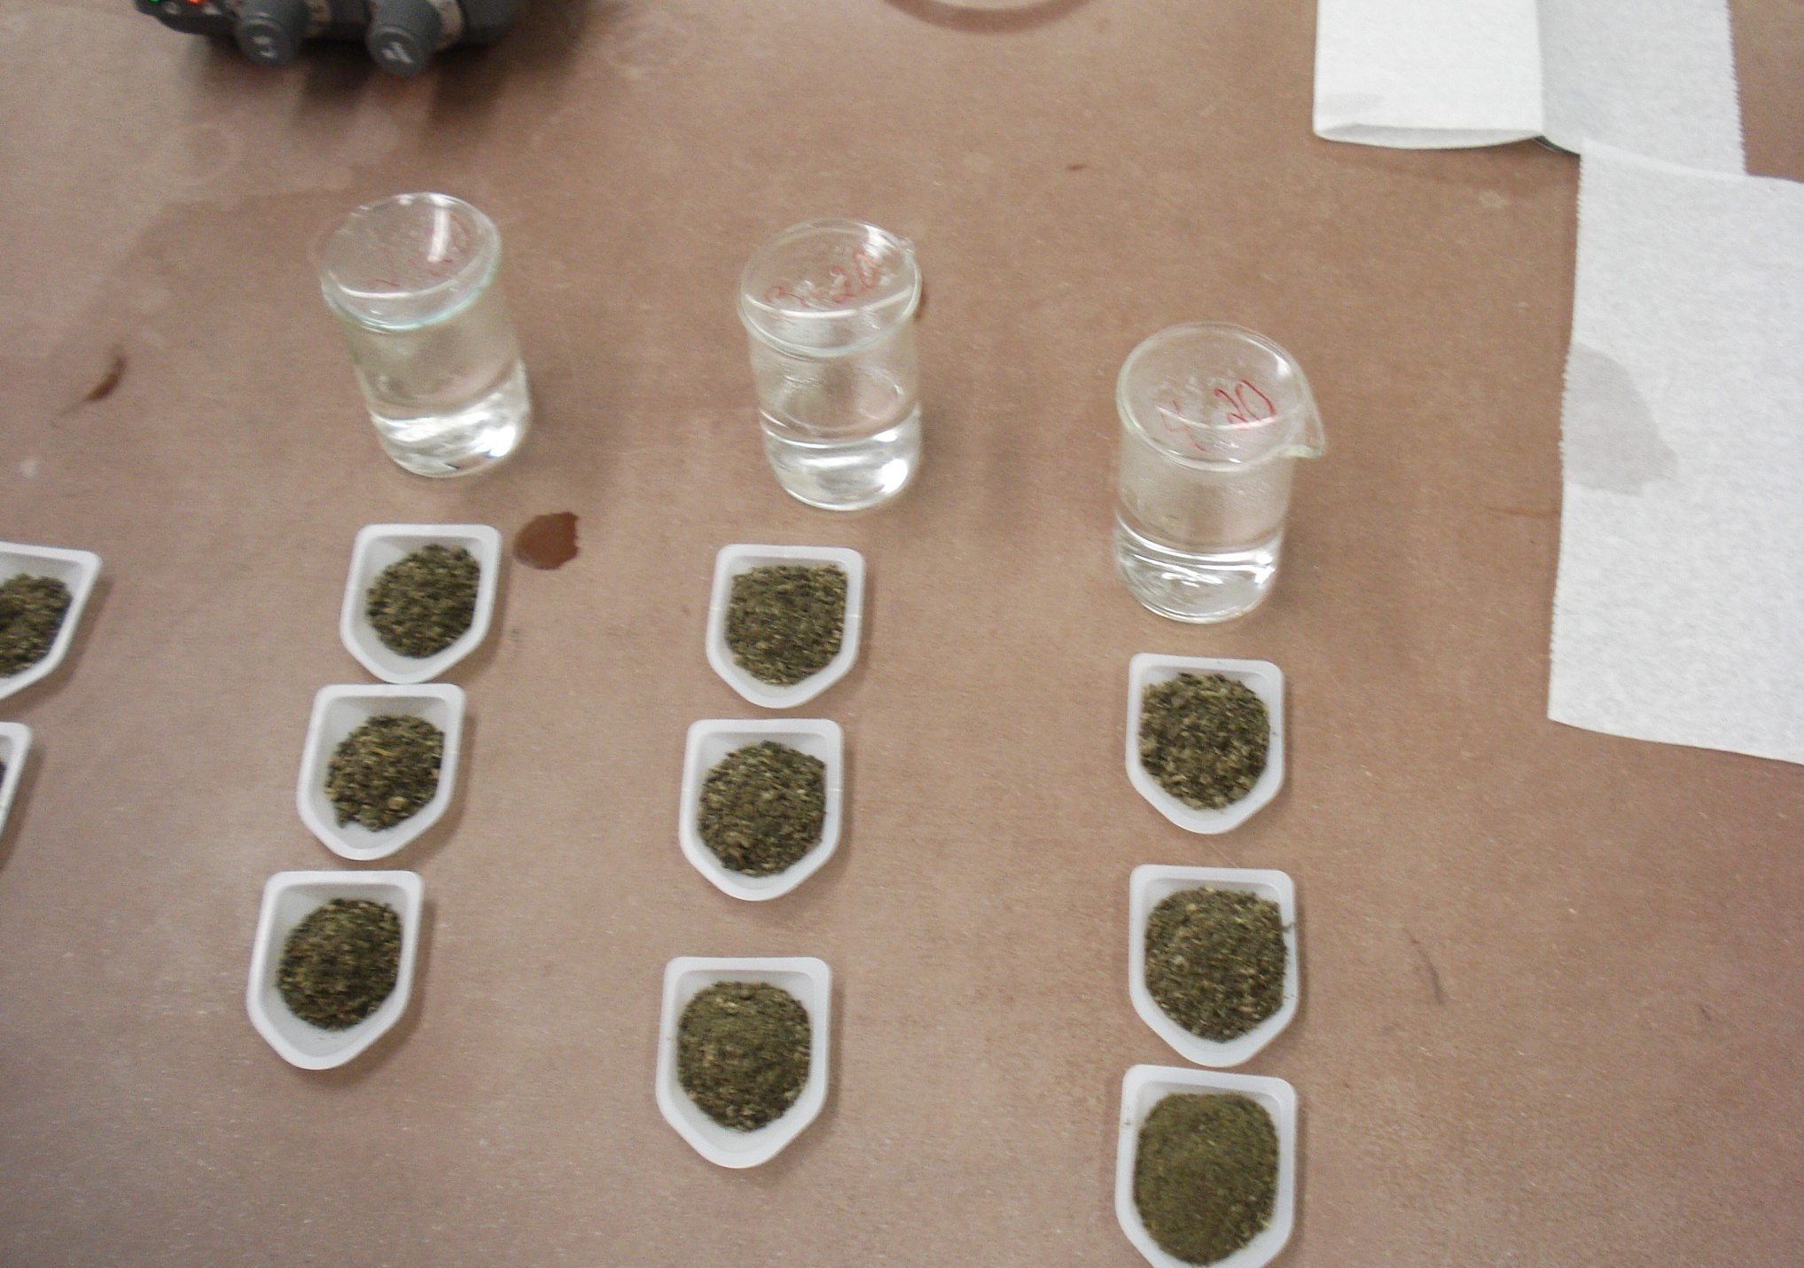
Materials and Methods

Slide 10
Preparation of Oral Culture
Samples from two human mouths
Streaked on tryptic soy agar plates with 5% sheep’s blood
Incubated at 37ºC for 72 hours

Slide 11
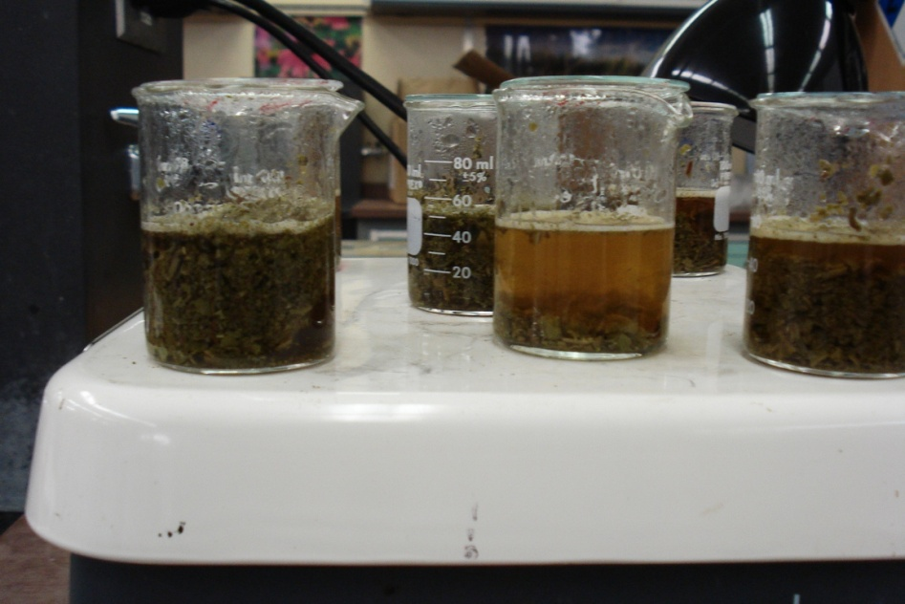
Paper Disk Diffusion (PDD)
Brewing Time (min) | Concentration (mg/mL)
60 | 0
 | 20
 | 40
 | 60
 | 80
40 | 0
 | 20
 | 40
 | 60
 | 80
20 | 0
 | 20
 | 40
 | 60
 | 80

Slide 12
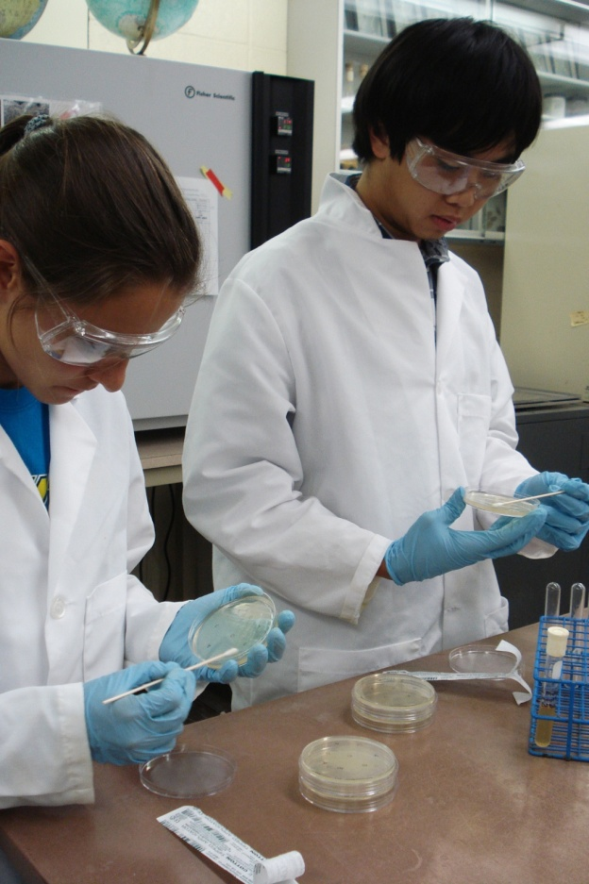
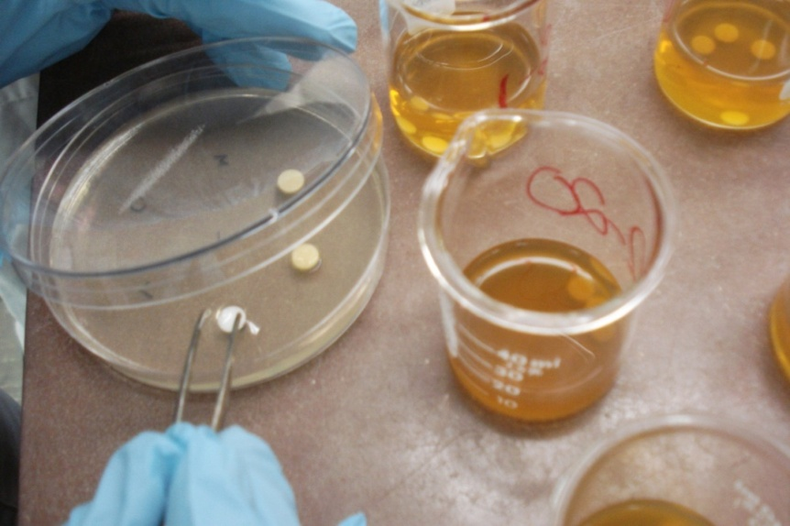
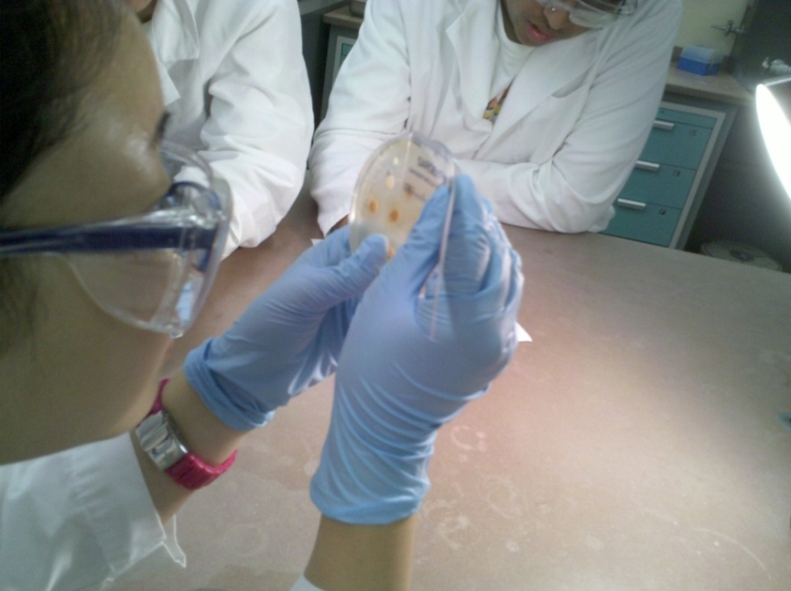
Paper Disk Diffusion

Slide 13
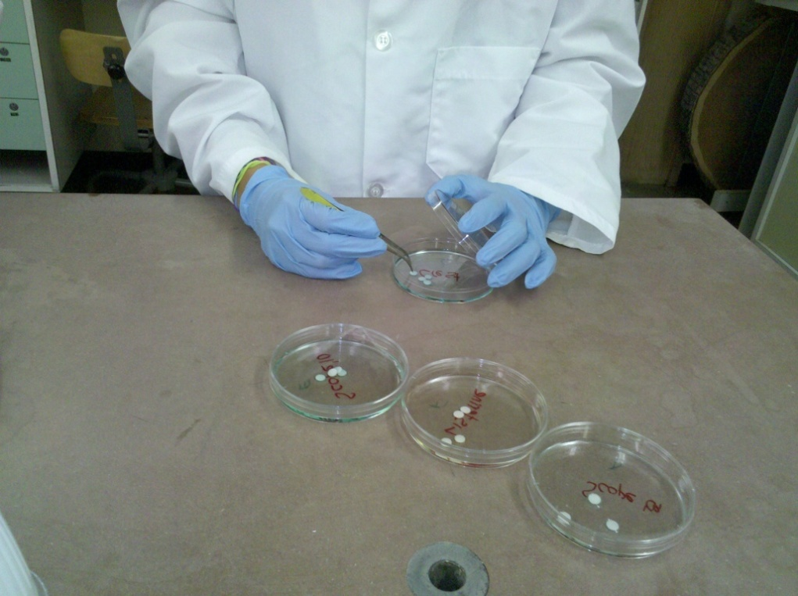
Paper Disk Diffusion
Act® Restoring™
Oasis® Moisturizing Mouthwash
Tom’s of Maine® Natural Cleansing Mouthwash
Scope® Original Mint Mouthwash
Listerine® Antiseptic
Crest® Pro-Health™
Cēpacol® Antibacterial Mouthwash with Ceepryn®

Slide 14
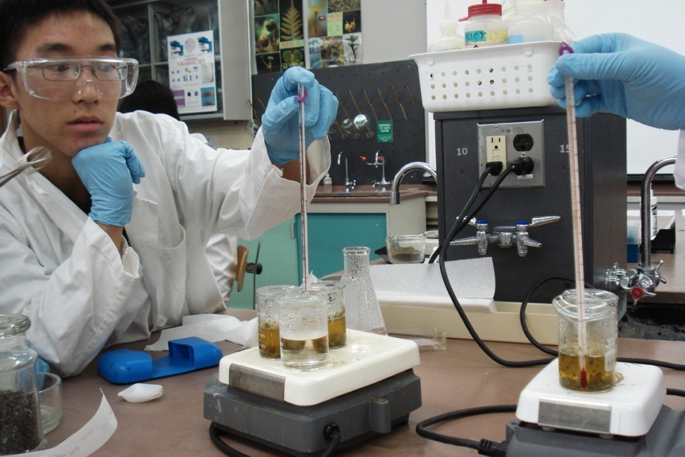
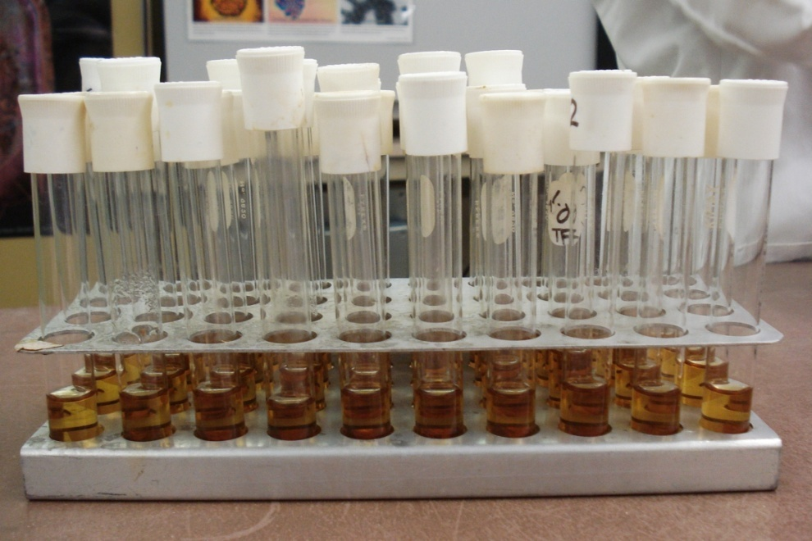
Minimum Inhibitory Concentration (MIC)
Brewed at 90ºC for 20 minutes with concentrations of 0, 1.5, 2.5, 3.5, 4.5, 5.5, 6.5, and 7.5 mg/mL
Test tubes prepared with 4.9 mL tryptic soy broth, 5 mL green tea, and 0.1 mL oral culture or tryptic soy broth (control)

Slide 15
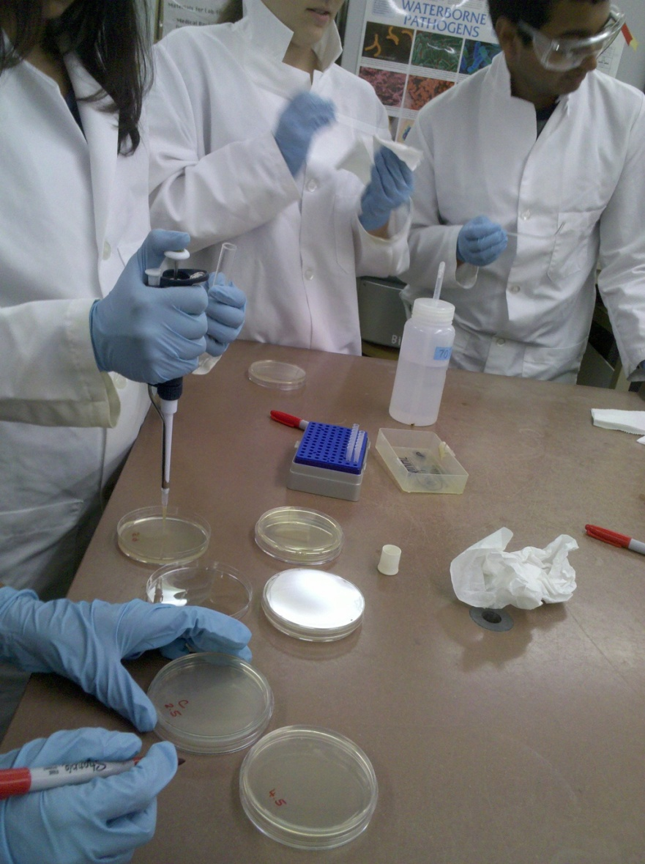
MIC
0.1 mL of each sample was removed and spread on tryptic soy agar plates
The plates were visually examined for bacterial growth

Slide 16
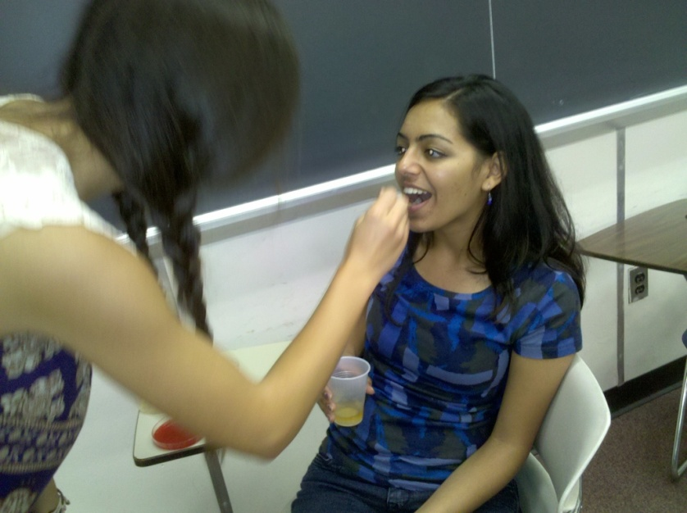
Oral Rinsing Study
Rinse with 30 mL of green tea, Scope® Original Mint Mouthwash, or water.
Swabbed immediately before, immediately after, 30 minutes after, and 45 minutes after

Slide 17
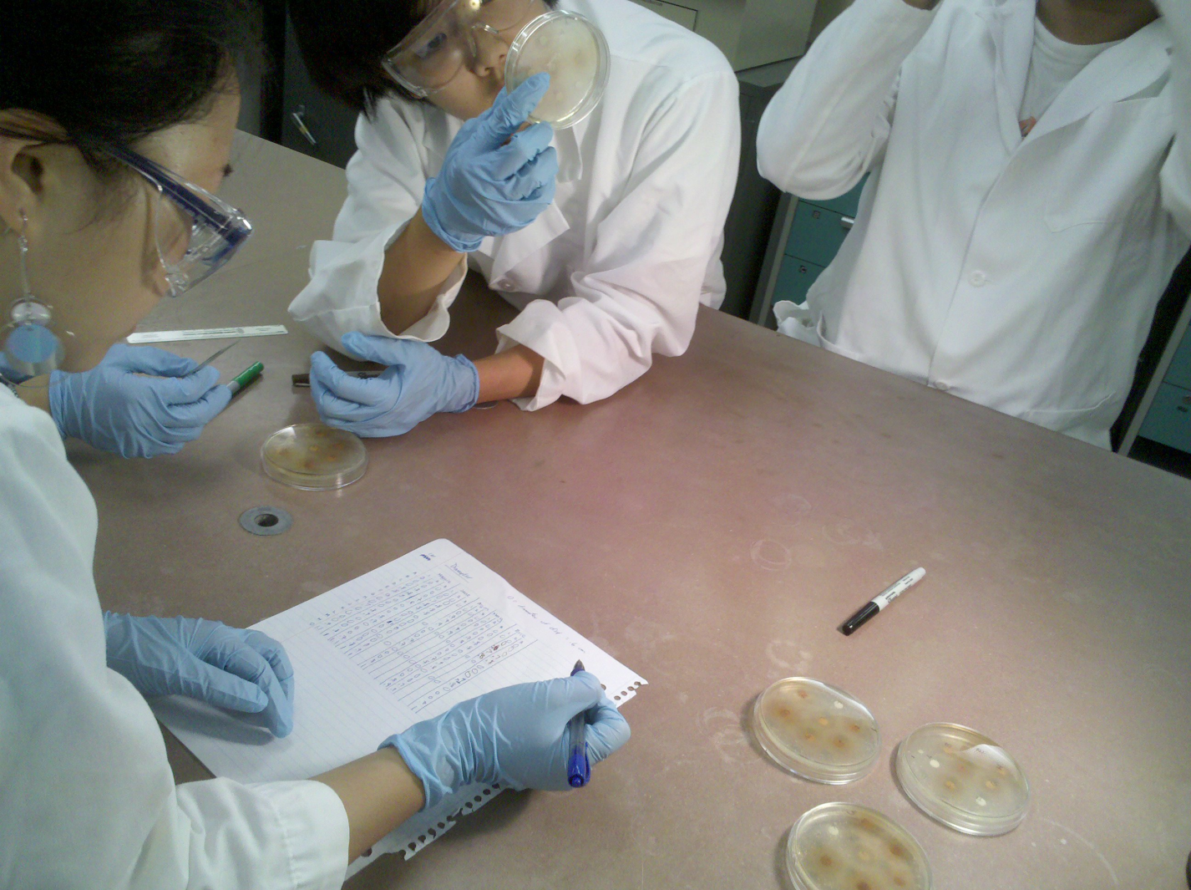
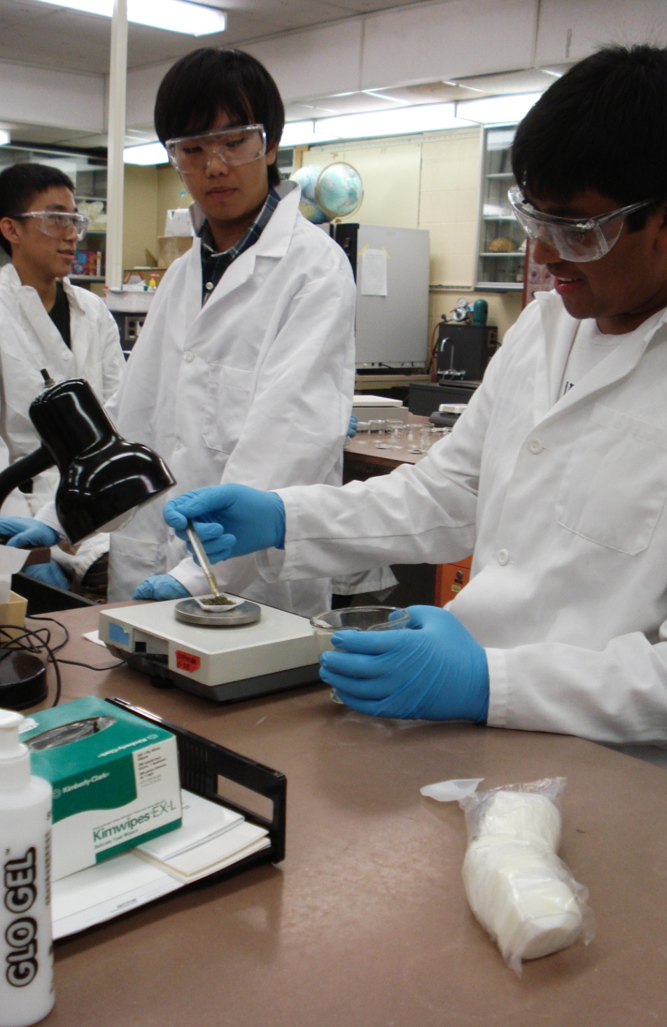
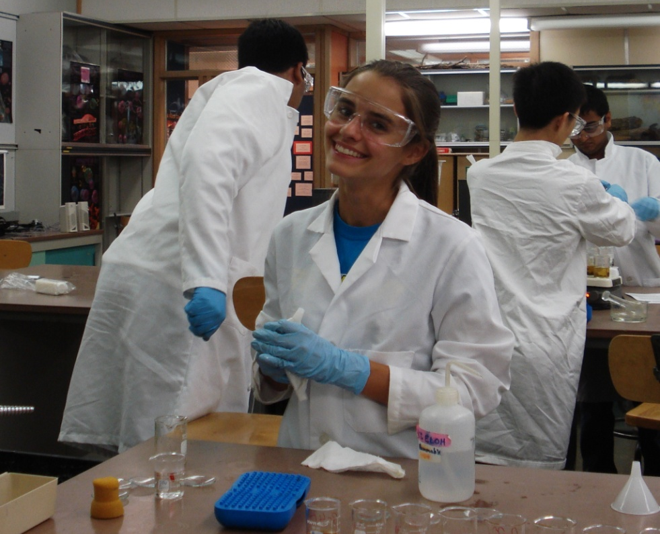
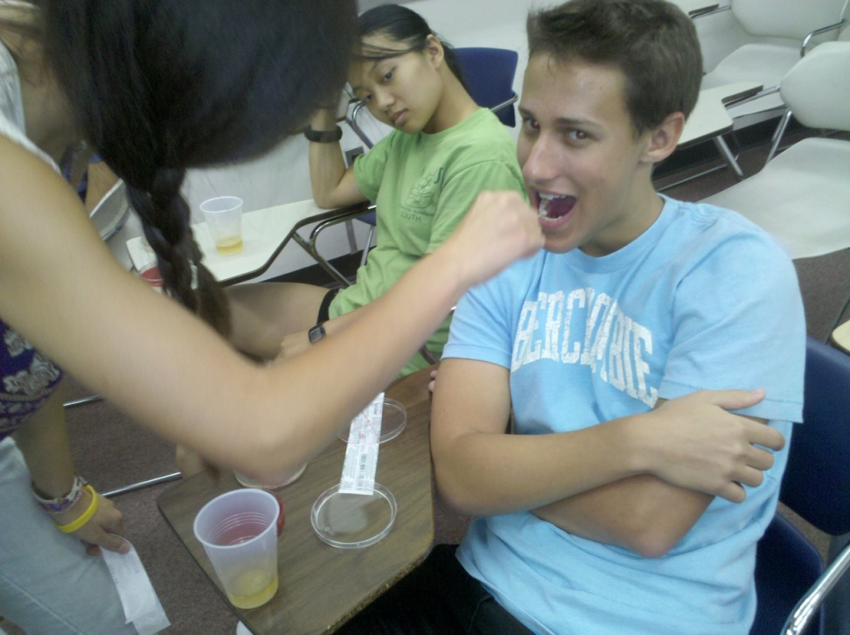
Results and Discussion

Slide 18
Paper Disk Diffusion
80 mg/mL concentration most effective 0.13 cm mean zone of inhibition with a 0.064 cm standard deviation.
Bacterial growth high in areas with no green tea
Tea at 40 and 60 min. ineffective

Slide 19
Paper Disk Diffusion with Tea
Hypothesized that highest concentration would prevent bacterial growth
One cup (20 mg/mL) not enough to kill all bacteria
No zones of inhibition on controls of water
Gram-positive bacteria killed as hypothesized
Gram-negative bacteria alive near tea
Notes:
Huge zone of inhibition from the larger colonies mostly gram positive.
20 mg/mL – average cup of green tea
Since that concentration did not kill the bacteria, we conclude that one cup is not enough.
Because our controls showed no zones of inhibition, we can infer that the zones of inhibition produced with higher concentrations of green tea were because of the antimicrobial effects of green tea.
Tea was not as efficient at 40 and 60 minutes. Perhaps the green tea became less effective as the leaves were infused in the water longer.

Slide 20
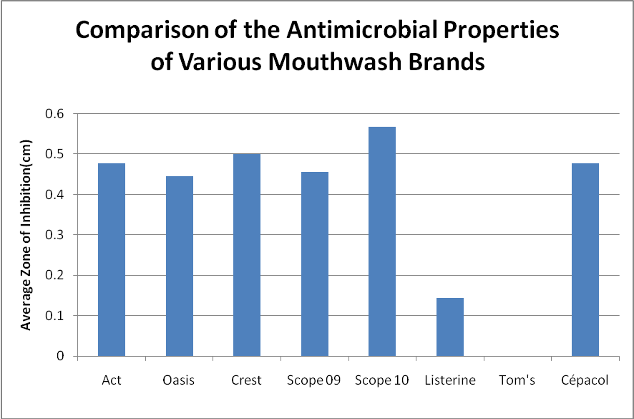
Mouthwash PDD

Slide 21
Paper Disk Diffusion with Various Mouthwashes
Scope®
Cetylpyridium chloride (CPC)
Alcohol
Crest® Pro-Health™
Cetylpyridium chloride
No alcohol
Sources of Error
Unknown bacteria
Nearest millimeter
Notes:
Alcohol does not serve as strong antiseptic since Crest was 2nd best.
Even though Listerine contains ethanol, it was second to least effective in killing the bacteria.
The least effective was Tom’s mouthwash. It contains sodium fluoride, which prevents tooth decay but lacks antibacterial properties.
The Tom’s mouthwash and Listerine hardly showed any zones of inhibition, which was similar to the lack of zones of inhibition around the 20 mg/mL of green tea
Again, we did not know the bacteria and the measurements were not too accurate.

Slide 22
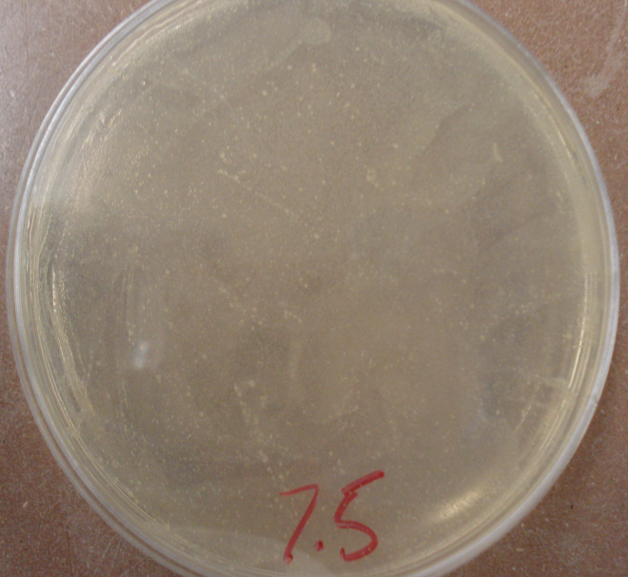
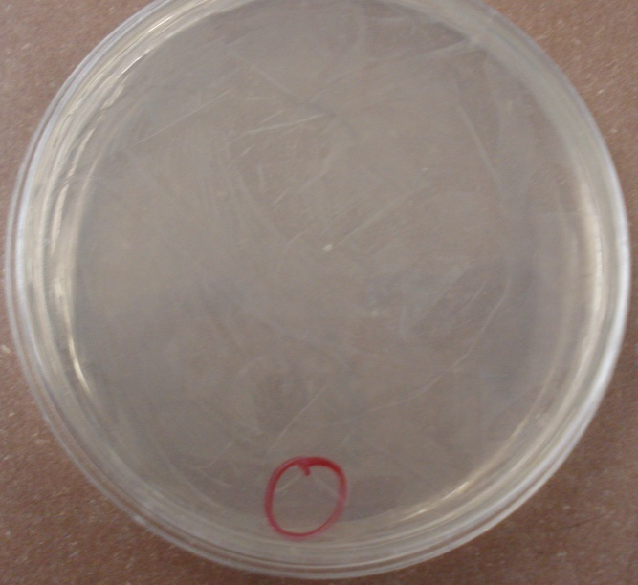
Minimum Inhibitory Concentration
Visually analyzed bacterial cultures
Lower concentrations of green tea most effective
Contradicts paper disk diffusion results
Results similar to those of NJGSS 2009

Slide 23
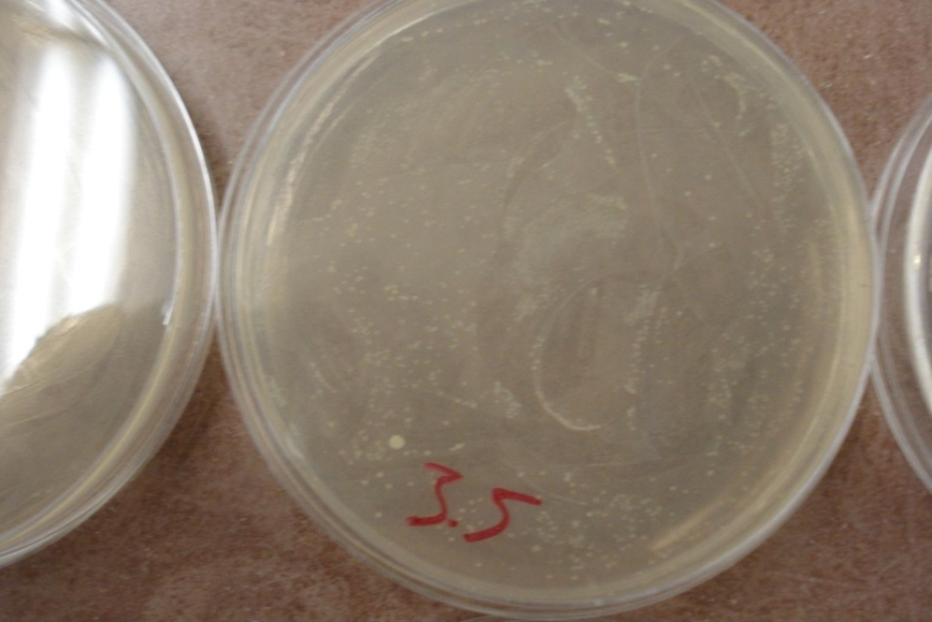
Minimum Inhibitory Concentration
Ineffective filtration of tea leaves
Possible growth of beneficial bacteria
No definite conclusion
Notes:
In previous studies, increased concentrations of green tea killed both gram positive and negative bacteria.
Our results are the opposite.
One of the controls, the 2.5 mg/mL dish, did exhibit three distinct colonies of bacteria. If all the controls showed this type of bacteria growth, it could be assumed that the source of contamination was from the green tea. However, since the 2.5 mg/mL dish was the only control with bacteria, this contamination must have been from an outside source.

Slide 24
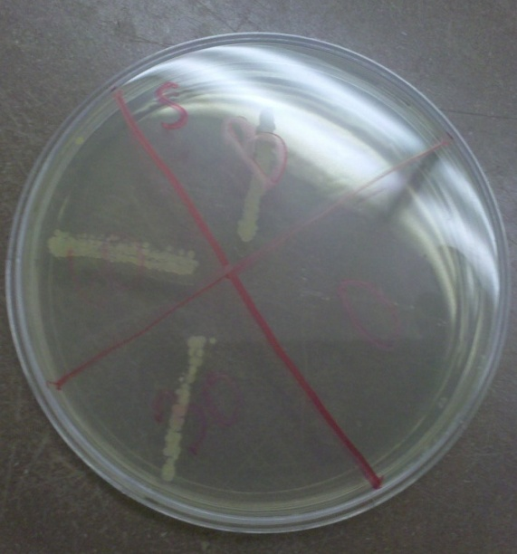
Oral Rinsing Study
Hypothesized that Scope would be more effective than green tea
Scope most effective
Discrepancies in green tea
Water not effective
Sources of Error
Not enough trials
Errors in swabbing
One subject gargled

Slide 25
What not to do…

Slide 26
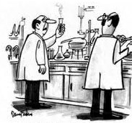
Sources of Error
“What’s the opposite of Eureka?”
Unknown bacteria
Contamination
Small sample size
Fluctuating temperature
http://www.paduiblog.com/2009/12/articles/dui-media-reports/harrisburg-dui-lawyer-comments-on-inaccurate-blood-alcohol-content-and-bad-bac-results/
Notes:
Contamination from air, pipette tip, ineffective sterilization : human error.

Slide 27
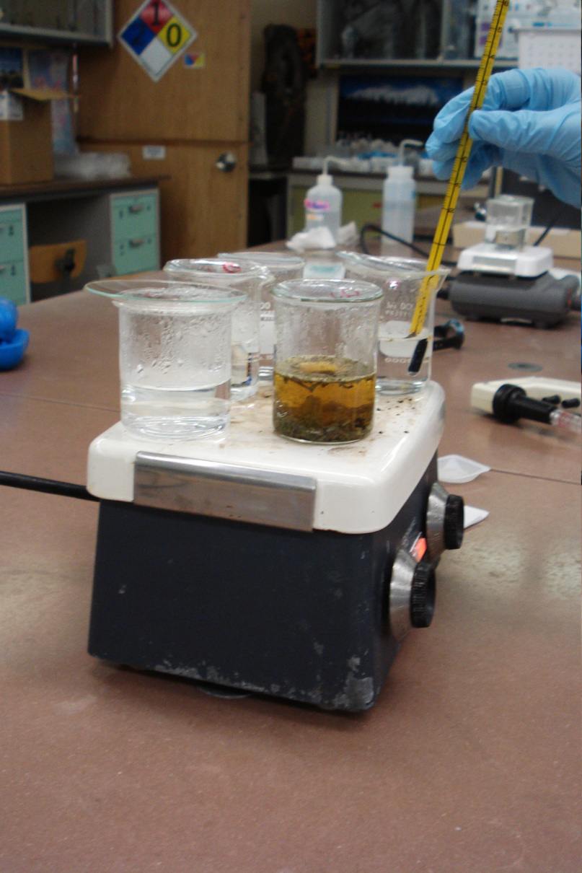
Future Studies
Maintain proper temperature
Use green tea extract
Different brands of green tea
Specific bacterium instead of just a mixed sample from the mouth
Alter MIC method
Notes:
One incubation period

Slide 28
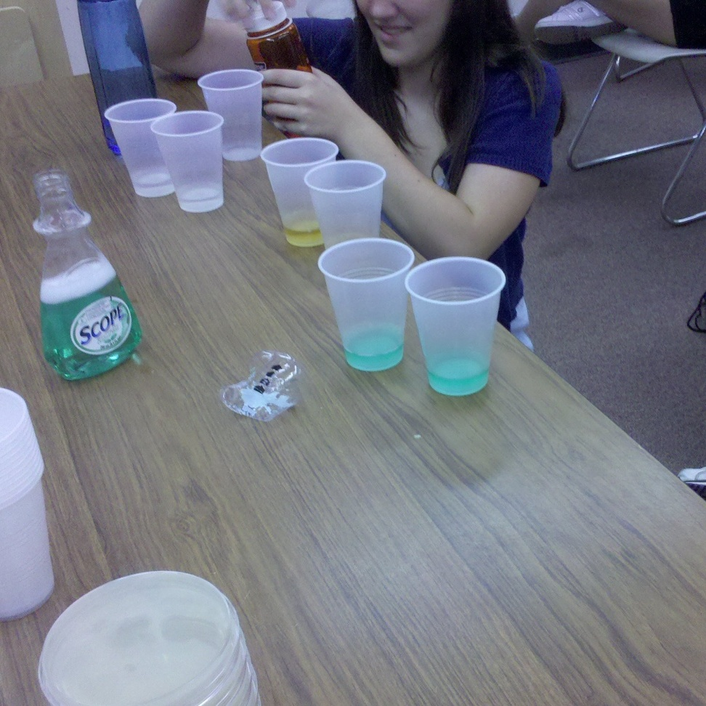
Future Studies
Oral Rinsing Study
More test subjects
Consistent rinsing
Greater concentration of green tea
Differentiate between beneficial and harmful bacteria

Slide 29
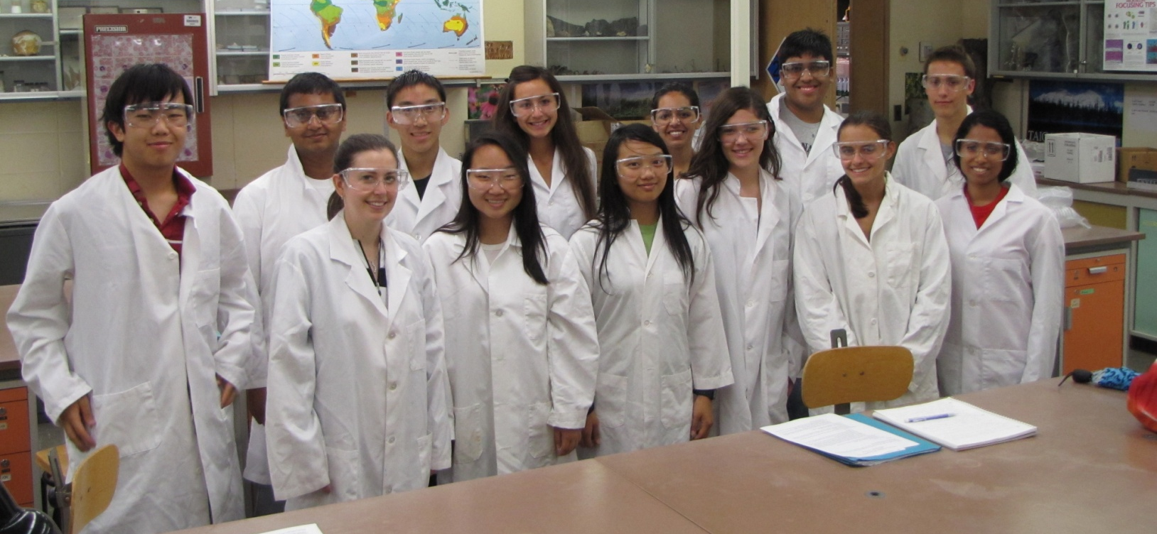
Conclusion
Effective killer of bacteria
Future studies to confirm results
Potential use as a natural mouthwash
High concentration

Slide 30
Acknowledgements
Mrs. Sandler
Tina Varghese
Dr. Miyamoto
Dr. Quinn
Myrna Papier
John and Laura Overdeck
Bayer Health Care
Bristol-Myers Squibb
The Crimmins Family Charitable Foundation
Jewish Communal Fund
The Edward W. and Stella C. Van Houten Memorial Fund
The Ena Zucchi Trust
Novartis
Johnson and Johnson
Independent College Fund of New Jersey
Roche
NJGSS Alumnae and Parents 1984-2009
Corporate Matching Gifts: Alliance Bernstein, AT&T Foundation, Direct Edge, Goldman Sachs, and Company, Johnson and Johnson, Met Life, Microsoft Corporation, Network for Good

Slide 31
Any Questions?

