Slide 1

The Effects of Medial Amygdala Lesions on Fear and Anxiety
Rachel Bergman, Eileen Gongon, David Handsman, Saheela Ibraheem, Eileen Jiang, Nikhil Keny, Wendy Wei, Caresse Yan, Annie Yang, Sabrina Zeller, Allen Zheng, Linda Zhong
New Jersey Governor’s School of Sciences 2010
Q: How Many Rats does it take to screw in a light bulb?

Slide 2


Why Does Anxiety Research Matter?
  Anxiety disorders are the MOST common mental illness in the US
  18% of those 18 yrs or older (40 million)
  $42 Billion/yr in medical costs
  Advancing knowledge on anxiety
  Animal model
  [source: Anxiety Disorder Association of America]
Notes:
Citations!!!

Slide 3

Fear vs. Anxiety
  Fear
    Response to immediate danger
    Short duration
  Anxiety
    Response to potential danger
    Long duration

Slide 4
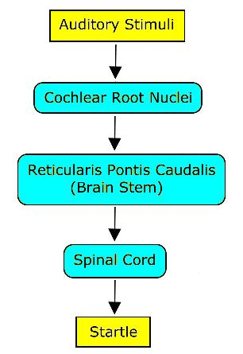
Acoustic Startle Response
Response to intense auditory stimuli
Well documented pathways
Characterized by spontaneous muscle contraction

Slide 5



Three Separate Experiments
  OFPS
  Conditioned stimulus (CS): neutral stimulus paired with an unconditioned stimulus (US), which automatically triggers a response
  Davis, Walker, and Paschall experiment
    Odor (CS)
    Shock (US)
LES
Good model of anxiety
Bright light is naturally aversive to rats
Long duration stimulus
No conditioning needed
    APS
  Pheromones- detected by same species
  Allomones- detected by another species
  Trigger anxiety response in rats
  Increase neural activity in medial nucleus and AOB
Notes:
Combine with two subsequent slides.

Slide 6
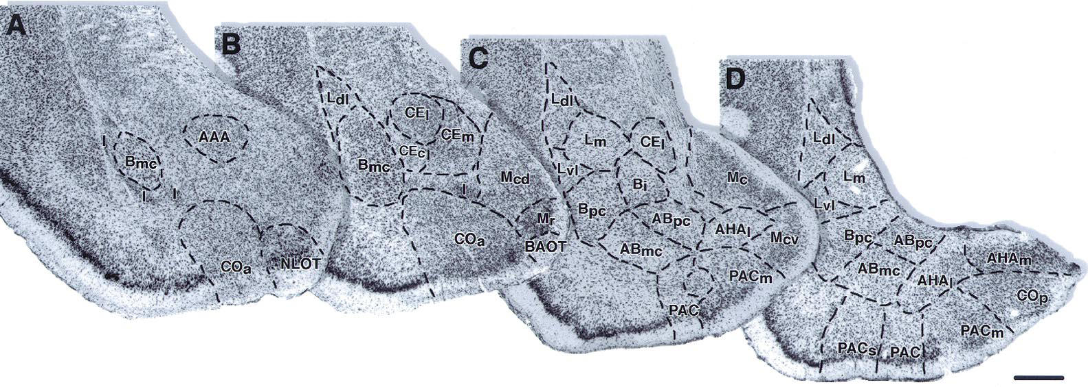
Source: Pitkanen et al. (2001)
0.5mm
Ce
rapidly-developing,
phasic fear response:
“conditioned fear”
sensory
input
La

Slide 7
Source: Pitkanen et al. (2001)
0.5mm
Ce
rapidly-developing,
phasic fear response:
“conditioned fear”
sensory
input
La
slowly-developing,
sustained fear response:
“anxiety”
BNST

Slide 8
Source: Pitkanen et al. (2001)
0.5mm
Ce
rapidly-developing,
phasic fear response:
“conditioned fear”
sensory
input
La
Me
slowly-developing,
sustained fear response:
“anxiety”
BNST

Slide 9
Source: Pitkanen et al. (2001)
0.5mm
Ce
rapidly-developing,
phasic fear response:
“conditioned fear”
sensory
input
La
pheromone/
allomone input
Me
slowly-developing,
sustained fear response:
“anxiety”
BNST

Slide 10
Hypothesis
  Lesions in the medial nuclei would be expected to result in:
    decrease in startle response in the experiments involving oFPS, LES, and APS
Ce
rapidly-developing,
phasic fear response:
“conditioned fear”
sensory
input
La
pheromone/
allomone input
Me
slowly-developing,
sustained fear response:
“anxiety”
BNST
Notes:
support for oFPS hypothesis: Walker, Davis, and Paschall: infusion of drugs that block the glutamate receptors and findings on the role of the basolateral nucleus and the medial nucleus in the amygdala

Slide 11
Experimental Process
Medial Amygdala Surgery
Olfactory Fear Potentiated Startle
One Week Recovery
Light Enhanced Startle
Allomone Potentiated Startle

Slide 12
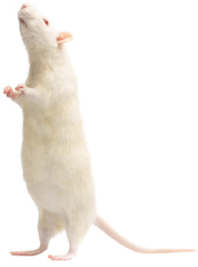
Subjects
  Twenty male rats, 250-300g
  Unlimited access to standard rat chow and water
  Housed individually in clear plastic cages
  3 groups: control, sham, and lesion

Slide 13
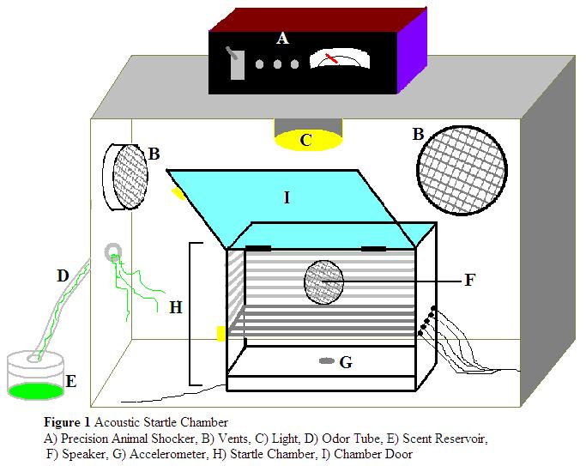
Startle Chamber Apparatus

Slide 14
Olfactory Fear Potentiated Startle Procedures
EXPERIMENT 1
Day 1: Baseline
Day 2: Baseline
Day 3: Baseline
Day 4: Conditioning with Odor-Shock Pairings
Day 5: Startle Test Session

Slide 15
Analysis: Olfactory Fear Potentiated Startle
Rats’ percent potentiation during odor pulses relative to trailing no odor pulses

Slide 16
Light-Enhanced Startle Procedures
EXPERIMENT 2
Part 1: 5 min no sound, followed by 41 random pulses every 30 sec
→complete darkness
Part 3: 46 Random pulses every 30 sec
→complete darkness
Part 2: Repeat with Light
Part 2: Repeat
→complete darkness

Slide 17
Light-Enhanced Startle was Achieved
Notes:
17
Need to first be able to simulate LES
% change in startle amplitude = % startle difference between first phase and second phase of both DLD and DD session
Startle ampltidue difference between 2nd and 1st phase
You can see the light phase elicited a greater startle reponsse
(rats exposed to DLD testing demonstrated greater difference in startle startle)

Slide 18


AMe Lesions Disrupted LES
Sham Rats
Lesion Rats
% Potentiation
L-D D-D
L-D D-D
L-D D-D
L-D D-D
Startle Amplitude Change is higher during DLD testing than in DDD testing for sham rats.
Suggests that sham rats also experience light-enhanced startle.
Lesion rat data suggest medial amygdala lesions decrease anxiety-related startle

Slide 19
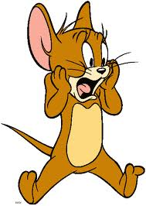



Freezing Behavior
EXPERIMENT 3
Empty
Gauze- Filled Container
Empty
Cat Hair Filled Container
Empty
Gauze- Filled Container

Slide 20
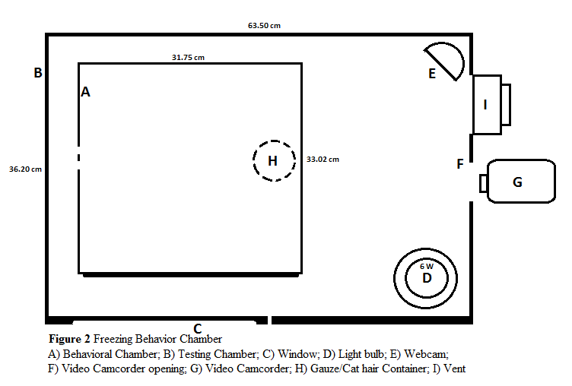
Freezing Behavior Apparatus

Slide 21
Cat Hair Induced Sustained Freezing Behavior

Slide 22
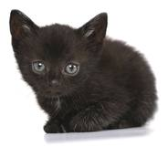
Allomone Potentiated Acoustic Startle
Experimental
Control
Nothing
Nothing
Nothing
Cat Hair
*Setup was identical to that of baseline testing

Slide 23
Very Strange Results
Sham Rats:
n = 2
Lesioned Rats:
n = 4
Cat hair is anxiogenic, but does not potentiate startle
Possible causes
  -Ventilation
  -Different triggers/pathways in the nervous system
More testing is needed to produce a larger sample size and decrease the standard error

Slide 24
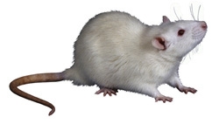
Conclusion
Medial amygdala may play a role in anxiety pathways as shown by LES; unclear from APS
Medial amygdala plays no role in OFPS
To confirm → more test subjects and histology
Consistent with hypothesis and some other studies
- This year: study showing lesions enhance startle response
Notes:
Neural circuitry of fear and anxiety.

Slide 25
Acknowledgements
Dr. Graham Cousens
Zack Vogel
Lab Assistants: Francesco Laterza, Amanda Kearns, Jaime Ballesteros
Tama the cat
The Red Cross, Drew University, NJGSS ‘10, Bristol-Myers Squibb, Bayer HealthCare
THANK YOU!

Slide 26
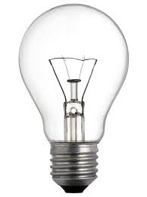
QUESTIONS?
A: None. Rats prefer to be in the dark.

