Slide 1
Zero-Order Controlled Release Kinetics
Through Polymer Matrices
Kyle Douglas, James Farber, Steven Flynn, Janie Gu,
Vivian Qin, Jenny Shih, Jake Silberg, Anita Wamakima
Dr. David Cincotta, Jeremy Tang
Notes:
Left:
Vivian
Jenny
Steve
James
Right (computer side):
Anita
Janie
Kyle
Jake

Slide 2
Controlled Release
Normally 1st or 2nd order
0th order rare but essential
Goal: Use semipermeable membrane to keep rate of release constant
Notes:
Vivian

Slide 3
Background
Began in late 1940’s & 1950’s
Applications:
Agriculture
Zoology
Cosmetics
Medicine
Environment
Notes:
Anita

Slide 4
Background
Notes:
Anita

Slide 5
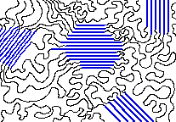
Membrane: Polymers
Series of repeating monomers
Diverse properties:
Intermolecular forces
Molecular shape
Crystallinity
Use different properties to control release
http://www2.chemistry.msu.edu/faculty/reusch/VirtTxtJml/polymers.htm
Notes:
Jenny

Slide 6
Solubility Parameters
Predict solubility of different substances
Hansen solubility parameter
Equation: R_{a}² =
4(δ _{D1} - δ _{D2}) ² + (δ _{P1} - δ _{P2}) ² + (δ _{H1} - δ _{H2}) ²
Notes:
Janie
Also as part of the project, we tried to construct mathematical models to predict the solubility of different substances moving across the polymer membranes. The basis of our model was the Hansen solubility parameter which takes into account three factors, namely the energy associated with dispersion forces, dipole interactions, and hydrogen bonds. The value of the RED (or Relative Energy Difference) ratio predicts the solubility of two substances in each other. Basically, the higher the value, the less soluble they are in each other.

Slide 7
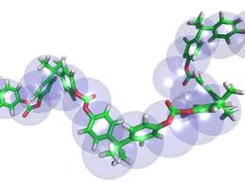
Hypothesis
Principle of “like likes like”
Closer solubility parameters → faster diffusion rate
Notes:
Janie
Molecules that have polarities similar to those of the membranes will diffuse significantly faster than those that do not.
The closer the molecule’s solubility parameter is to that of the membrane, the faster it will diffuse through it.

Slide 8
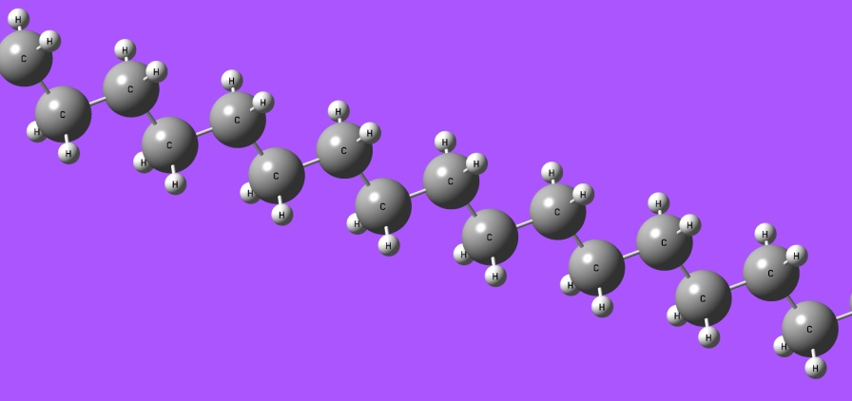
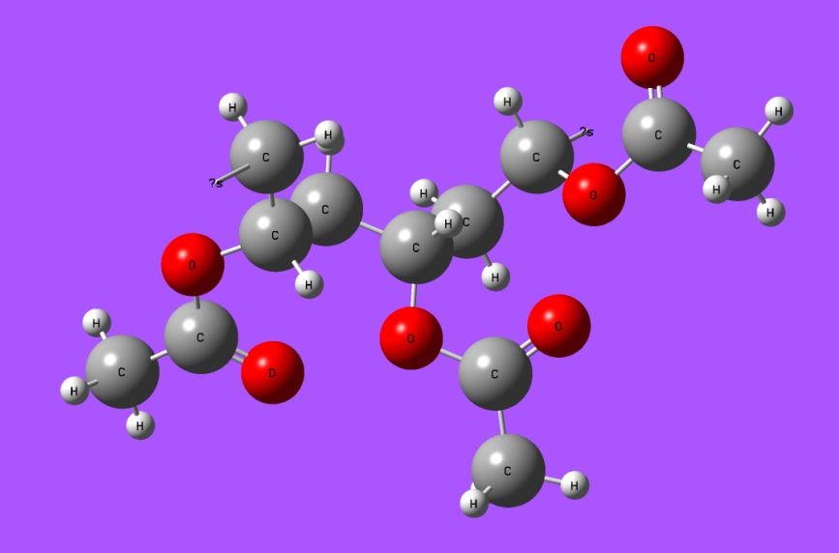
Polymers Tested
Polyethylene (C₂H₄)
Ethylene-Vinyl Acetate (EVA) Copolymer
Vinyl Acetate (CH₃COOCH=CH₂)
10%
12%
Rest is ethylene (C₂H₄)
Notes:
Jenny

Slide 9
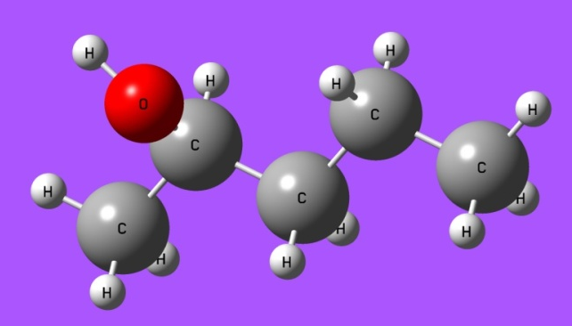
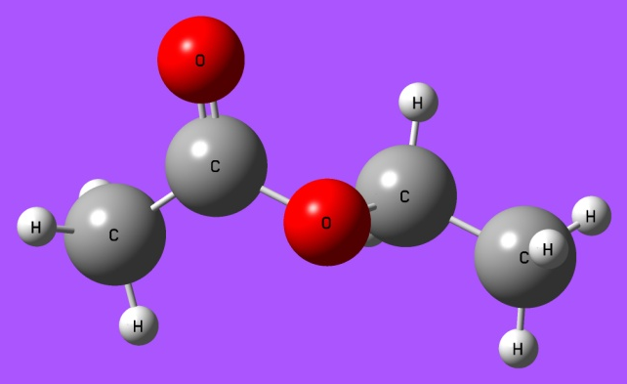
Substances Released
 | 2-Pentanol | Ethyl Acetate | Hexane
Molecular Formula | C₅H₁₂O | C₄H₈O₂ | C₆H₁₄
Mass (g/mol) | 88.148 | 88.105 | 86.18
Properties | Most polar BP: 119ºC | Somewhat polar BP: 77ºC | Least polar BP: 69ºC
Notes:
Kyle

Slide 10
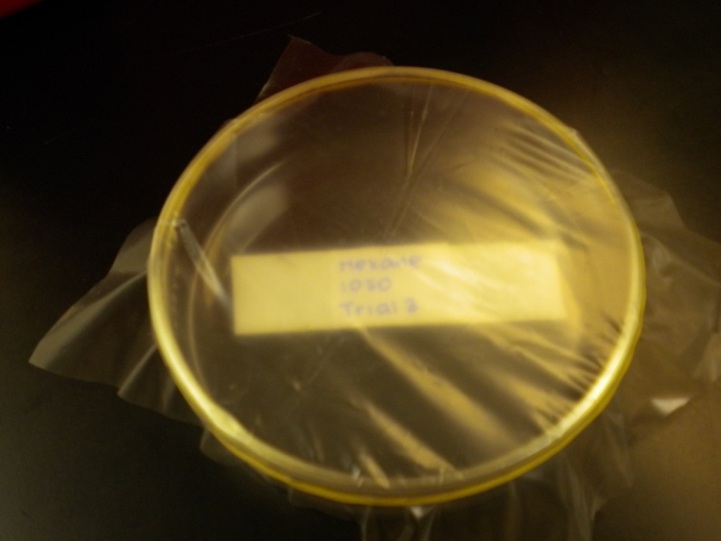
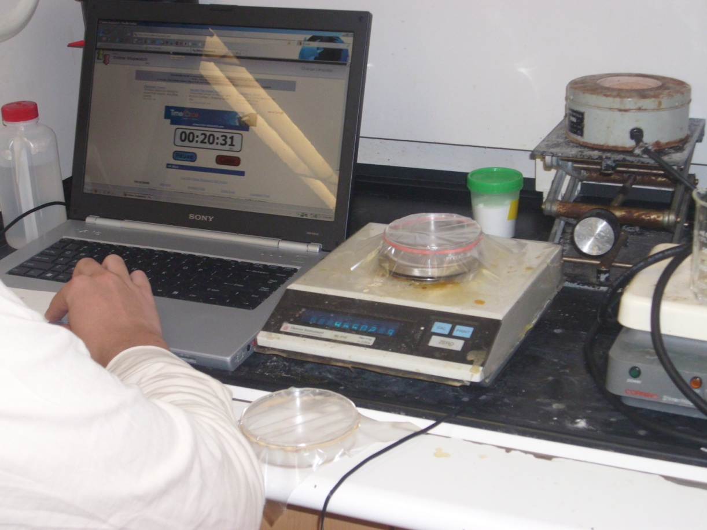
Apparatus
Notes:
Steve

Slide 11
Schematic of the Apparatus
Notes:
Janie

Slide 12
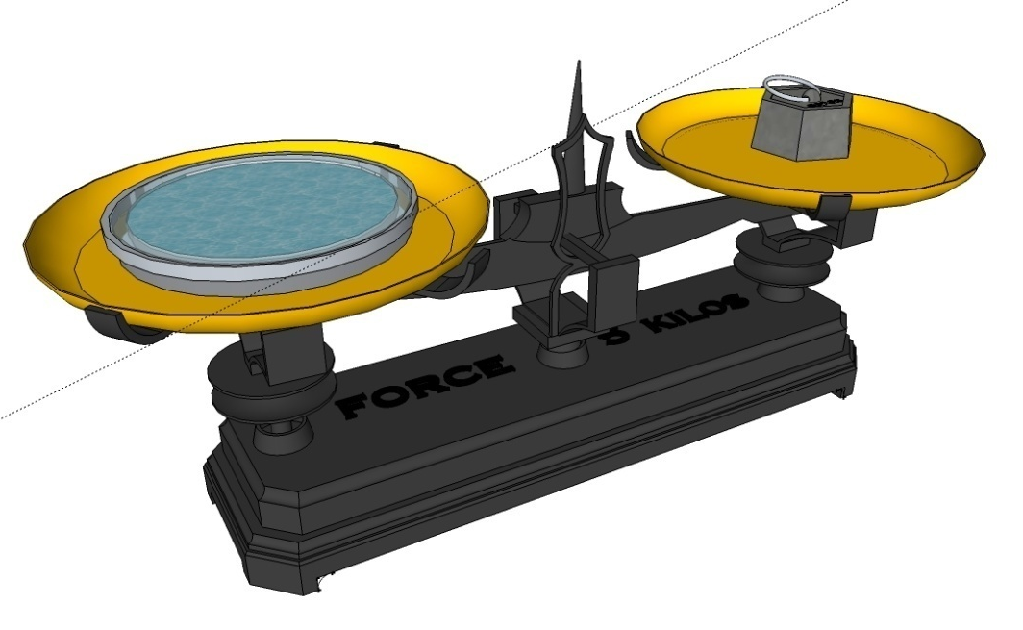
Apparatus
Notes:
Steve
Insert animation

Slide 13
Data
Notes:
James

Slide 14
First-Order Outlier

Slide 15
Rates of Evaporation
Notes:
James
Divide by 60 to convert from min to s, change to SI units (g/sm^2), take into account thickness of membrane (1.8mm for PE vs. 1.5mm for EVA 10% and EVA 12%), mention that although hexane and PE are both nonpolar, other factors may have come into play, namely crystallinity, note that hexane has highest vapor pressure (effect shown in graph)

Slide 16
First-Order Outlier

Slide 17
Statistical Analysis
ANOVA’s and t-tests indicated significant difference between data sets
p < 0.05
Molecule | Hexane | 2-Pentanol | Ethyl Acetate
p-value | 0.001 | 0.00004 | 0.00007
Notes:
Janie
Don’t read p-values
Mention how outliers were not used in statistical analysis

Slide 18
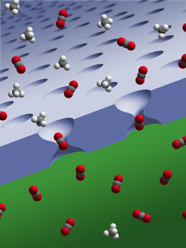
Conclusion
Zero-order release was achieved using the mechanism
Solubility parameters did not account for numerous other factors
Notes:
Jake

Slide 19
Future Studies
Mixtures of molecules (i.e. perfume)
Other properties of polymers
Size
Explore solubility parameters in-depth
Non-volatile substances – different apparatus
Notes:
Jake

Slide 20
Acknowledgements
Dr. David Cincotta, mentor
Jeremy Tang, assistant
Sig Sigamani of Celanese Corporation and Stephen Takacs, providing polymers
Dr. David Miyamoto, director
NJGSS and sponsors, opportunity
Notes:
Janie

