Slide 1
THE EFFECTS OF HARSH ENVIRONMENTS ON SOLAR CELLS
Laura Bruce, Brian Dawes, James Horner, Krupa Patel, Ronak Patel, Nicholas Porto,
Steven Scarfone, Olivia Shabash, Priyanka Shah, Daphne Sun, Jisoo Yoon
Advisor: Dr. Paul V. Quinn Sr.
Teaching Assistant: Sally J. Warner
Notes:
Steve

Slide 2
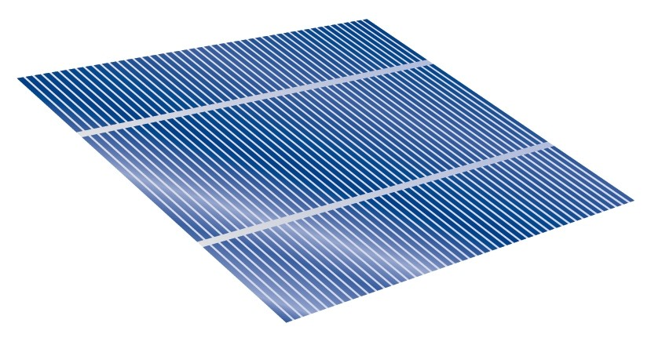
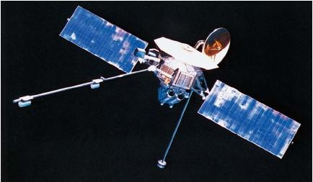
NASA Strives for Efficient Solar Cells
  NASA interested in decay of cells
Notes:
Krupa

Slide 3
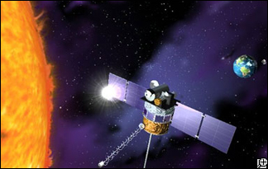
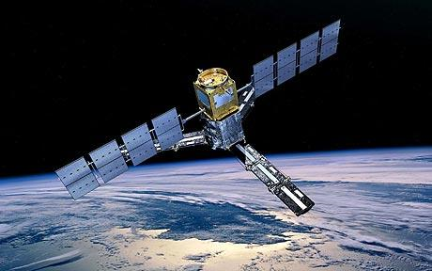
Solar Cells in Space
Variables tested include:
→ Light intensity
→ Wavelength
→ Environmental factors such as radiation, heat, and freezing
Notes:
Krupa

Slide 4
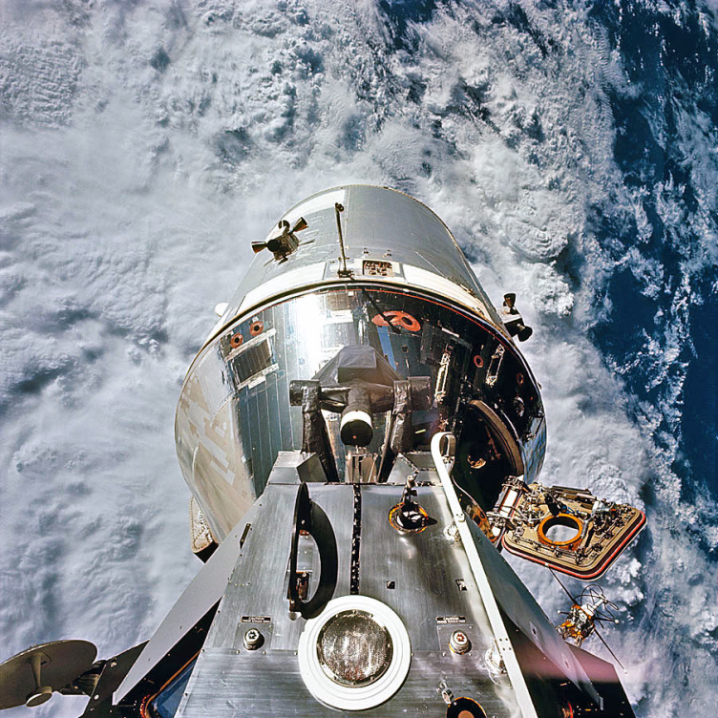
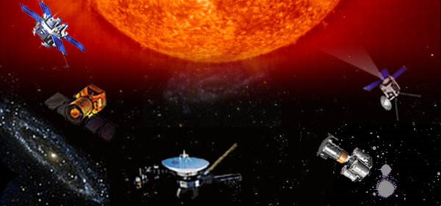
Conditions in Space
  Average temp:
  2.725 Kelvin (-455˚F)
  → Sunlight temp:
  393 Kelvin (248˚F)
  → Radiation affects cells
Notes:
Krupa

Slide 5

The Photoelectric Effect
Generates current
Increasing light
frequency increases
electron energy
Increasing electron
energy increases
current
h = Planck’s constant
f = frequency
E_{ph} = photon energy
K = electron energy
φ = work function
Notes:
Brian

Slide 6
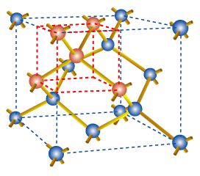
Doping Silicon
Primary material
Diamond FCC
crystalline structure
Doped with boron and
phosphorous atoms
Notes:
Brian

Slide 7
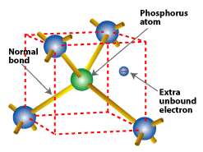
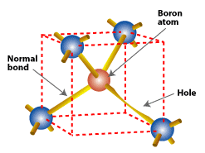
Doping Silicon
N-Type
P-Type
Notes:
Brian

Slide 8
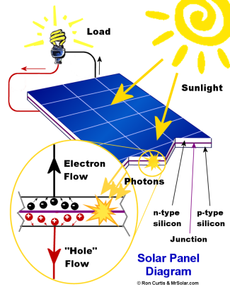
How Solar Cells Work
Notes:
Jisoo

Slide 9
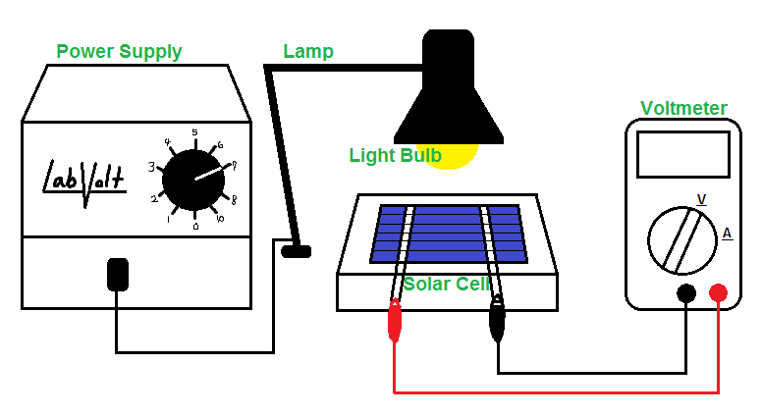
Apparatus
Notes:
Laura

Slide 10
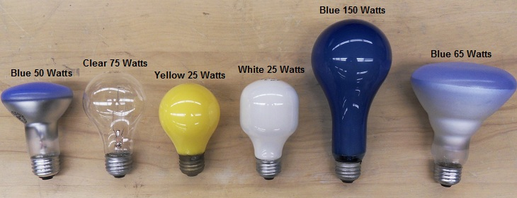
Baseline
Six light bulbs used to create baseline:
65 Watts
Notes:
Laura

Slide 11
Comparing Wavelengths of Light
Notes:
Steve

Slide 13
Comparing Different Intensities
Notes:
Steve

Slide 15
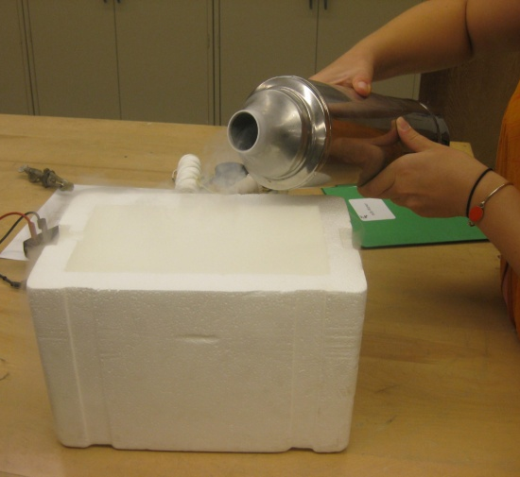
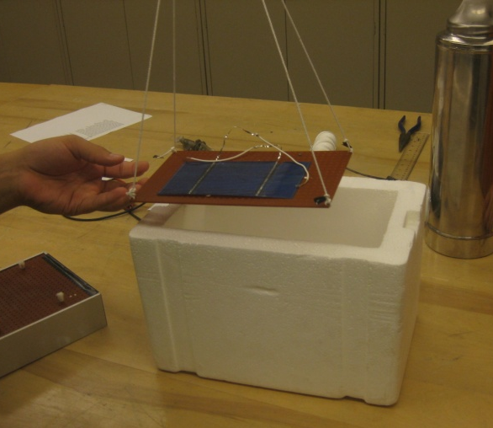
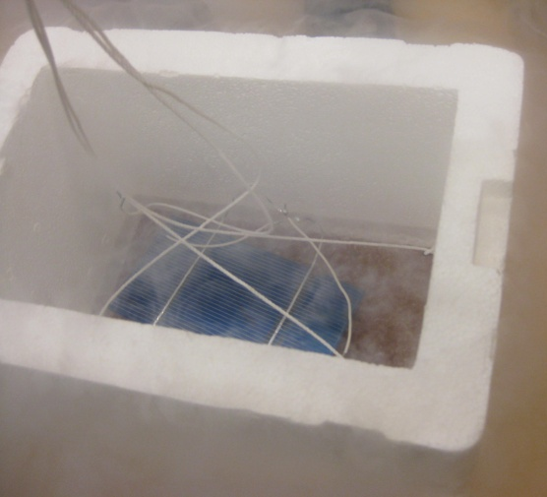
Freezing Solar Cells
→ Liquid nitrogen exists at
77.2 Kelvin (-320.7°F)
Notes:
Nick
15

Slide 16
Effects of Freezing
Notes:
Nick

Slide 17
Effects of Freezing
Notes:
Nick

Slide 18
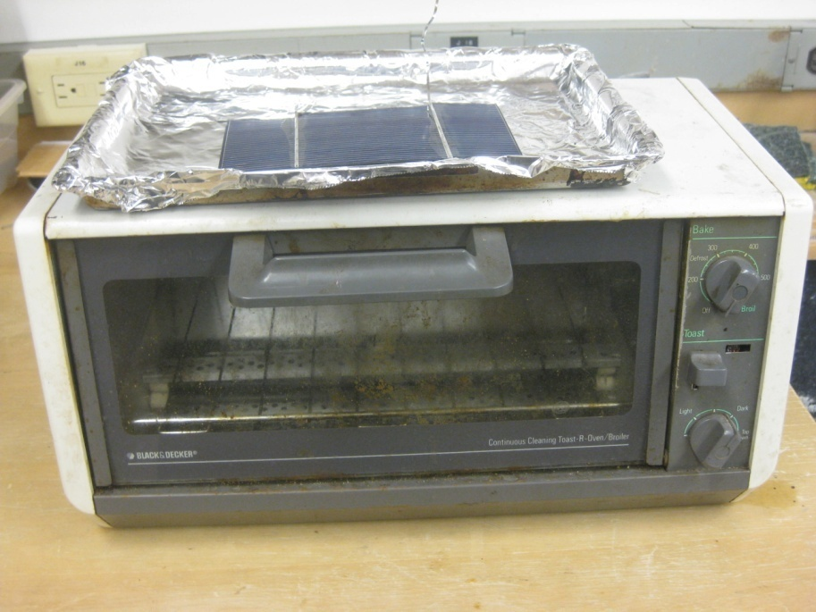
Heating Solar Cells
→ Avg. temp. of object in sunlight: 248°F
→ Highest temp. metals reach in space: 500°F
Notes:
Daphne

Slide 19
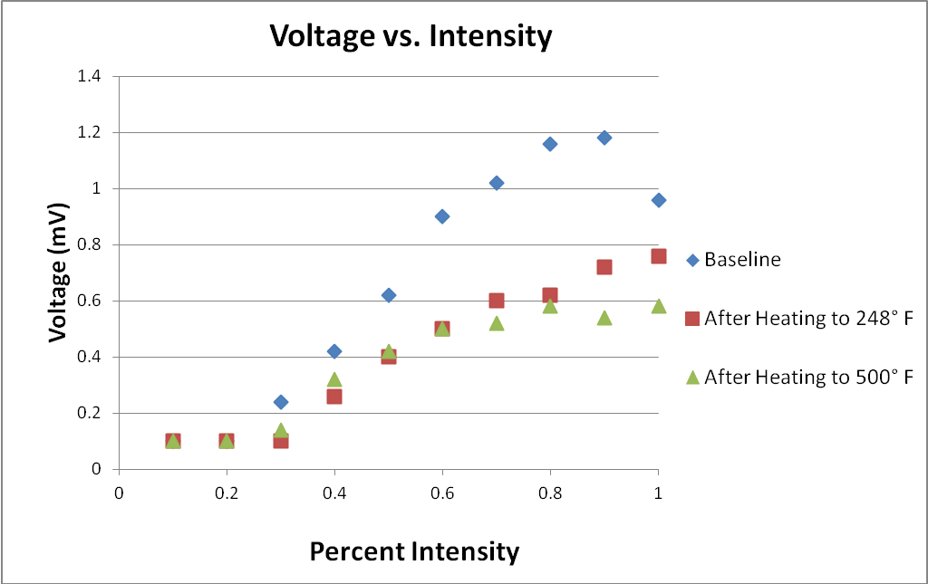
Effects of Heating
Notes:
Priyanka
19

Slide 20
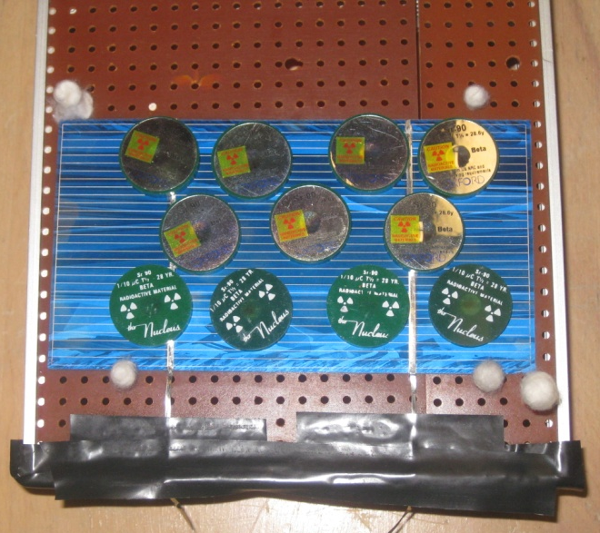
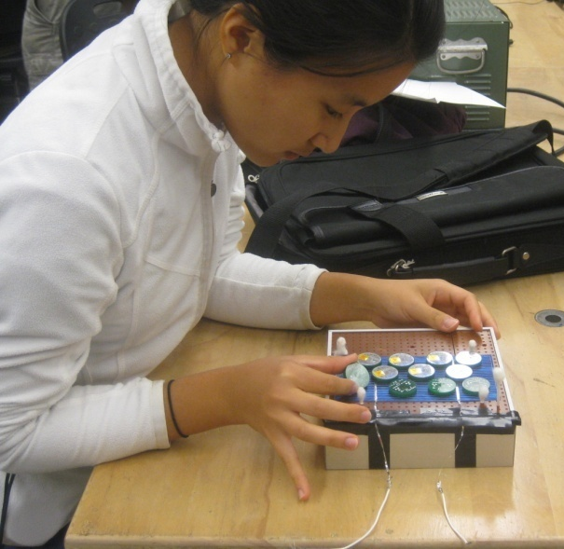
Testing Radiation
→ 100 microcurie strontium-90 placed on solar cell
→ Cells exposed to beta decay (electrons)
Notes:
James
20

Slide 21
Effects of Radiation
Notes:
James
21

Slide 22
Notes:
James

Slide 23
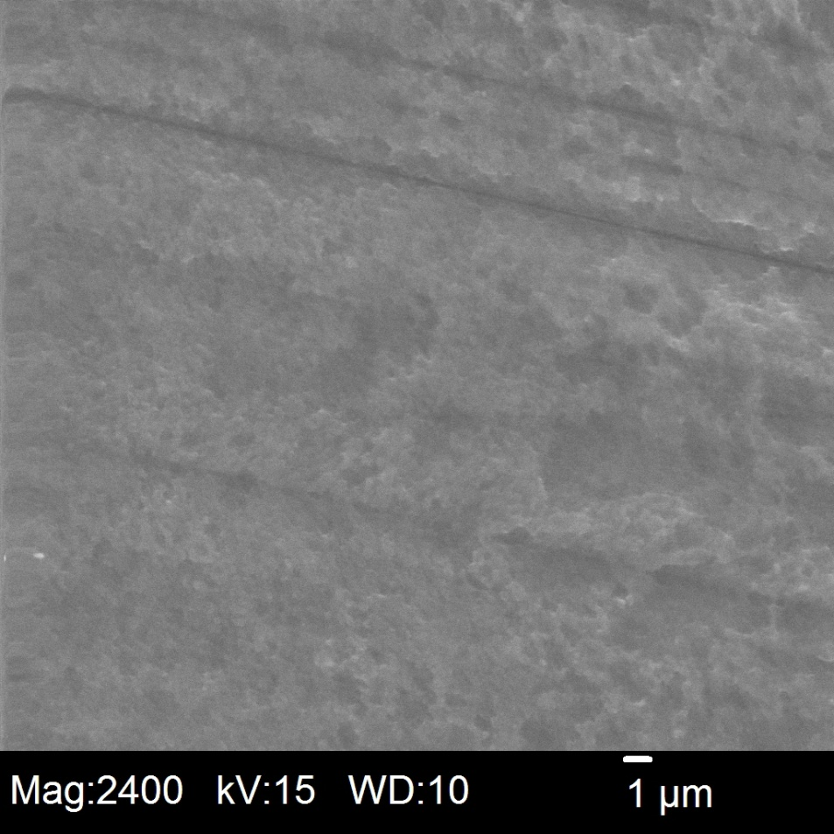
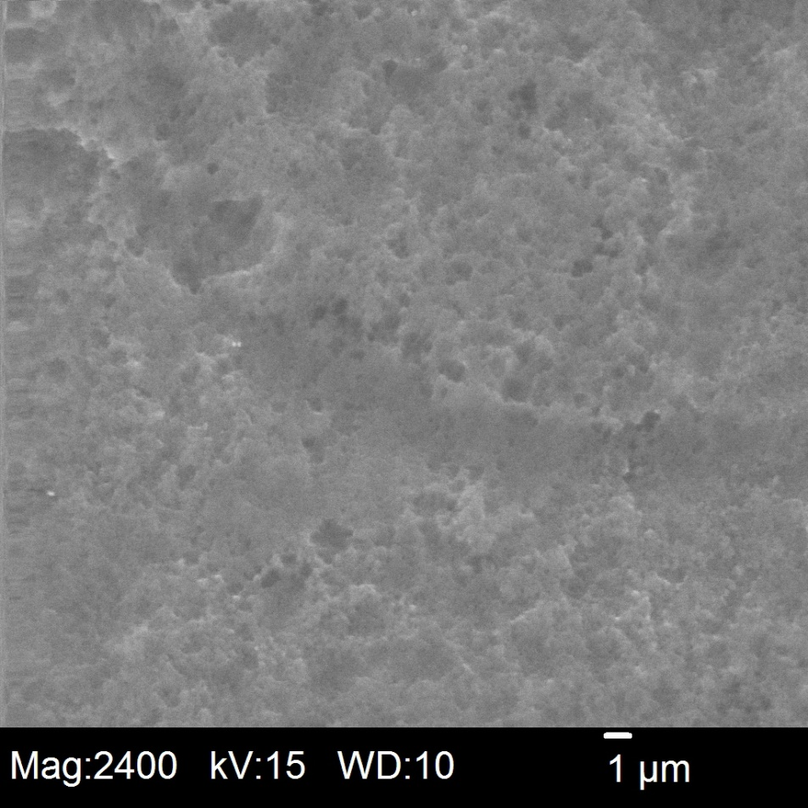
SEM Imaging
Normal solar cell
Frozen solar cell
Notes:
Ronak

Slide 24
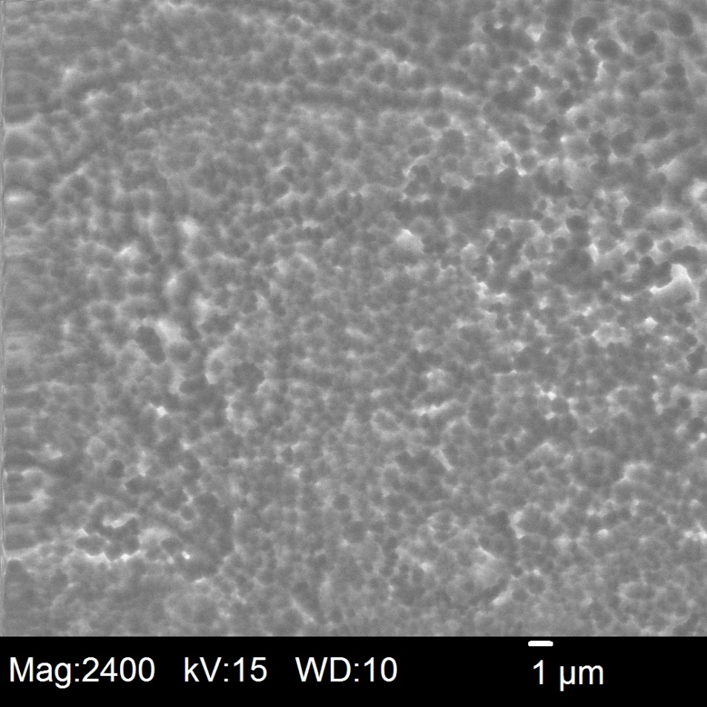
SEM Imaging
Normal solar cell
Heated solar cell
Notes:
Ronak

Slide 25
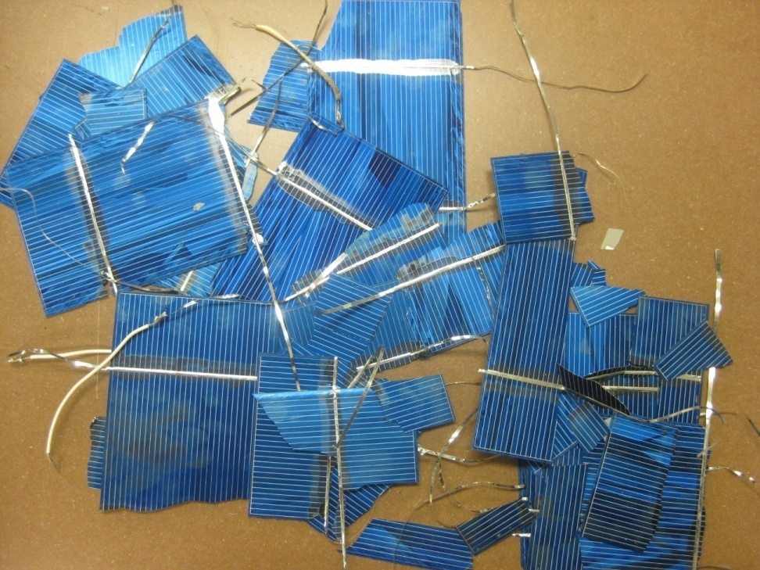
Factors that Affect Outcome
→ Resistance of voltmeters
→ Extraneous light sources
→ Overheating
→ Other damage
Notes:
Olivia
25

Slide 26
Conclusion
→ Blue Light optimum source
→ 150 W optimum intensity
→ Heating destroys cells
→ Freezing may improve performance
→ Radiation alters cell performance
→ Framework for future experimentation
Notes:
Olivia

Slide 27
Acknowledgments
Advisors
→ Dr. Paul Quinn
→ Sally Warner
Liquid Nitrogen Supplier
→ Dr. Ryan Z. Hinrichs
Directors
→ Dr. Miyamoto
→ Dr. Surace
Notes:
Olivia

Slide 28
Acknowledgments
Thank you to all of our sponsors!
→ John and Laura Overdeck
→The Ena Zucchi Trust
→ Johnson and Johnson
→ Jewish Communal Fund
→ Bristol-Myers Squibb
→ Bayer HealthCare
→ The Crimmins Family Charitable Foundation
→ Novartis
→ The Edward W. and Stella C. Van Houten Memorial Fund
→ Roche
→ Independent College Fund of New Jersey
→ Corporate Matching Gifts: Alliance Bernstein, AT&T Foundation, Direct Edge, Goldman, Sachs, and Company, Met Life, Microsoft Corporation, Network for Good
→ NJGSS Alumnae and Parents 1984 - 2009
Notes:
Olivia

Slide 29
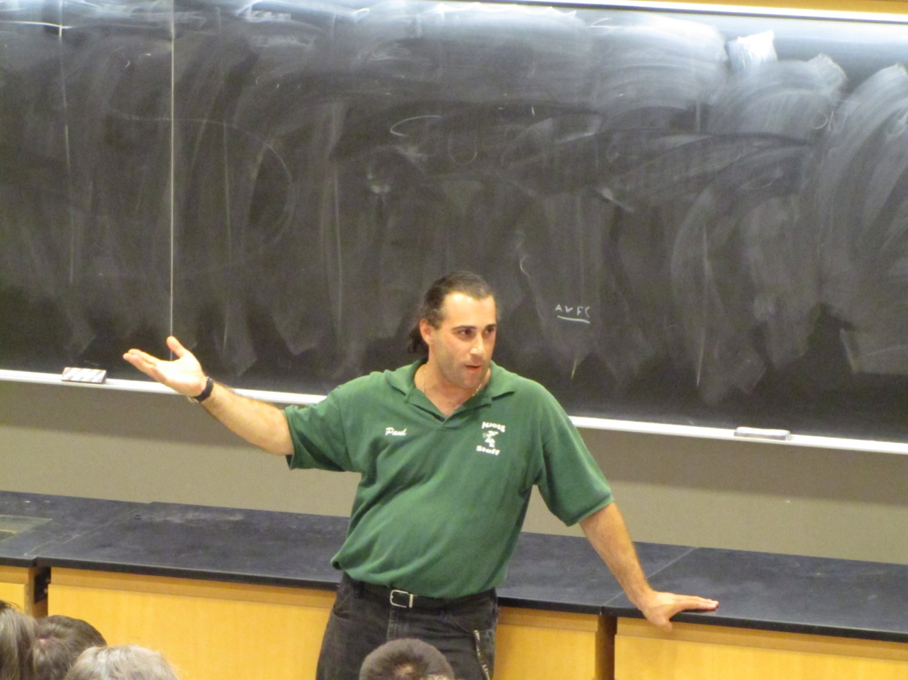

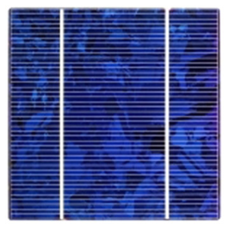
Questions?

