Slide 1
Debunking the Enemy Release Hypothesis: Do introduced Norway maple lack defenses against native herbivores?
Tony Chen, Julianna Garreffa, Emily Gleason,
Joe Miciak, Alomi Parikh, David Shang, Rebecca Shi

Slide 2
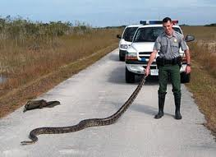
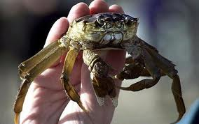
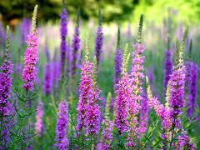
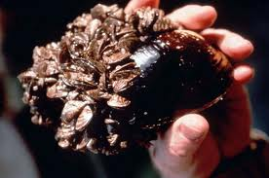
Invasive Species
Invasive species: a species introduced into an ecosystem where it does not naturally occur
Can be introduced deliberately or accidentally
Can have severe ecological and economic effects

Slide 3
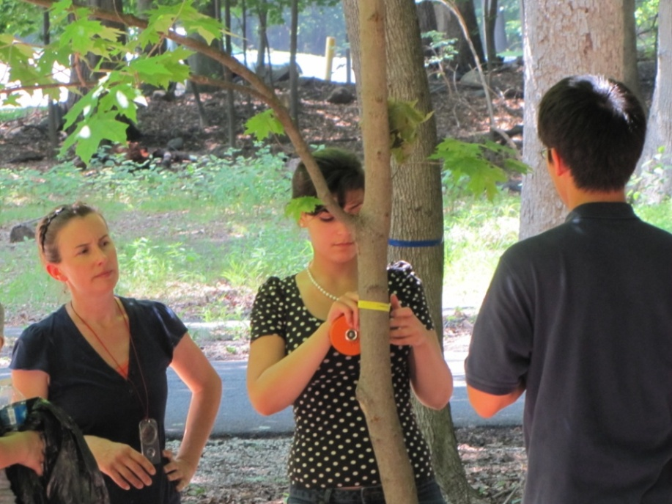
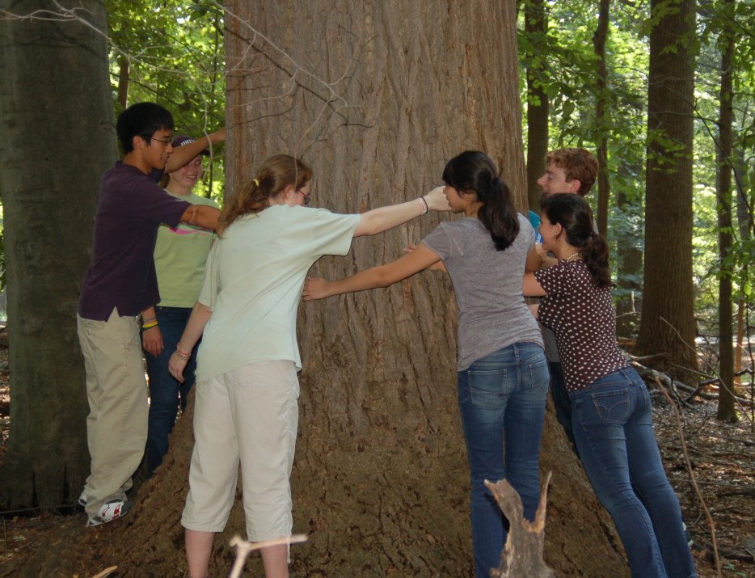
Drew University Forest Preserve
Dominant trees – Norway maple, Sugar maple, Beech
DBH – diameter at breast height
Saplings – 2-9 cm DBH
Mature – over 11 cm DBH

Slide 4
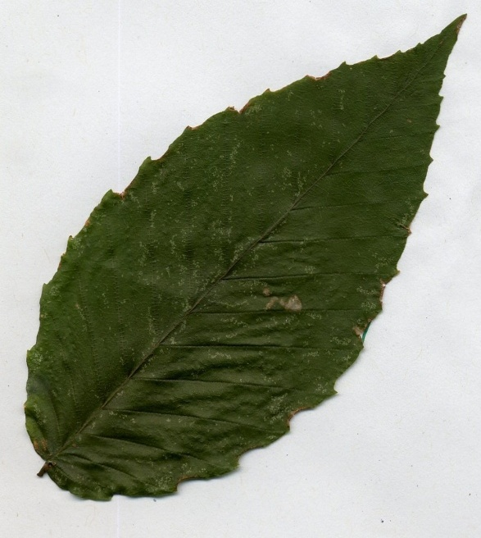
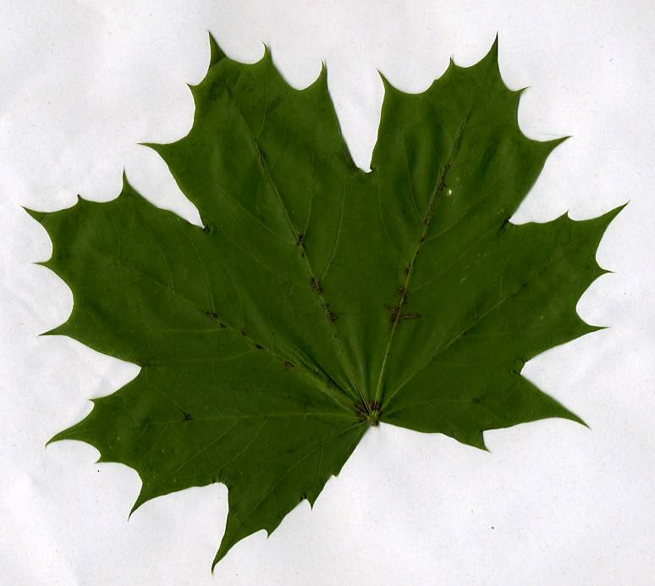
American Beech
Norway Maple
Sugar Maple

Slide 5
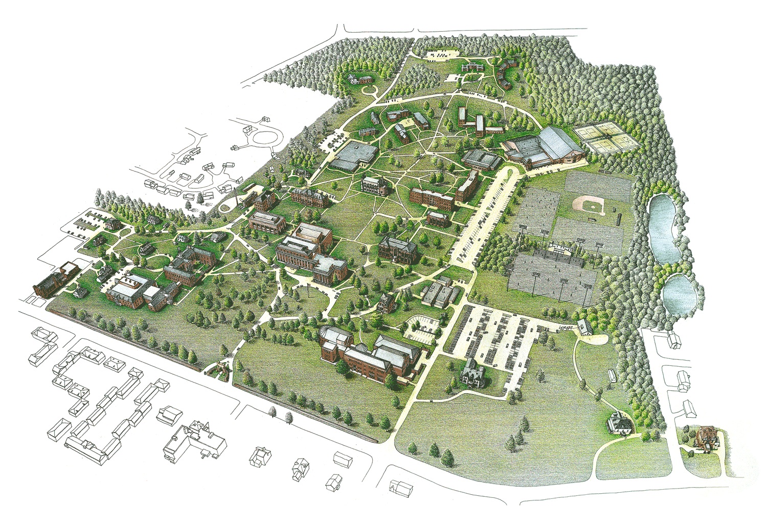

Slide 6
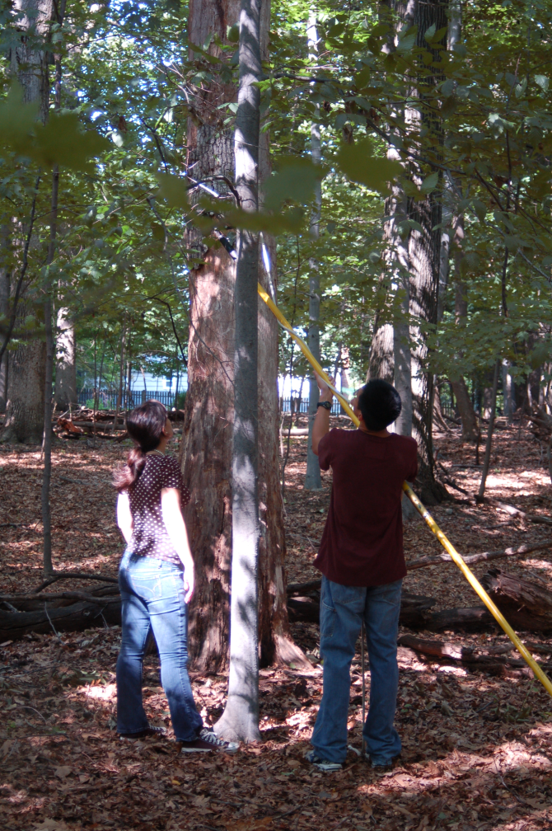
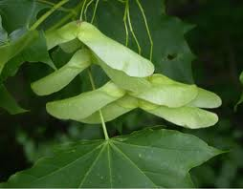
Invasion of Norway Maple
Originally introduced as a landscaping tree
Possible reasons for success
More shade tolerant
Larger seeds, dispersed by wind

Slide 7
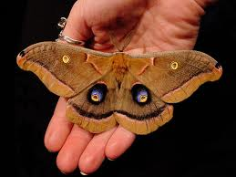
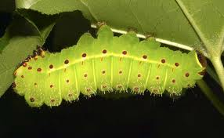
Enemy Release Hypothesis (ERH)
Invasive species succeed because they lack natural predators in their new environment

Slide 8
Hypothesis
If ERH is a factor, less herbivorous damage would be present on the invasive Norway maple compared to the native species
2009 NJGSS study did not support this

Slide 9
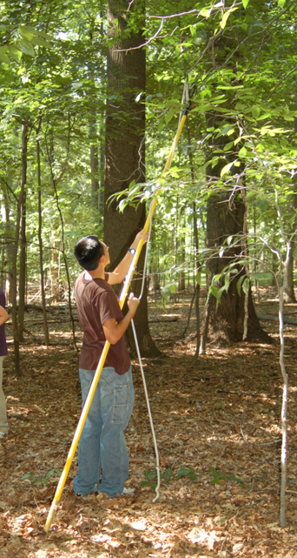
Sample Collection
Leaves cut randomly from different heights
10-15 leaves collected from each tree without bias
275-310 leaves from each species/age category

Slide 10
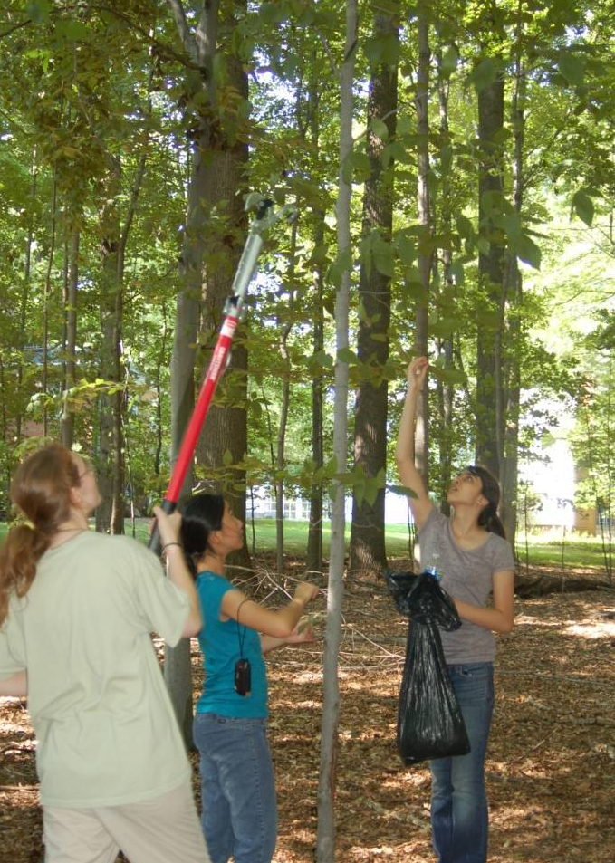
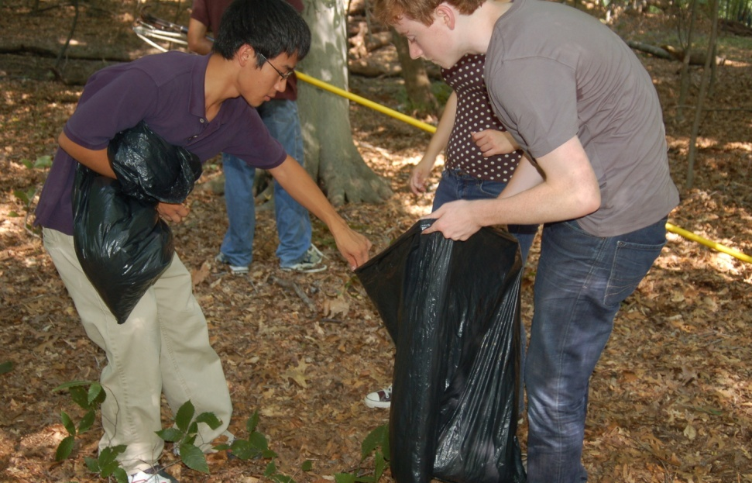
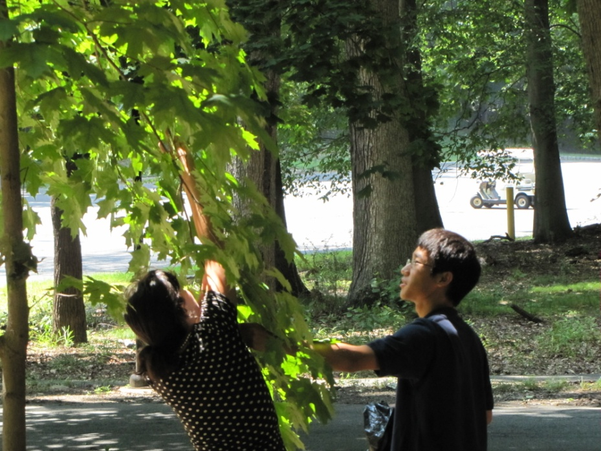
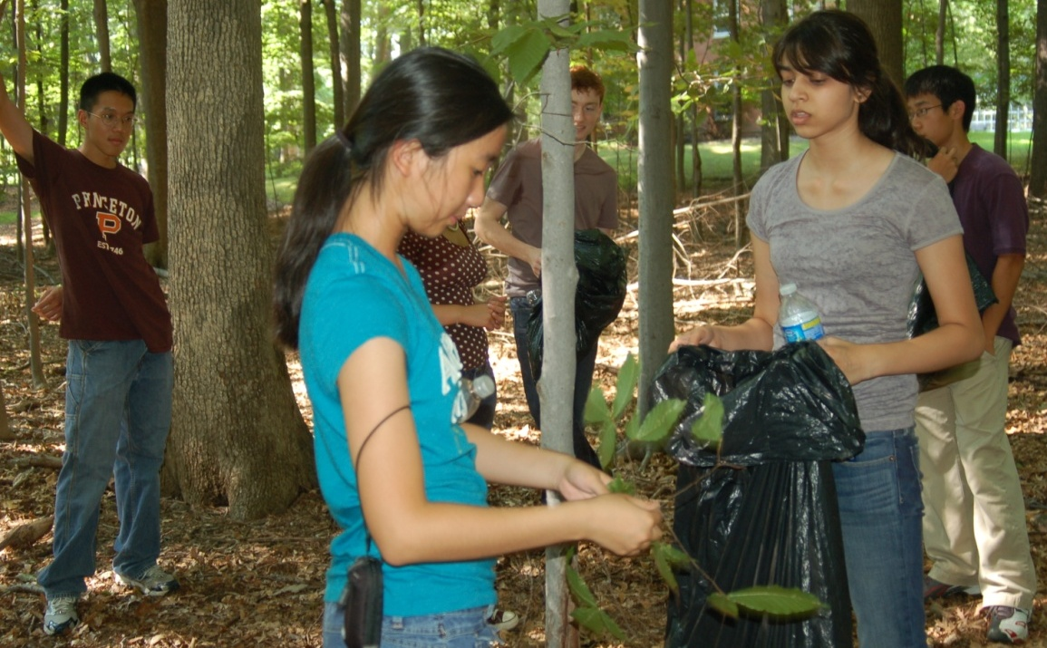

Slide 11
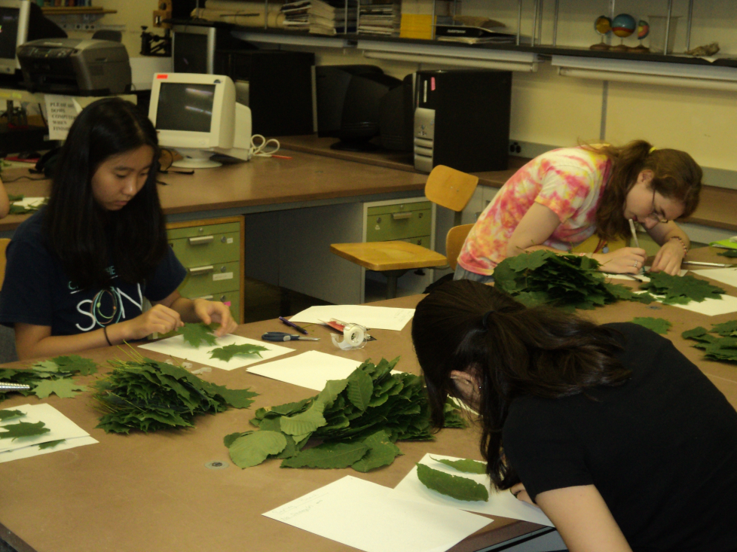
Damage Assessment
Separation of leaves
Only insect damage was considered
Leaves were taped to paper, outlines of missing edges were drawn in
Leaves were scanned, analyzed using Image J
Total area and damaged area were measured
Percent damage was calculated

Slide 12
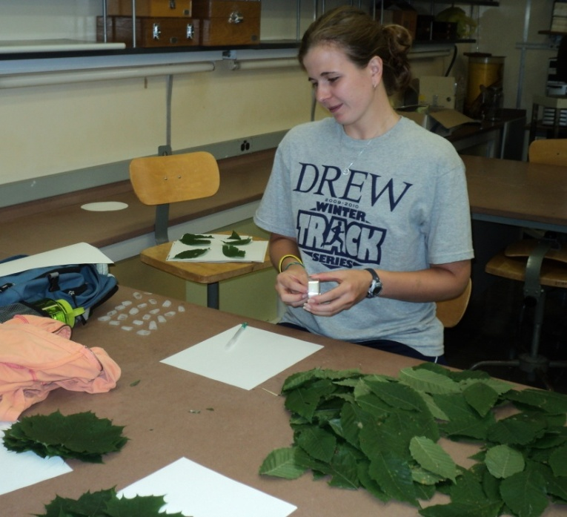
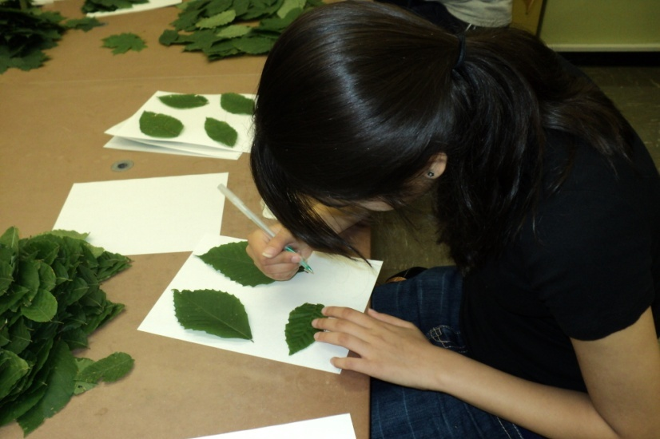
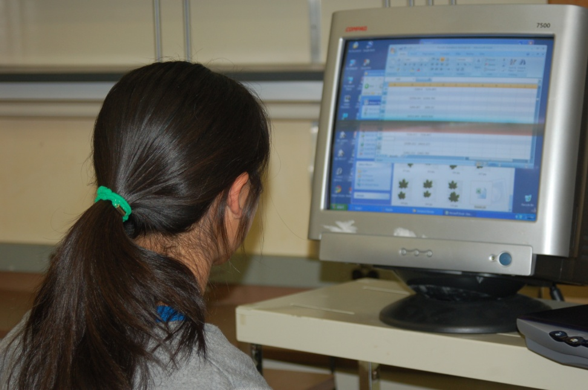
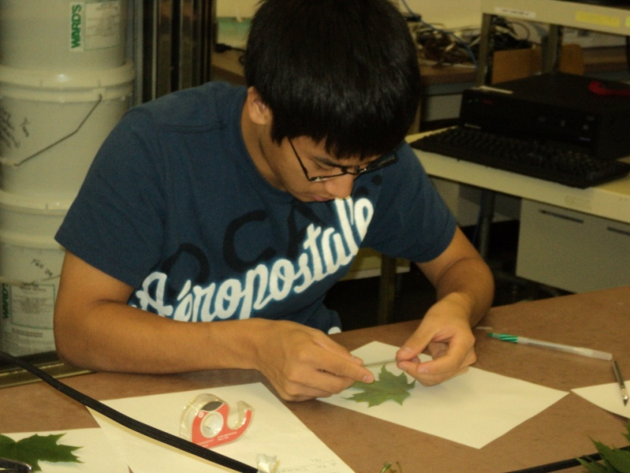

Slide 13
Statistical Analysis
Statistical Package for the Social Sciences 17.0 (SPSS)
ANOVA tests to determine effects of species and age on damage (percent and total)
Post hoc comparisons – Bonferroni test
Log transformation of data for normality

Slide 14
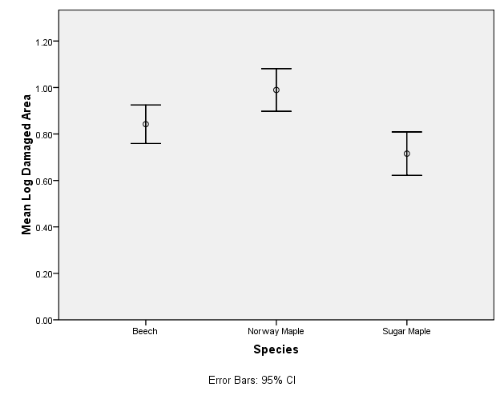
Results
Absolute leaf damage and species type
Norway maple > sugar maple
a
a
Beech
Norway
Sugar
Species
“a” indicates a statistically significant difference between two values

Slide 15
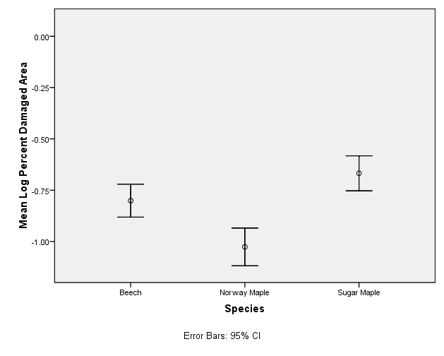
Results
Percentage leaf damage and species type
Sugar maple and beech > Norway maple
b
a
a, b
Beech
Norway
Sugar
Species
“a, b” indicate statistically significant differences between values

Slide 16
Results
Absolute leaf damage and age of tree
No significant difference

Slide 17
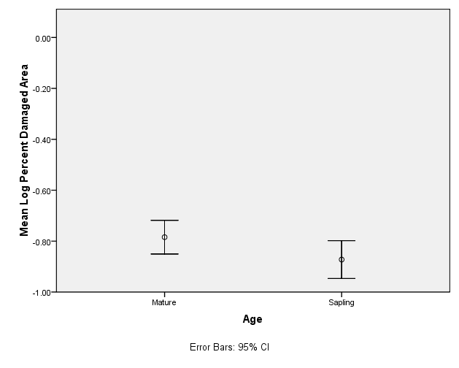
Results
Percent leaf damage and age of tree
Mature trees had slightly more damage than saplings
a
a
Mature
Sapling
Age
“a” indicates a statistically significant difference between values

Slide 18
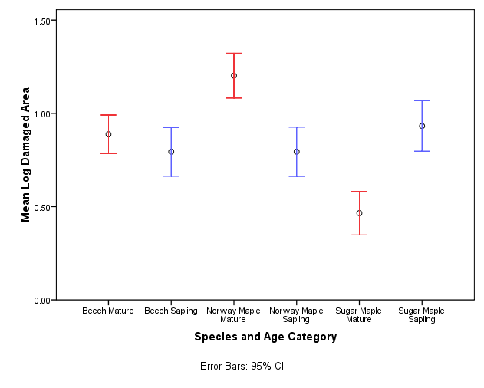
Results
Absolute leaf damage and interaction between species and age
a, b, c
d
a
b
c
a, b, c, d
“a, b, c, d” indicate statistically significant differences between groups

Slide 19
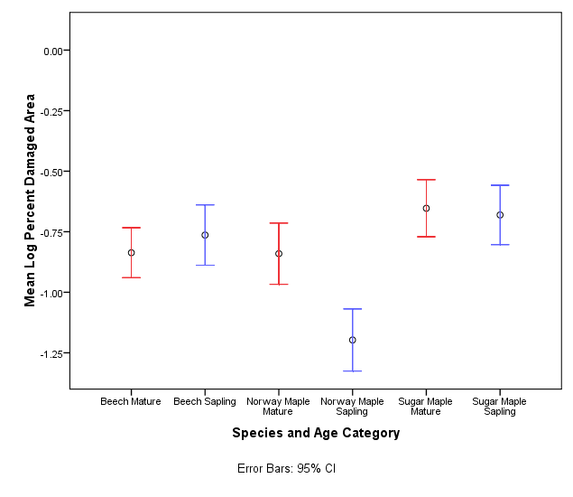
Results
Percent leaf damage and interaction between species and age
Norway maple saplings had lower damage than all other groups
d
e
b
a
c
a, b, c, d, e
“a, b, c, d, e” indicate statistically significant differences between Norway maple saplings and other groups

Slide 20
Discussion
Norway maple had most total damage
Results contradict ERH
Perhaps the introduced Norway maple has not yet developed its own natural defenses
Plants may develop these adaptations over prolonged exposure to predators

Slide 21
Possible Explanations
Optimal Foraging Theory
Eating Norway maple is beneficial for herbivorous insects
Resource Availability Hypothesis
Would explain the Norway maple’s success in other North American forests
The Green World Hypothesis
Supports top down model as opposed to bottom up

Slide 22
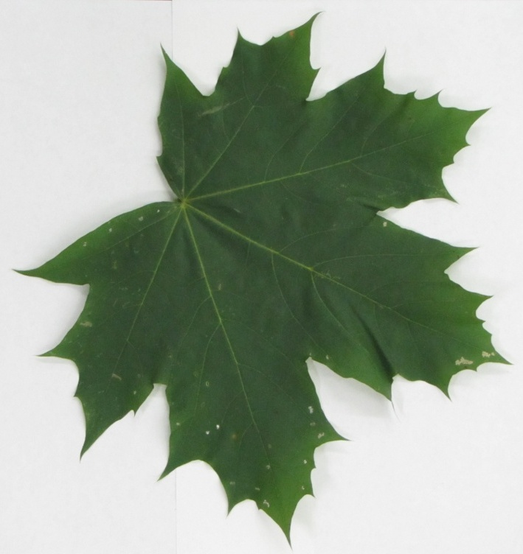
Discussion
Norway saplings had lowest percent leaf damage
Possible explanation:
- Larger leaf size of Norway maple compared to those of sugar maple and beech

Slide 23
Possible Studies
Survey of herbivorous damage of a community with invasive and native plant species
Study could show whether introduced species possess disadvantages because of the lack of defense against predators

Slide 24
Possible Errors in Study
Observer bias
Long wait after picking leaves before analysis
Differentiation between fungal and insect damage
Estimation of leaf outline
Scanning only damaged leaves

Slide 25
Improvements for Future Studies
Increase sample size
Gather leaves from higher branches
Study leaf damage based on height of leaves

Slide 26
Acknowledgements
NJ Governor’s School in the Sciences
Dr. David Miyamoto
Myrna Papier
Laura and John Overdeck
Staff
Other sponsors
Special thanks to our advisor, Kristi MacDonald-Beyers, and our team assistant, Jessica Reid

Slide 27
Picture Citations
Cecropia moth - http://littleredelf.wordpress.com/2004/06/05/one-eye-in-a-sea-of-many/
Luna moth -http://xclinic.ning.com/profiles/blogs/luna-moth-in-nyc-street-trees
Python - http://weblogs.sun-sentinel.com/news/politics/dcblog/2009/07/
Loosestrife - http://www.ogwa-hydrog.ca/en/node/423
Zebra Mussel - http://www.fws.gov/invasives/laws.html
Chinese Mitten Crab - http://www.telegraph.co.uk/earth/wildlife/5815421/Invasive-species-spread-around-world-in-ships-ballast-tanks.html
Norway maple seeds - http://www.treecanada.ca/tree-killers/norway-maple.htm

Slide 28
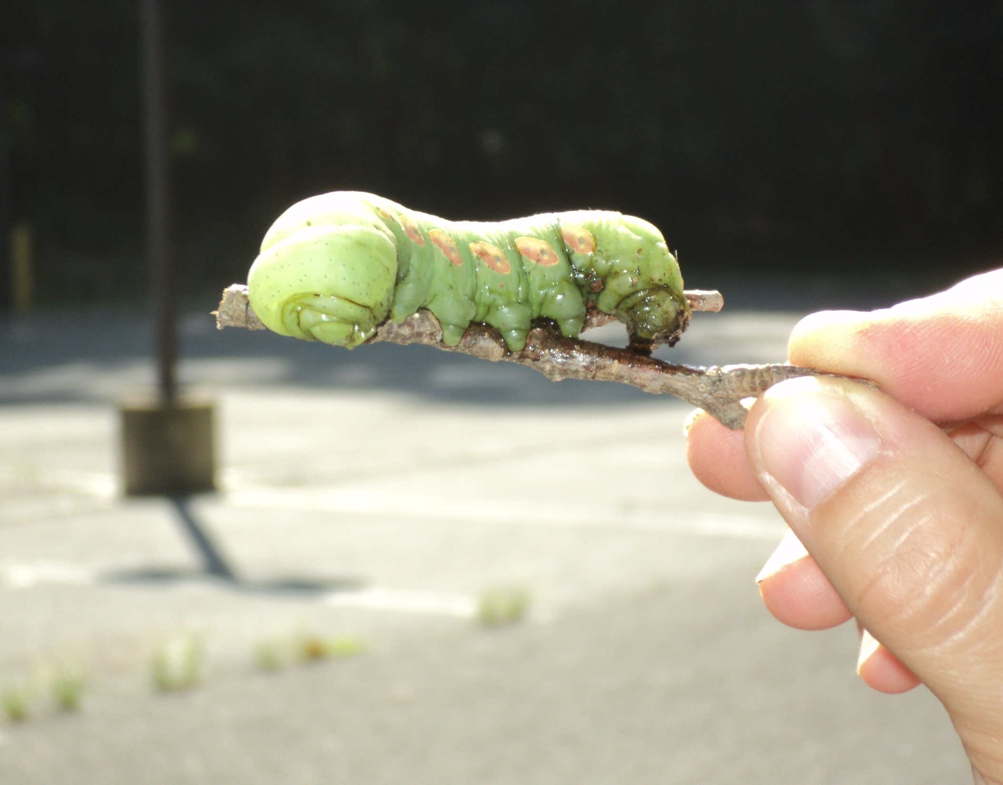
Frankie!

